Slide 1
Development of Inspection Tools for the AY-102 Double Shell Tank at the DOE Hanford Site

Slide 2
Team Members
Principle Investigator: Leonel Lagos, Ph.D., PMP
Project Manager: Dwayne McDaniel, Ph.D., P.E.
Technical Staff: Anthony Abrahao, Hadi Fekrmandi
DOE Fellows: Michael DiBono, Ryan Sheffield, Erim Gokce
Work supported by: U.S. Department of Energy Office of Environmental Management under Cooperative Agreement # DE-EM0000598

Slide 3
Outline
AY-102 Tank Background
Proposed Inspection
Magnetic Miniature Rover
Testing and Evaluation
Path Forward

Slide 4
Task Description
3.) 4” Air Supplying Piping
1.) Refractory Air Slots through the Annulus
2.) 6” Leak Detection Piping
Notes:
Tank waste was found in the annulus of tank AY-102
An inspection tool is required to isolate and pinpoint the source of the material entering Tank AY-102 annulus space
There are three possible entry points: (1) Refractory air slots through the annulus, (2) 6” leak detection piping, (3) 4” air supply piping

Slide 5
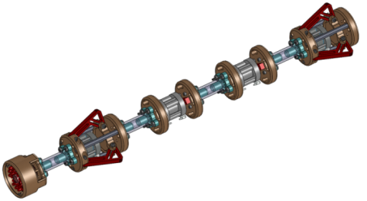
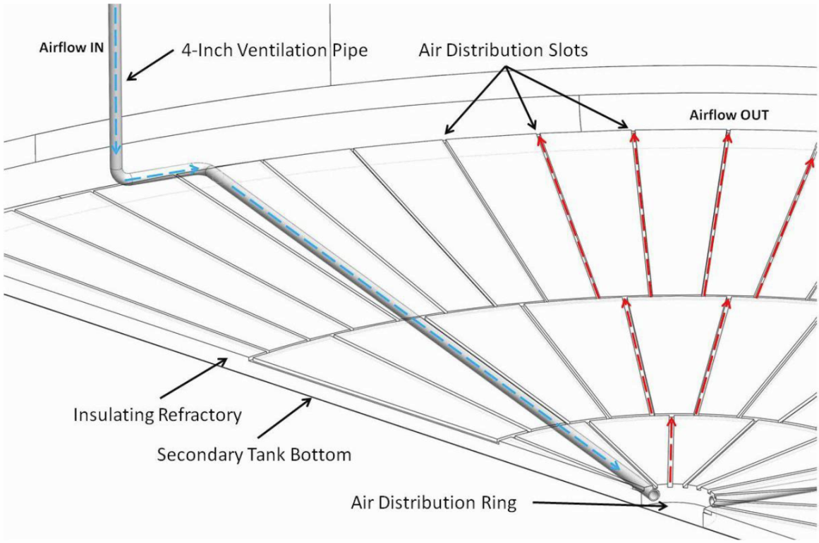
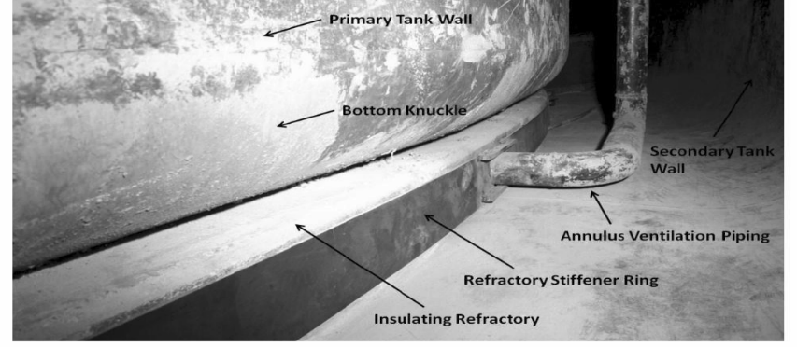
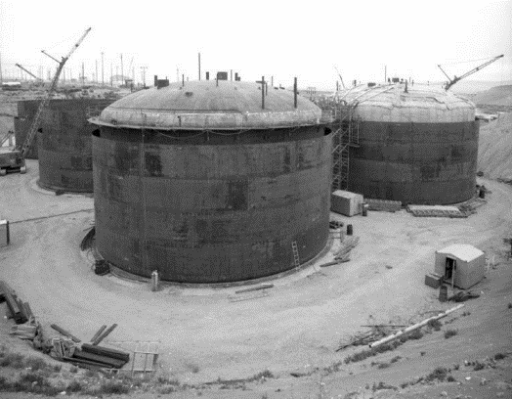
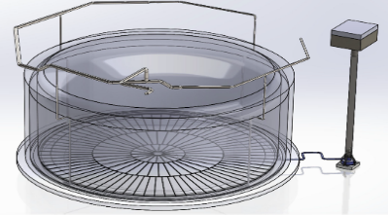
Task Description
Background
Tank waste was found in the annulus of tank AY-102.
An inspection tool is required to isolate and pinpoint the source of the material entering Tank AY-102 annulus space
There are three possible entry points:
(1) refractory air slots through the annulus,
(2) 6” leak detection piping, and
(3) 4” air supply piping

Slide 6
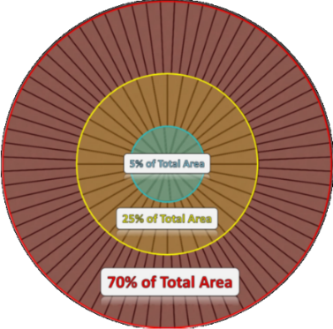
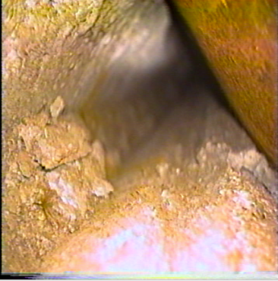
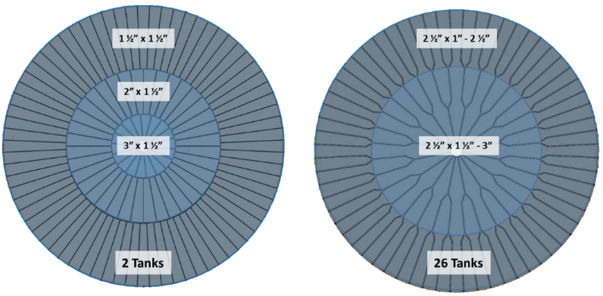
Refractory Slot Inspection Tool
OBJECTIVE:
To develop an inspection tool that navigates through the refractory pad air channels under the primary liners of the DST’s at Hanford while providing live video feedback
DESIGN PARAMETERS:
Travel through small cooling channels with dimensions as small as 1.5” x 1.5”
Remote controlled
Inserted through a riser to the annulus floor
Live video feedback
Radiation hardened (~80 rad/hr)
High temperature environment (~170 ° F)
Must not subject the channel walls to pressures greater than 200 psi (the compression strength of the refractory material)
Navigate ~ 50 feet to the tank center, while maneuvering four 90 ° turns (first phase – 17 feet, no turns
Notes:
Channels arranged in 3 sections, with two 90° turns connecting each:
(1) 17 feet of 1 ½“by 1 ½“ square slots
(2) 12 feet 1 ½“by 2” square slots
(3) 7 feet of 1 ½“by 3“ square slots

Slide 7
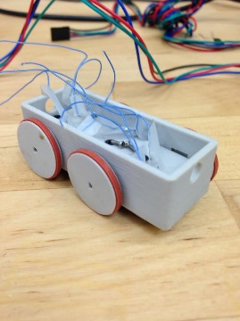
Initial Designs
Use of tank-treads for improved maneuverability
Upside down travel to avoid refractory debris (via magnets)
GENERAL APPROACH
EARLY PROTOTYPES
Insufficient pulling force
Inadequate clearance with tank surface
Cumbersome reassembly
Difficulty overcoming obstacles (small wheels)

Slide 8
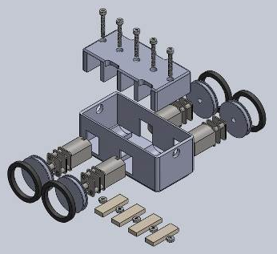
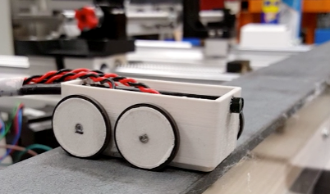
Prototype
Wheels being 3D printed (diameter increased by 6mm to improve obstacle avoidance ability)
Stronger motors, capable of 10x the amount of torque
Brackets to fit motor in place, allowing for replacement in the event of failure
Metal gear motors vs. plastic gear motors
Notes:
The general design of the inspection tool has been completed and a prototype was assembled. Modifications that led to significant improvement in the performance include:

Slide 9
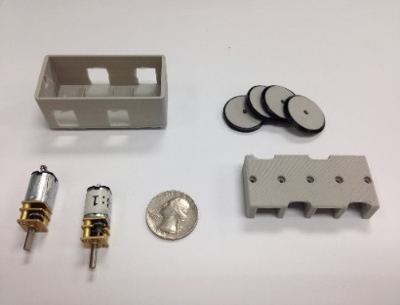
System Components
Arduino Uno board with ATMega328 microcontroller
Eggsnow USB Borescope Endoscope 5.5mm inspection camera
298:1 Micro Metal Gearmotor (4)
3D Printed 20mm x 3mm wheels (4)
Square-Profile O-Ring for wheels
3D printed body and bracket
Neodymium magnet – 3/4” x 1/8” x 1/10” – 3 lb pull force (4)
Tether: 10m in length, 6mm wide (expandable to 11mm wide), braided sleeving

Slide 10
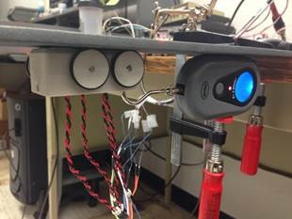
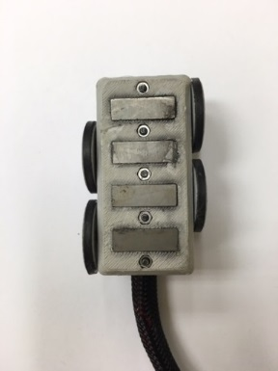
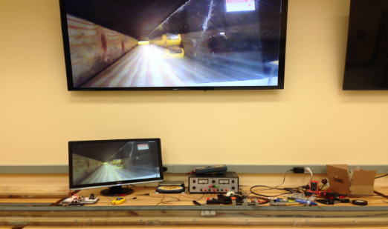
Bench Scale Testing
Maximum Pull Force
Device weight: 0.18 lb
Average pull force: 4.75 lb
Tests performed at: 5V
Power/Weight ratio: 26
Motor rated for 3-9 V
Pull force average obtained from 30 measurements

Slide 11
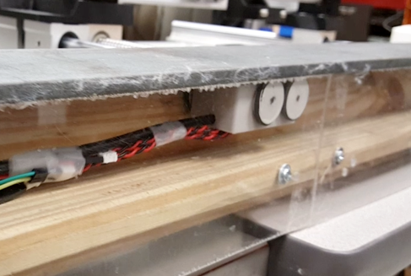
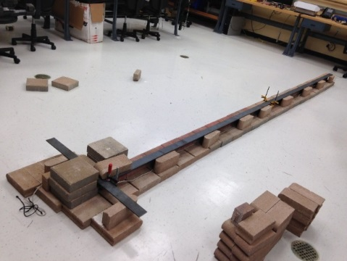
Bench Scale Testing
DIFFERENT MATERIALS FOR BASE
Wood
Pavers
1.5” x 1.5” cross section
17’ initial corridor
Steel plate on top of test bed
SIMILAR PARAMETERS
Added two 90 degree turns
Pavers provided more realistic surface
MODIFICATIONS IN 2ND TEST BED

Slide 12
Cable Management
Goal: To design a system to let out/recover the tether of the rover with precision

Slide 13
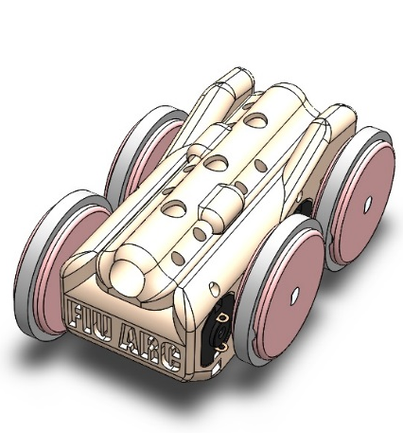
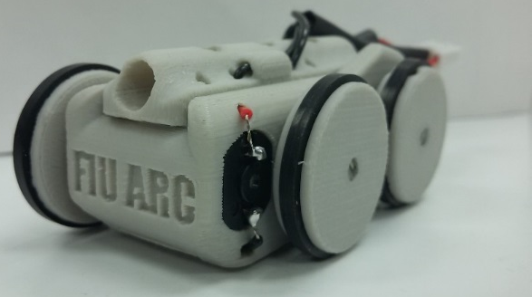
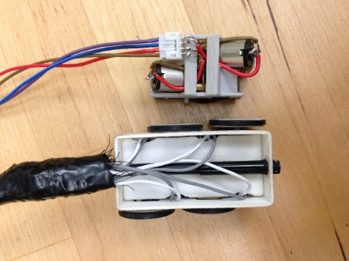
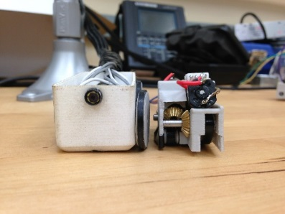
Alternative Design
Explore first 17 feet
Make 90 degree turn

Slide 14
Moving Forward
Develop full-scale mock up test bed
Develop delivery mechanism for easy development
Provide feedback of other inspection parameters (temperature, relative humidity, radiation)
Redesign a radiation hardened version

Slide 15
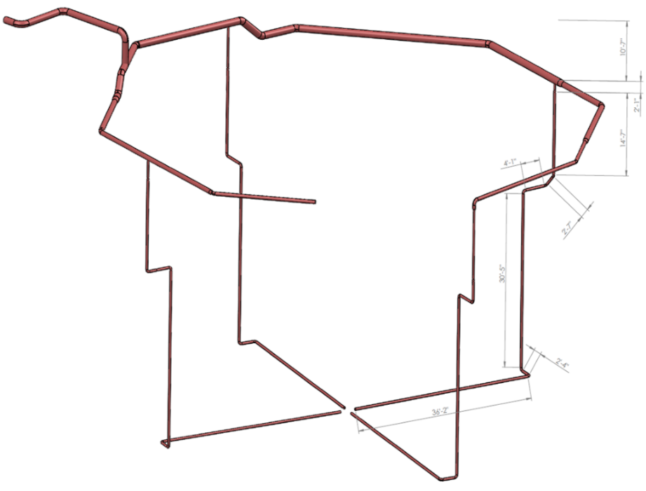
Peristaltic Crawler
Objective
To develop an inspection tool that crawls through the air supply pipe that leads to the central plenum of the primary tank of the DSTs at Hanford and provides video feedback
Design parameters
Remotely controlled
Video feedback recorded for future analysis
Radiation hardened (~ 80 rad/hr)
Exposure to elevated temperatures (~ 170 F)
Maneuver in pipes and fittings (3” and 4” diameter)
Navigate through:
elbows,
bends,
transitions, and
vertical runs
Proposed inspection approximately 100 feet (significant portion is gravity fed)
Notes:
Anthony - May s

Slide 16
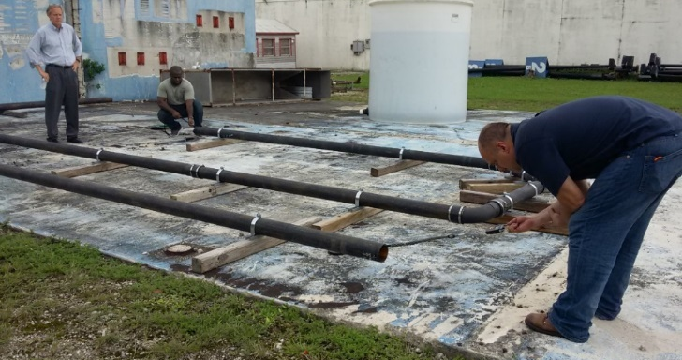
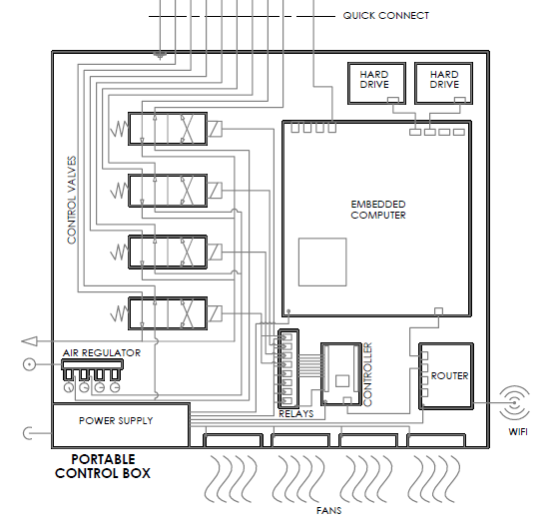
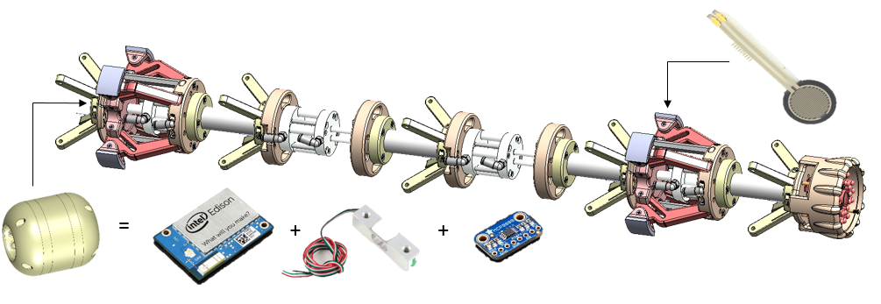
Peristaltic Crawler
Results
Instrumentation:
Embedded computer
Tether load cell
Additional sensors
Bench scale test
Portable control box

Slide 17
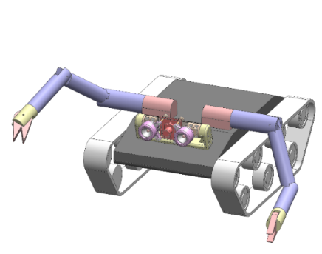
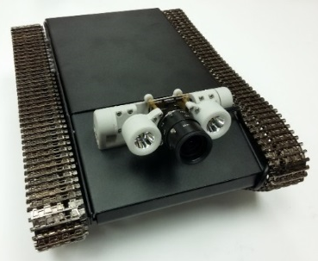
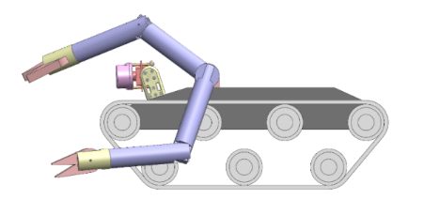
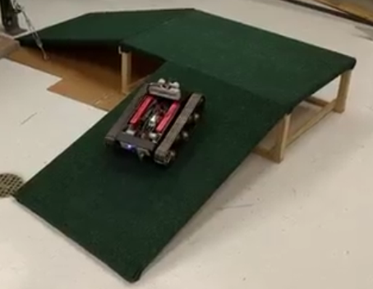
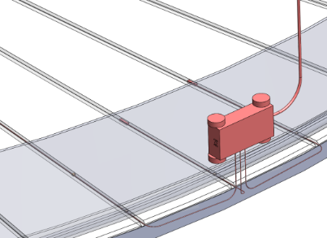
Mobile Platform
Objective
To develop a multifunctional robotic platform that can be used to provide visual inspection and act as a parent robot for inspections tools and sensors.

