Slide 1
Unrefined Humic Substances as a Potential Low-cost Remediation Method for Acidic Groundwater Contaminated with Uranium
Hansell Gonzalez Raymat
DOE Fellow
Graduate Student, Ph.D. in Chemistry

Slide 2
Background

Slide 3
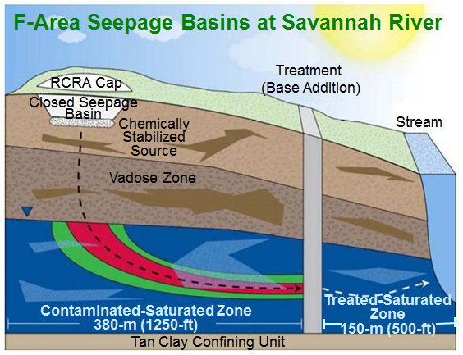
Background
Approximately 1.8 billion gallons of acidic waste solution were discharged to a series of unlined seepage basins at the F/H Area.
The constituents of concern (COCs) are tritium, uranium-238, iodine-129, strontium-90, and technetium-99.
Radionuclides such as uranium are migrating into the groundwater creating an acidic plume pH between 3.5-5.
U
U
Uranium migration

Slide 4
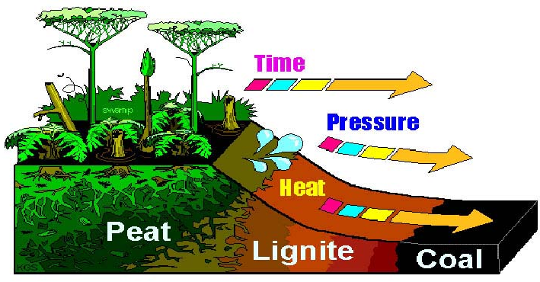
Background
Humic substances are ubiquitous in the environment, occurring in all soils, waters, and sediments of the ecosphere.
Humic substances arise from the decomposition of plant and animal tissues.
Fulvic acid soluble at all pH values.
Humic acid insoluble at pH < 2.
Humin insoluble at all pH values.
Formation of Humic Substances

Slide 5
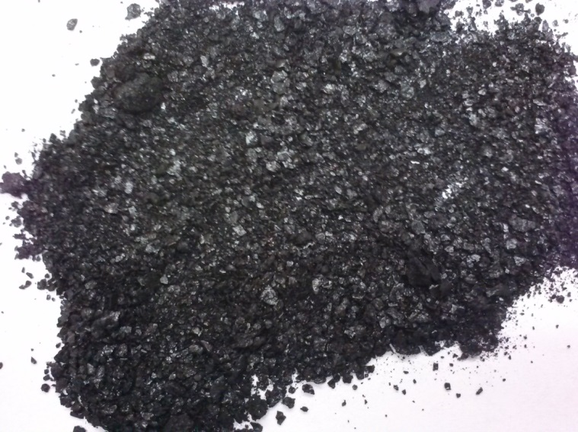
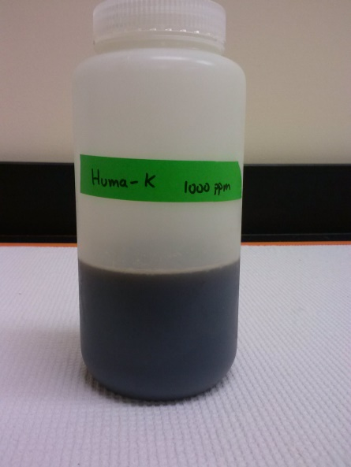
Huma-K
Huma-K is an organic fertilizer that comes from the alkaline extraction of leonardite (a low-rank coal).
Huma-K has a high content of humic substances.

Slide 6
Objective
The principal objective of this study is to determine if the low cost unrefined humate solution known as Huma-K can be used to facilitate uranium adsorption to control the mobility of Uranium in acidic groundwater.
This objective will be fulfilled by completing the following specific aims:
Characterization of Savannah River Site sediments and Huma-K.
Sorption behavior of Huma-K on Savannah River Site sediments.
Removal of Uranium using Huma-K coated sediments.

Slide 7
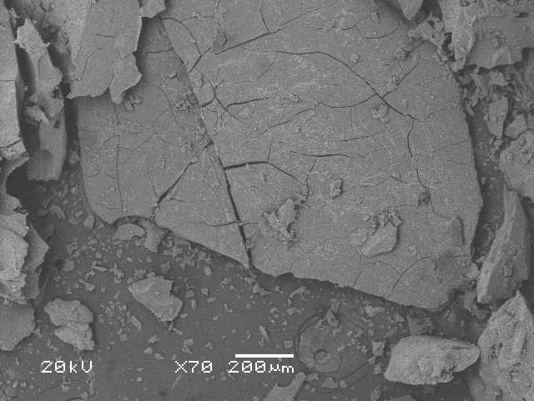
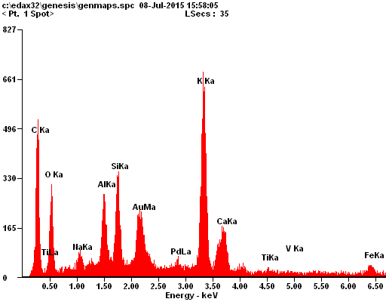
SEM/EDS
Scanning Electron Microscopy with Energy Dispersive X-Ray Spectroscopy (SEM/EDS) was used to investigate the surface morphology and elemental composition of SRS sediments from the F-Area and Huma-K.
SEM of Huma-K (left image) and EDS analysis (right image)

Slide 8
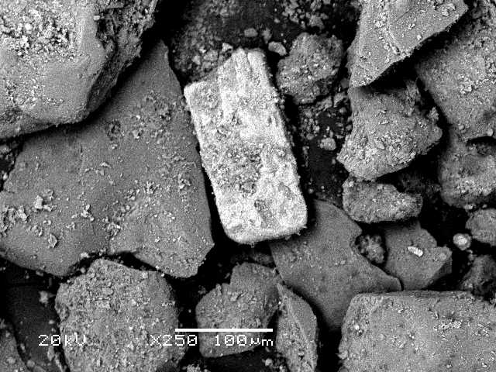
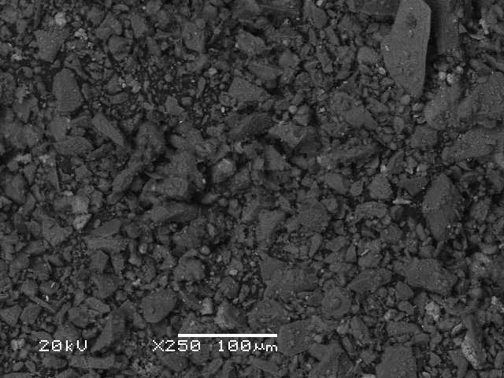
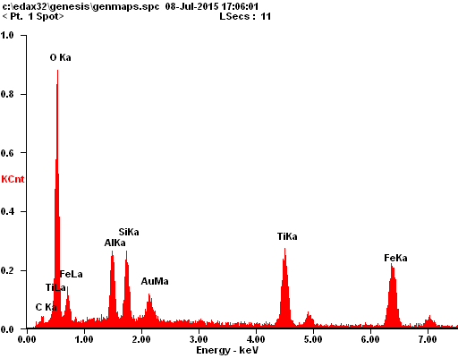
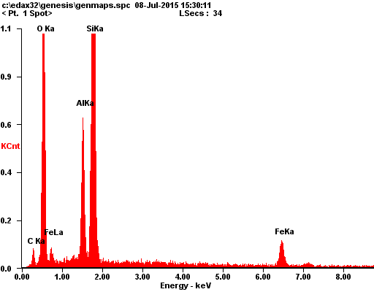
Results
SEM of SRS Sediments coarse fraction (left image) and fine fraction (right image)
EDS results of SRS Sediments coarse fraction (left image) and fine fraction (right image)

Slide 9
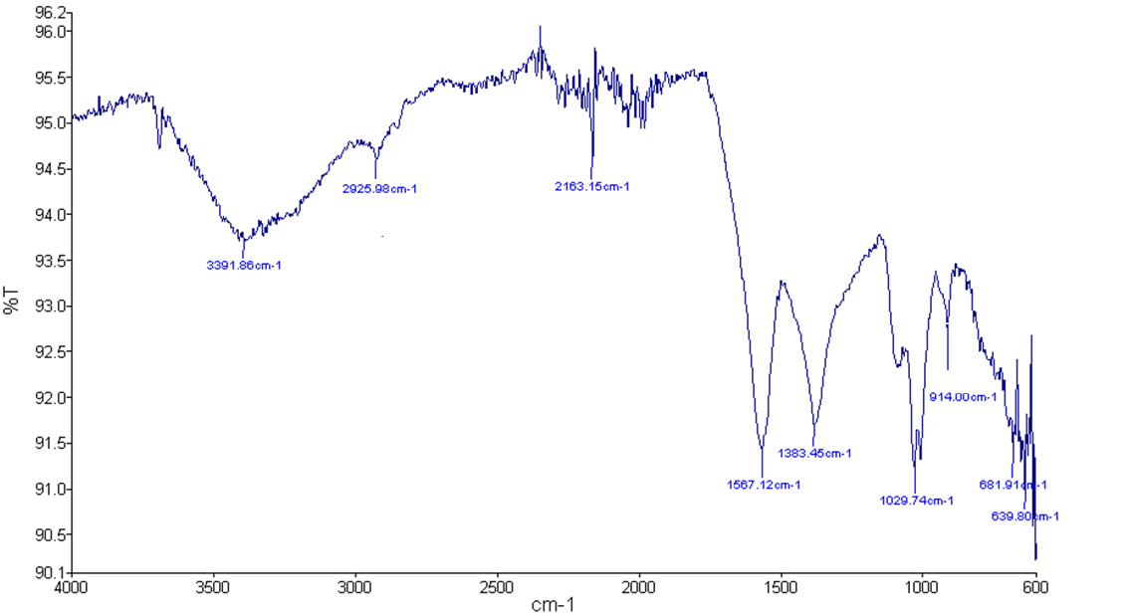
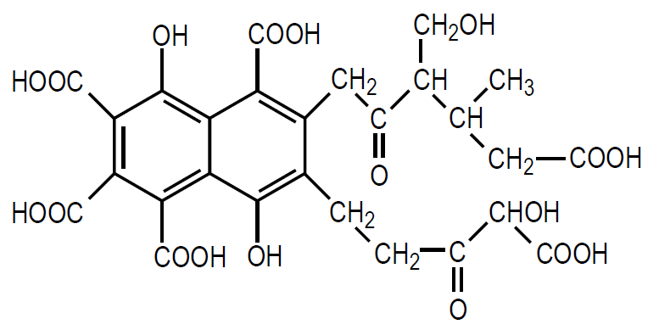
Fourier Transform Infrared Spectroscopy (FTIR)
C-H
O-H
N-H
C-C
COO⁻
C-O
FTIR of Huma-K

Slide 10
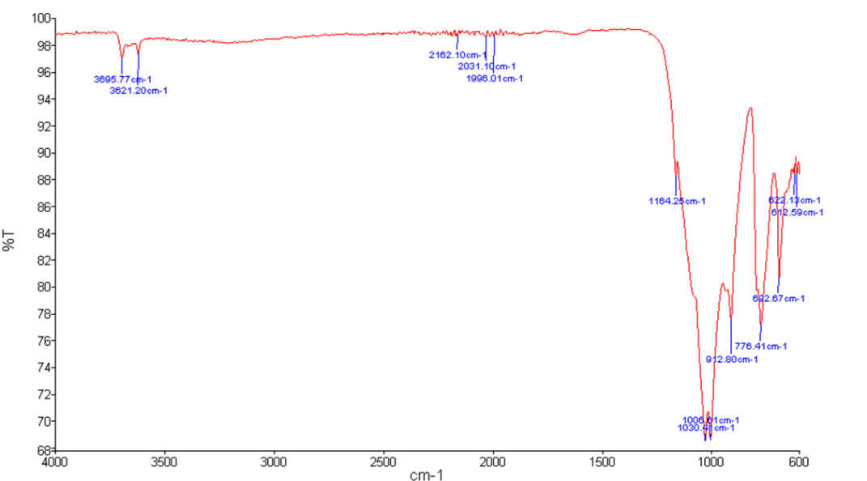
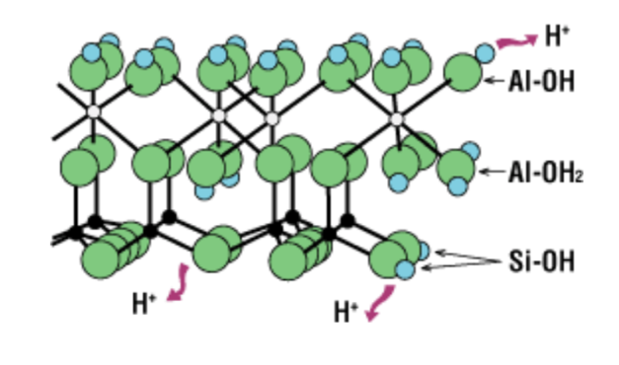
Results
Al-OH
Si-O
Si-O
Al-OH
Kaolinite structure
Si-O
FTIR of SRS Sediments (fine fraction)

Slide 11
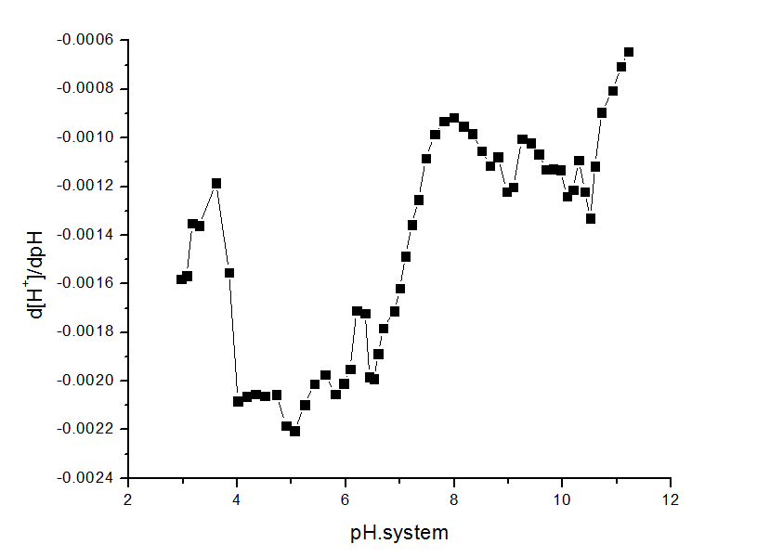
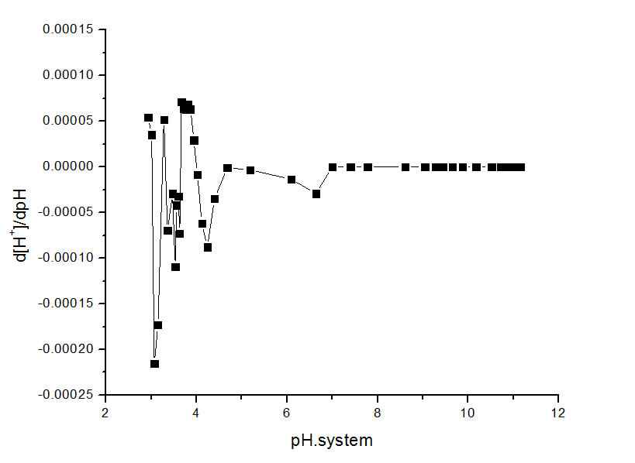
Potentiometric Titrations
Potentiometric Titrations provide useful information on the protonation/deprotonation properties of Huma-K and SRS sediments.
Potentiometric Titration of Huma-K
Potentiometric Titration of SRS sediments

Slide 12
Desorption of Huma-K
The results showed a increased in desorption as the pH is increased.
Desorption of Huma-K from sediment at different pH values

Slide 13
Conclusions
EDS analysis, FTIR, and potentiometric titrations clearly revealed the presence of humic substances in Huma-K.
EDS and FTIR confirmed the presence of kaolinite in the fine fraction of SRS sediments. Potentiometric titrations indicate that sediments have similar acido-basic properties as quartz mineral.
Desorption of Huma-K increases with the increase of pH
Future Work
First manuscript for publication that will include all the experimental work done with Huma-K as a low-cost remediation method.
Sorption experiments to study the removal of uranium by SRS sediments amended with Huma-K.

Slide 14
Acknowledgements
Mentor
Dr. Yelena Katsenovich
DOE-FIU Science and Technology Workforce Development Program
Sponsored by the U.S. Department of Energy, Office of Environmental Management, under Cooperative Agreement DE- EM0000598.

