Slide 1
DOE-EM Cooperative Agreement
FIU Performance Year 6
Year End Research Review
Presented: September 21, 2016
to the U.S. Department of Energy
Dr. Leonel Lagos, PhD, PMP® (Principal Investigator)

Slide 2
FIU-DOE Year End Research Review
Wednesday Sept 21, 2016 Morning | Wednesday Sept 21, 2016 Afternoon
9:00 - 10:00 Workforce Development & Training (FIU Project 4) | 1:00 - 2:00 High Level Waste / Waste Processing (FIU Project 1)
10:00 - 11:00 D&D and IT for EM (FIU Project 3) | 2:00 - 3:00 Soil/Groundwater (FIU Project 2)
Presentations available at doeresearch.fiu.edu

Slide 3
FIU Project 1
Chemical Process Alternatives for Radioactive Waste

Slide 4
FIU Personnel and Collaborators
Principal Investigator: Leonel Lagos
Project Manager: Dwayne McDaniel
Faculty/Staff: Amer Awwad, Dave Roelant, Anthony Abrahao, Aparna Aravelli, Seckin Gokaltun, Hadi Fekrmandi, Reza Abbasi Bahranchi
DOE Fellows/Students: Anthony Fernandez, John Conley, Maximiliano Edriei, Gene Yllanes, Michael DiBono, Clarice Davila, Erim Gokce, Sebastian Zanlongo, Mackenson Telusma
DOE-EM: Gary Peterson, Steve Schneider, Rod Rimando
WRPS: Dennis Washenfelder, Terry Sams, Ruben Mendoza, Mike Thien, Jason Gunter
NETL: Chris Gunther

Slide 5
Project Description
Task 17 Advanced Topics for Mixing Processes
computational fluid dynamics modeling of HLW processes in waste tanks
Task 18 Technology Development and Instrumentation Evaluation
evaluation of FIU’s SLIM for rapid measurement of HLW solids on tank bottoms
development of inspection tools for DST primary tanks
Task 19 Pipeline Integrity and Analysis
pipeline corrosion and erosion evaluation
nonmetallic materials evaluation
16
Notes:
Our project focuses on developing approaches that can be applied to operational issues in waste processing strategies, primarily at hanford. Advances in these issues can improve efficiency, save money, and reduces health and safety risks to both personnel and the environment. In our tasks, we utilize both computational methods as well as in-situ filed technologies to assist in the improving the retrieval processes. We currently have 6 tasks/subtasks that are

Slide 6
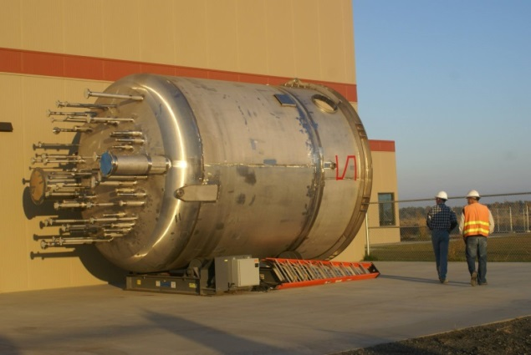
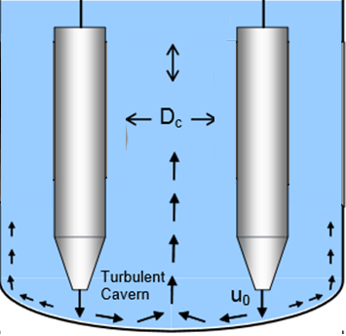
Task 17.1 - CFD Modeling of Mixing Processes in Waste Tanks
Background
Various mixing processes are required before tank waste can be transferred to facilities for treatment. The processes can involve pulse jet mixers, spargers and potentially other means to generate a homogenous mixture prior to transfer.
14-ft-diameter vessel to test PJMs
Pulse Jet Mixers (PJM)
PJMs contain pressurized vessels which intake the waste and discharge it back out at high velocity creating radial jets. These jets collide at the center of the vessel creating an up wash and promoting circulating motions.
PJM circulation Demonstration

Slide 7
Present Tasks
Task 17.1 - CFD Modeling of Mixing Processes in Waste Tanks
Objective
Develop computational capability as a prediction tool to:
  Evaluate the performance of mixing mechanisms for high-level waste
  support critical issues related to HLW retrieval and processing
Capabilities of Star-CCM+ code will be improved incrementally to obtain a comprehensive tool that includes the complex flow features of HLW mixing
Star-CCM+ will be used in order to investigate accuracy of correlations used to predict impacts of the radial jets on LLW mixing
Notes:
Update

Slide 8

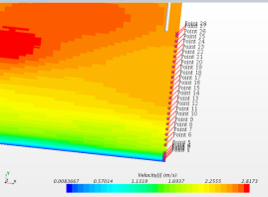
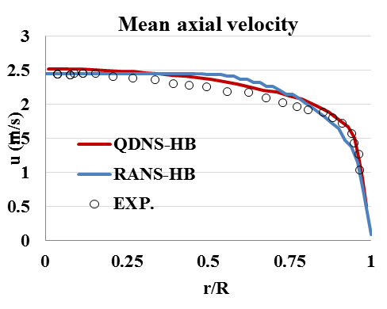
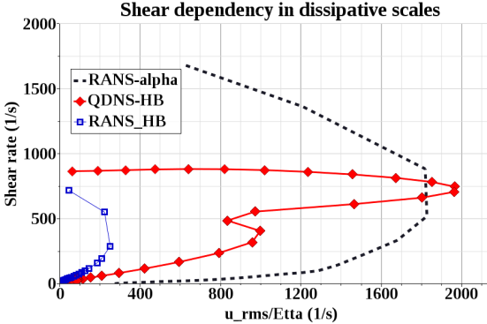
Task 17.1 - CFD Modeling of Mixing Processes in Waste Tanks
Results
3D modeling of non-Newtonian fluids using QDNS and RANS were validated with experimental data. Improved previous efforts to match experimental data.
Investigated shear dependency to improve RANS modeling – QDNS and RANS were found to be significantly different.
Our current modified RANS method also was significantly different from the QDNS shear dependency.
Notes:
Last bullet – black line represents the shear rate for alpha rans

Slide 9
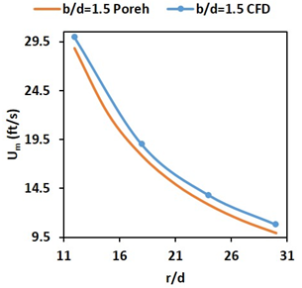
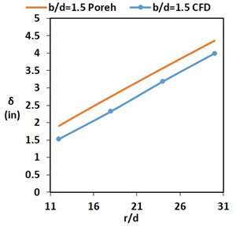
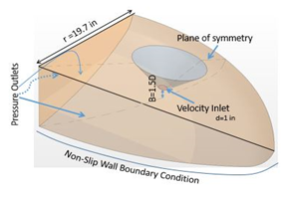
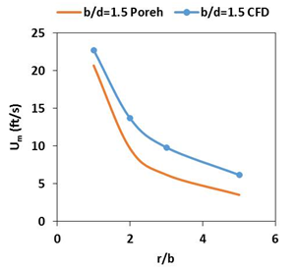
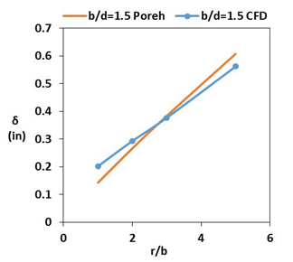
Task 17.1 - CFD Modeling of Mixing Processes in Waste Tanks
Results
Used Star-CCM+ to validate Poreh’s correlations to determine jet thickness and max velocity for various geometric configurations.
Poreh’s formula was fairly accurate for the r/b and b/d ranges of current PJM systems when predicting velocity and jet thickness.
Radial Jet Characteristic Comparison
Jet Maximum Velocity
Jet Thickness
Flat Impingement
Jet Maximum Velocity
Jet Thickness
Curved Impingement

Slide 10
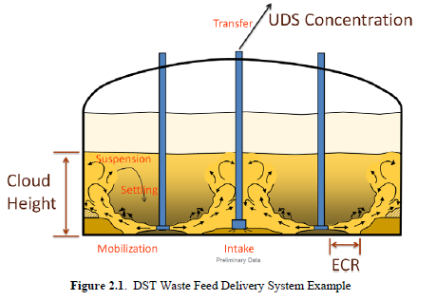
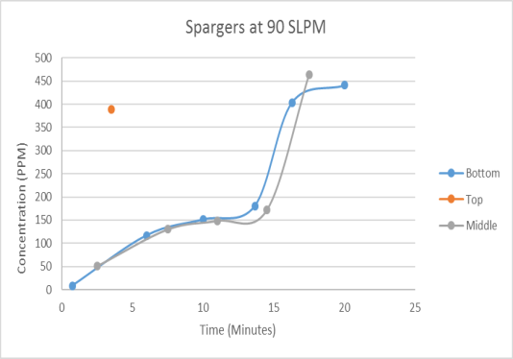
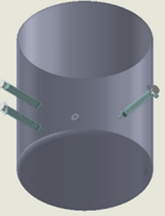
Task 17.1 - CFD Modeling of Mixing Processes in Waste Tanks
Tasks for FIU Performance Year 7
Need - accurate prediction of concentration of undissolved solids in waste tank feed delivery system at Hanford using CFD modeling.
To build a CFD model (Star-CCM+) that is capable of accurately predicting metrics for particle mobilization, suspension, settling, transfer line intake, and pipeline transfer.
Need –understanding of the operation time needed to fully mix vessels at Hanford. Experimental testing on mixing time of ethanol in the sparging of Bingham plastics was performed at NETL.
To evaluate Star-CCM’ s capability of matching experimental data pertaining to the field of non-Newtonian sparging mixing vessels.
Gain insight into the effects of rheological and physical characteristics on mixing times for accurate prediction in PJM operation.
(Experimental setup)
(Data obtained from experimental set up)

Slide 11
Task 18.1 - Evaluation of FIU’s 3D Sonar for Small Changes in Surface Layer of HLW as an Indicator of DSGREs
Motivation
Recently, engineers at Hanford have been focusing on increasing tank space in DSTs to mitigate issues related to the aging of SSTs. One of the major concerns associated with these transfers is the potential release of flammable gas. This can occur when the sludge levels are exceedingly high in the DSTs and is referred to as a deep sludge gas release event (DSGRE).
Objective
Monitor the settled solids layer in double shelled tanks to image any increase in volume of the waste as an indicator of the buildup of gas in the deep sludge layers
Challenge
Create a continuous monitoring capability using data filtering, processing and 3D visualization allowing operators to see any increase in height (volume) of the settled solids layer in the tanks

Slide 12
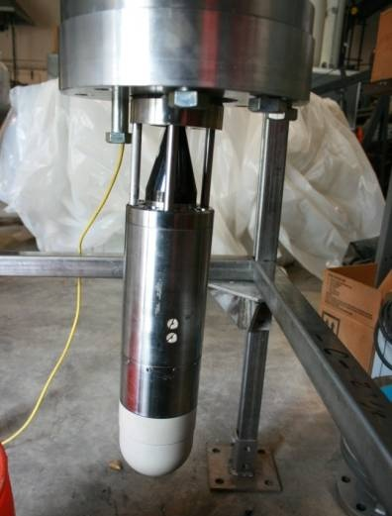
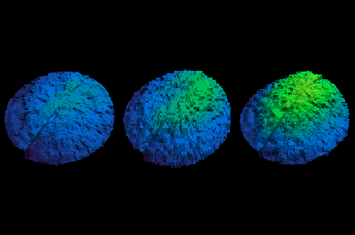
Task 18.1 - Evaluation of FIU’s 3D Sonar for Small Changes in Surface Layer of HLW as an Indicator of DSGREs
Results
Developed computer code to post process and image scans from a commercial 3D sonar.
Developed a lab scale testbed and conducted initial tests in water to validate sonar’s ability to detect small variations in surface height.
Accuracy to 6 mm is easily imaged at a sonar to solids distance of 30 cm (1 ft)
Currently developing code to correlate changes in surface height with gas volume.
Sand was mounded over an air bladder and placed on the test tank floor. Air was added in 2 stages to the bladder under the sand.
Three Sonar Images
Left: sand over empty bladder
Middle: sand surface after air is added
Right: sand surface after 2nd increment of air is added

Slide 13
Task 18.1 - Evaluation of FIU’s 3D Sonar for Small Changes in Surface Layer of HLW as an Indicator of DSGREs
Tasks for FIU Performance Year 7
Effort has completed at the end of Performance Year 6.

Slide 14
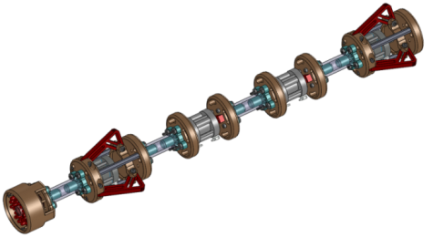

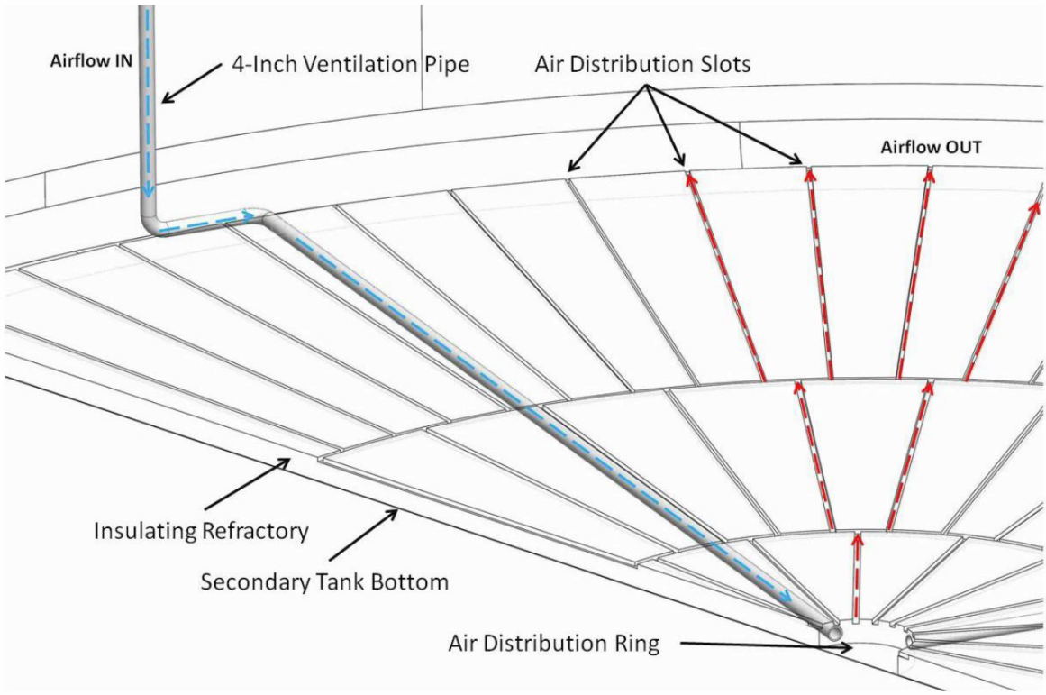
Task 18.2 - Development of Inspection Tools for DST Primary Tanks
Background
Tank waste was found in the annulus of tank AY-102.
An inspection tool is required to isolate and pinpoint the source of the material entering Tank AY-102 annulus space
There are three possible entry points: (1) refractory air slots through the annulus, (2) 6” leak detection piping, (3) 4” air supply piping

Slide 15
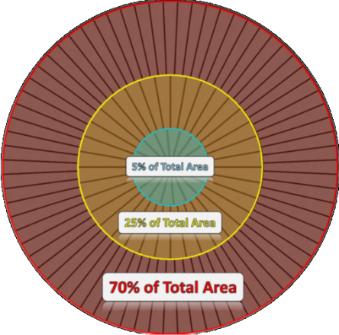
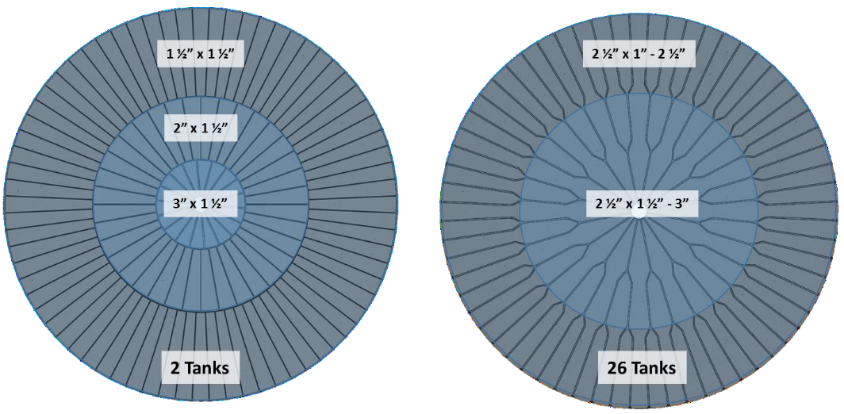
Task 18.2 - Development of Inspection Tools for DST Primary Tanks
Mini Rover
Objective
To develop an inspection tool that navigates through the refractory pad air channels under the primary liners of the DST’s at Hanford while providing live video feedback
(Kayle Boomer, WRPS 2015)
Design parameters
Travel through small cooling channels
Remote controlled
Provide live video feedback
Rad hardened (~ 80 rad/hr)
Withstand relatively high temperatures (~ 170 °F)
Navigate ~ 50 feet to the tank center
Maneuver through four 90° turns
Subject the channel to pressures not greater than 200 psi
AY
Tank Farm
AZ/SY/AW/AN/AP
Tank Farm
(Brandon J. Vazquez, WRPS 2015)
(Jason Gunter, WRPS 2015)

Slide 16
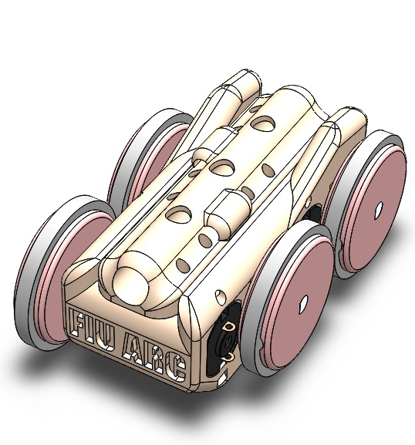
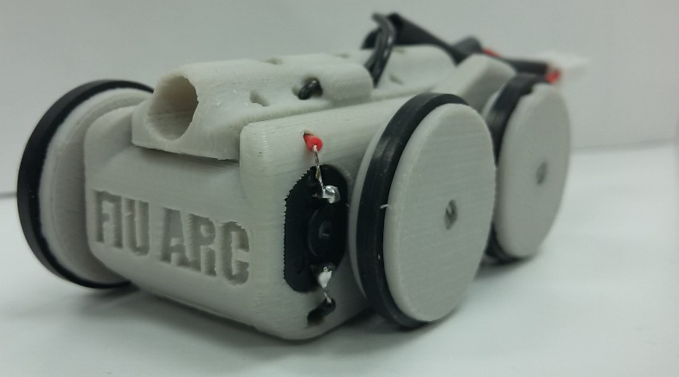
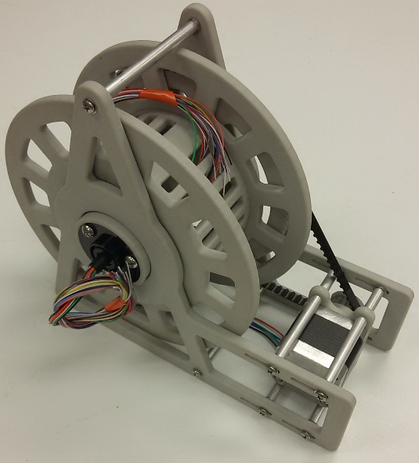
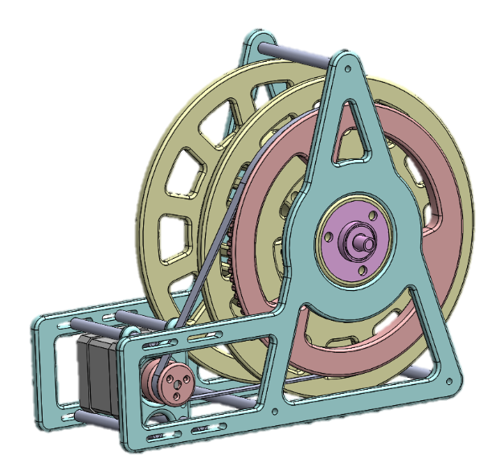
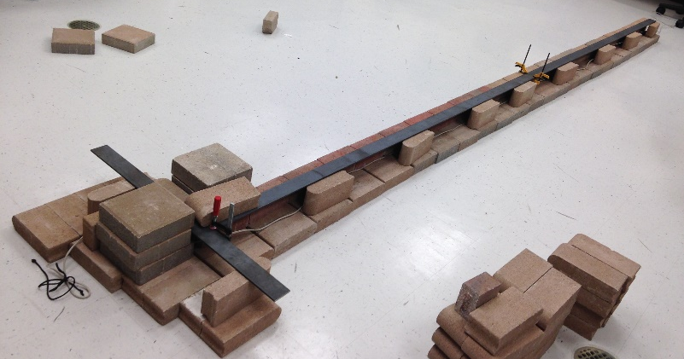
Task 18.2 - Development of Inspection Tools for DST Primary Tanks
Mini Rover
Results /Accomplishments
Improved design:
Stronger body
Lighter tether
Better controls
Bench scale test
Cable management

Slide 17
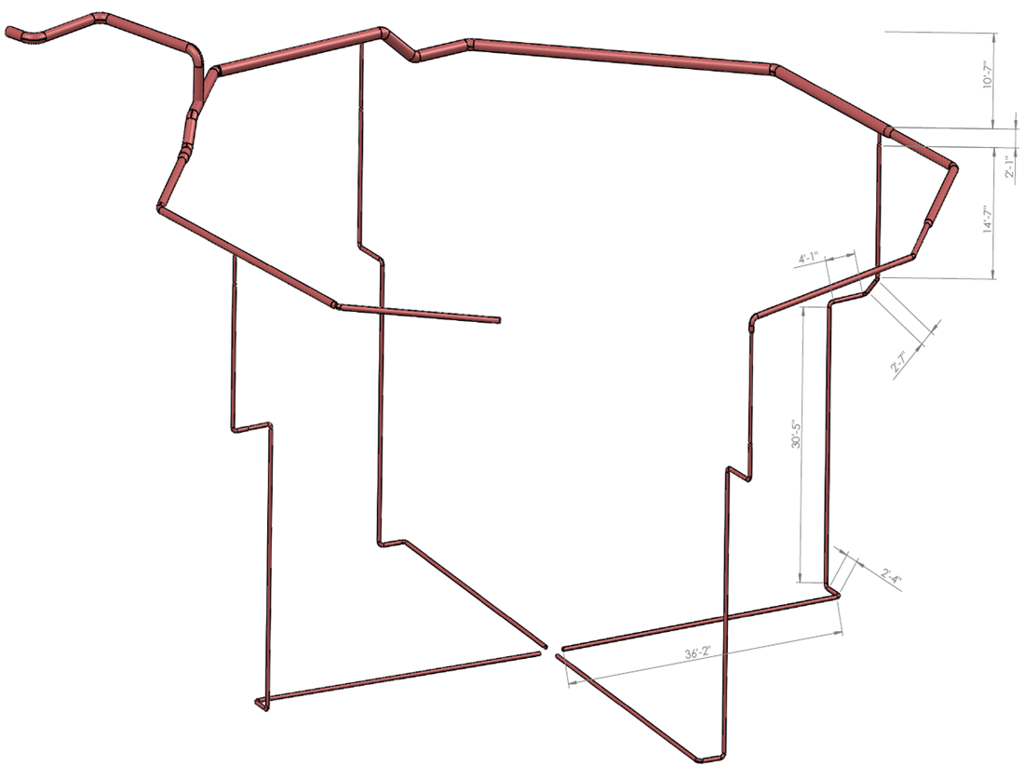
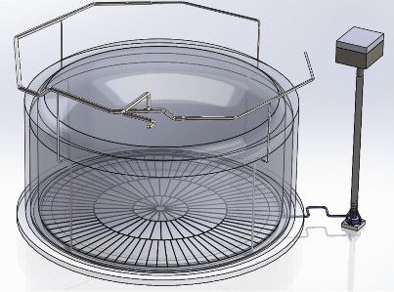
Task 18.2 - Development of Inspection Tools for DST Primary Tanks
Peristaltic Crawler
Objective
To develop an inspection tool that crawls through the air supply pipe that leads to the central plenum of the primary tank of the DSTs at Hanford and provides video feedback
Design parameters
Remotely controlled
Video feedback recorded for future analysis
Radiation hardened (~ 80 rad/hr)
  Exposure to elevated temperatures (~ 170 F)
  Maneuver in pipes and fittings with 3” and 4” diameter
  Navigate through elbows, bends, transitions and vertical runs
Proposed inspection -approximately 100 feet (significant portion is gravity fed)
Notes:
Anthony - May s

Slide 18
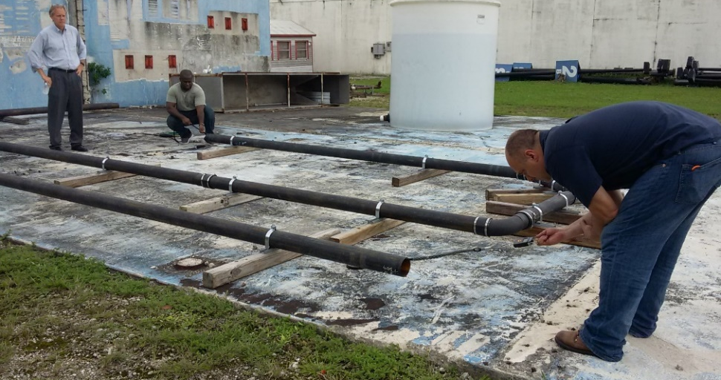
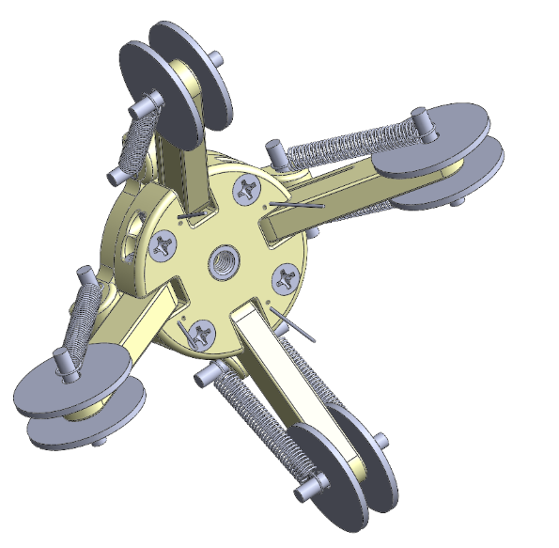
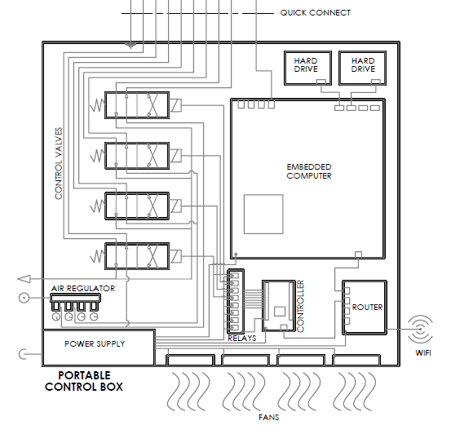
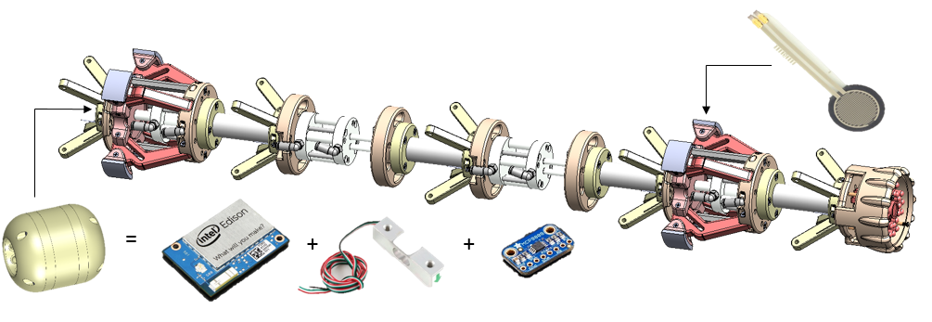
Task 18.2 - Development of Inspection Tools for DST Primary Tanks
Peristaltic Crawler
Results/Accomplishments
Instrumentation:
Embedded computer
Tether load cell
Additional sensors
Bench scale test
Portable control box

Slide 19
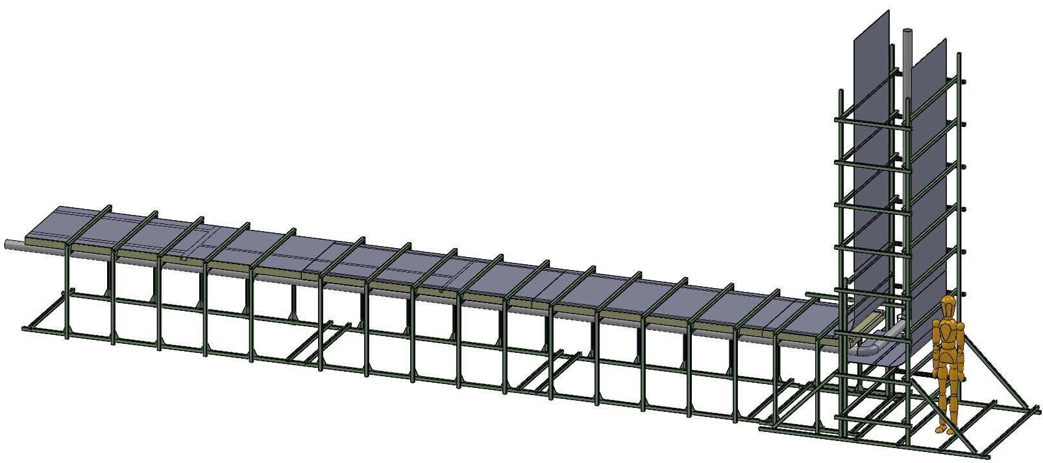
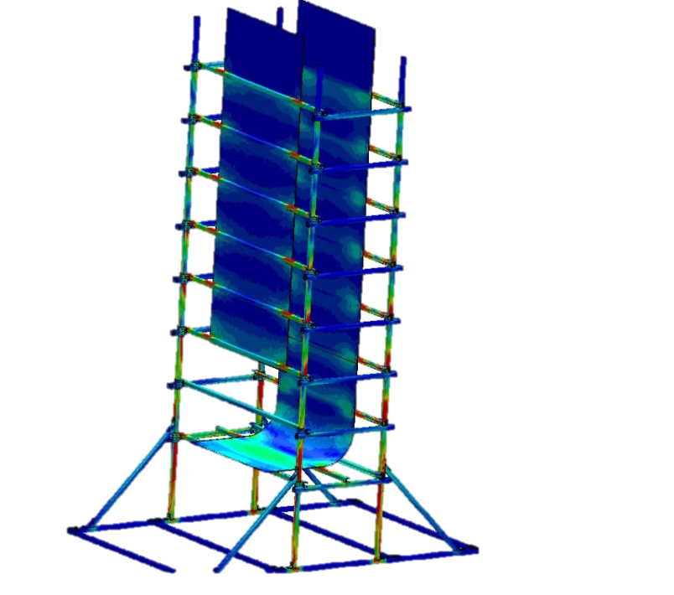
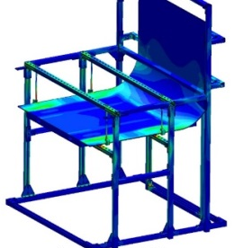
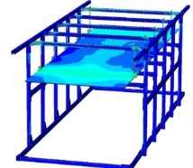
Task 18.2 - Development of Inspection Tools for DST Primary Tanks
Sectional Mock-up of DSTs
Objective
To design a full scale mockup of the DST to evaluate inspection technologies and robotic devices
Design parameters
Modular design
Dimensions 36’ length x 5’ width x 17’ height
Simulate several inspection conditions:
Refractory pad
Wall thickness
Center plenum access
Cooling channels geometry
Defects
Damaged weld beds, and
bottom cracks.

Slide 20
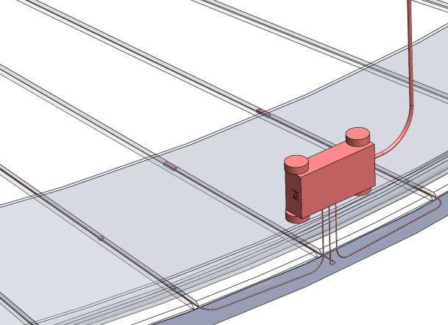
Task 18.2 - Development of Inspection Tools for DST Primary Tanks
Tasks for FIU Performance Year 7
Crawler
Assemble full-scale mock up test bed
Validate system in mock up
Investigate sensor integration - temperature, radiation, UT
Scale design for inspection in 6 inch leak detection line
Rover
Complete design and development of the cable management system
Investigate and develop delivery mechanism for easy deployment
Investigate sensor integration - temperature, radiation, UT
Validate system in mock with various refractory pad configurations

Slide 21
Task 18.3 - Investigation Using an Infrared Temperature Sensor to Determine the Inside Wall Temperature of DSTs
Background
Operating Specifications for the DSTs (OSD-T-151-00007) specifies the temperature requirements for waste
Current temperature methods
  process knowledge, approximations, measuring devices and modeling
  at least10 feet from the wall due to equipment and technical constraints
Models estimate wall conditions
    Typically not validated with field data
Objective
Demonstrate the use of an IR sensor to approximate the inside wall temperature of DSTs
  Utilize bench scale tests and heat transfer calculations
Notes:
Build an experimental set up
to represent a DST
Acquire an IR sensor
conduct emissivity adjustment tests
Define the test procedure
Conduct the experiments
Theoretical validations
Heat transfer calculations

Slide 22
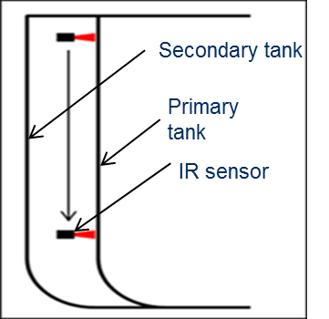
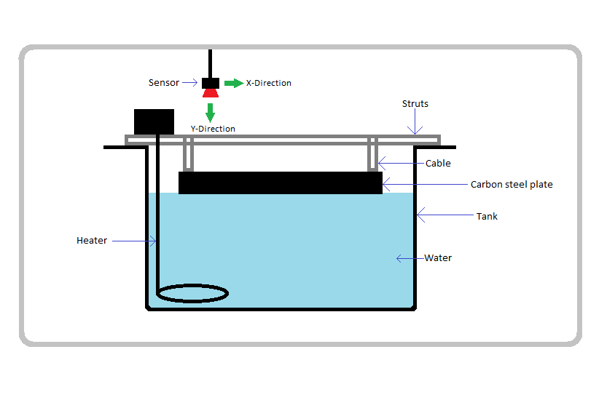
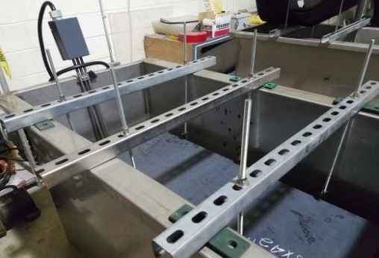
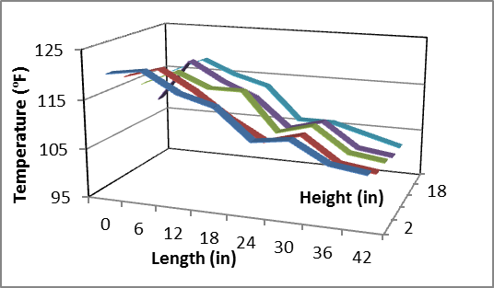
Task 18.3 - Investigation Using an Infrared Temperature Sensor to Determine the Inside Wall Temperature of DSTs
Results/Accomplishments
Developed test plan to evaluate IR sensor
  Vary plate thickness, water temperature, sensor elevation, distance of sensor to tank wall
Procured IR Sensor (Raytek MI3)
  Initial system configuration
Conducted emissivity tests
  material calibration (carbon steel)
Completed bench scale testing
  construction of the bench scale test bed and executing the test plan
Notes:
Spectral range : 8 μm to 14 μm
Response time: <1 second
Aperture Diameter: < 1”

Slide 23
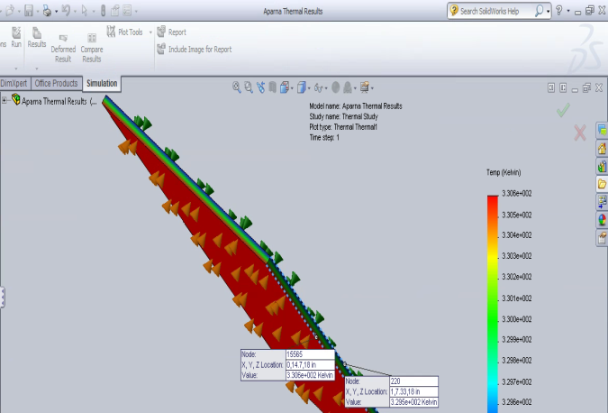
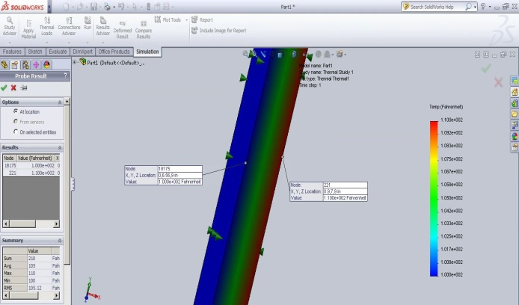
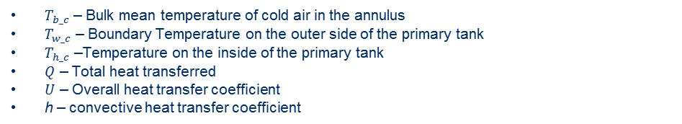
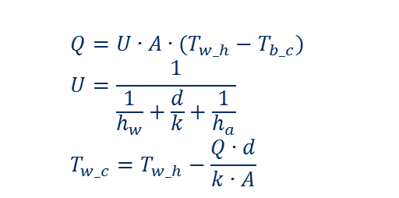
Task 18.3 - Investigation Using an Infrared Temperature Sensor to Determine the Inside Wall Temperature of DSTs
Results/Accomplishments
Modeling and simulation
  Developed model to estimate internal wall temperature simulation of heat transfer in the DST’s
Fundamental Heat Transfer Theory
  $Q=U∙A∙(T_{w_h}−T_{b_c})$
  $$U=\frac{1}{\frac{1}{h_{w}}+\frac{d}{k}+\frac{1}{h_{a}}}$$
  $$T_{w_c}=T_{w_h}−\frac{Q∙d}{k∙A}$$
$T_{b_c}$ – Bulk mean temperature of cold air in the annulus
$T_{w_c}$ – Boundary Temperature on the outer side of the primary tank
$T_{h_c}$ –Temperature on the inside of the primary tank
$Q$ – Total heat transferred
$U$ – Overall heat transfer coefficient
h – convective heat transfer coefficient
X - horizontal distance in the annulus (ft.); Y- vertical height (ft.); T -temperature of water (⁰F)
Notes:
Build an experimental set up
to represent a DST
Acquire an IR sensor
conduct emissivity adjustment tests
Define the test procedure
Conduct the experiments
Theoretical validations
Heat transfer calculations

Slide 24
Task 18.3 - Investigation Using an Infrared Temperature Sensor to Determine the Inside Wall Temperature of DSTs
Tasks for FIU Performance Year 7
Improve current testbed with multiple thermocouples and a data acquisition system
Test the IR sensor with new system on testbed with different design parameters. Validate using simulation models
Test the IR sensor on sectional mock up testbed of DSTs tank
Investigate the integration of the IR sensor into a robotic platform
Notes:
Dennis had mentioned two other tasks
Instrumentation to detect standing water in HLW lines
Remote inspection of Double Shell tank bottoms

Slide 25
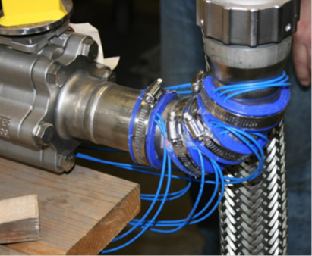
Task 19.1 – Pipeline Corrosion and Erosion Evaluation
Background
Due to uncertainties regarding the structural integrity of pipelines at Hanford, a Fitness-for-Service (FFS) program for the Waste Transfer System has been implemented.
A direct inspection and assessment of the condition of buried pipelines is required to evaluate the corrosion and erosion wear rates.
To predict the existing system’s remaining useful life
UT sensors
Objective
Investigate the use of remote permanently mounted Ultrasonic Transducer (UT) systems for measuring pipe wall thickness

Slide 26
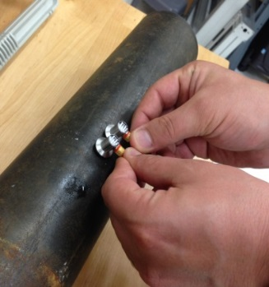
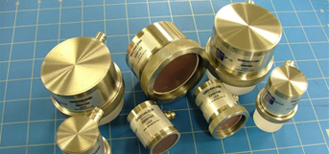
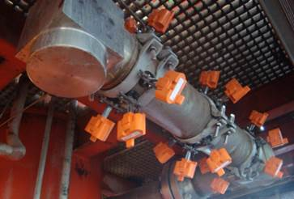
Task 19.1 - Pipeline Corrosion and Erosion Evaluation
Results/Accomplishments
Evaluated various couplants (gel and dry) for UT sensing using an Olympus dual element sensor
  Dry couplants provided inconsistent results
  Vacuum testing was conducted to evaluate removal of air gaps
Conducted a review of alternative sensor systems that meet the site requirements
  dry couplant, small sizes, accuracy of 0.001 in, semi permanent mounting, rad environment
Down selected sensors to two
  Permasense guided wave sensors – limited to 2 sensors for 2 in diameter pipes
  Ultran Group – couplant free sensors
Ultran WD 25-2 UT sensors
Permasense – guided wave sensors

Slide 27
Task 19.1 - Pipeline Corrosion and Erosion Evaluation
Tasks for FIU Performance Year 7
Assess the accuracy of the Permasence sensors on pipe sections and fittings (2, 3 and 4 inch diameters systems).
Develop experimental test loop to validate the use of the sensors. Determine optimal simulants to age/errode the pipe loop.
Evaluate the sensors on the DST sectional mock-up.
Investigate the potential integration of the sensors into robotic devices.

Slide 28
Task 19.2 - Evaluation of Nonmetallic Components in the Waste Transfer System
Background:
Nonmetallic materials are used in the US DOE’s Hanford Site Tank Farm waste transfer system. These include inner primary hoses in the HIHTLs, Garlock® gaskets, EPDM O-rings, and other nonmetallic materials.
Nonmetallic materials are exposed to β and γ irradiation, caustic solutions as well as high temperatures and pressure stressors. How they react to each of these stressors individually has been well established, but simultaneous exposure of these stressors is of great concern.
Objective:
Provide the Hanford Site with data obtained from experimental testing of the hose-in-hose transfer lines, Garlock® gaskets, EPDM O-rings, and other nonmetallic components under simultaneous stressor exposures.
Due to experimental testing location limitations, no radiation exposure testing will be conducted.
Notes:
Ethylene Propylene Diene Monomer
Previous Efforts:
Test plan for the irradiation of nonmetallic materials (Sandia Report)
RPP-PLAN-50529
Banded (Band-it) and Swaged Hose in Hose Transfer Line (HIHTL) Assembly, Service Life Verification Program (Lieberman Report)
RPP-6711, Rev.3, Appendix L

Slide 29
Task 19.2 - Evaluation of Nonmetallic Components in the Waste Transfer System
Phase 1 Test Plan:
Phase 1 will be limited to EPDM material testing (HIHTL, O-rings and gaskets). EPDM was selected for this phase of testing due to its use in multiple applications within the Hanford waste transfer system.
Material will be simultaneously exposed (aged) to both high temperature (85ºF, 130ºF and 180ºF) and caustic solution stressors.
A 25% sodium hydroxide solution will be used as the chemical stressor.
Material will be aged while in-service configuration as well as coupons for 180 and 360 days.
Post exposure mechanical performance testing will be conducted including burst pressure tests, leak tests (in-service configuration) and stiffness, tensile strength tests (coupons).

Slide 30
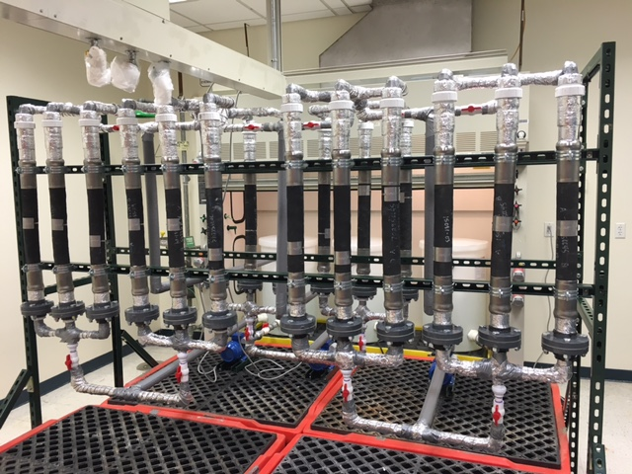
Task 19.2 - Evaluation of Nonmetallic Components in the Waste Transfer System
Due to limitations in resources – 24 coupons were manufactured by Riverbend
  6 room temp (180, 360 days)
  6 operating temp (180, 360 days)
  6 elevated temp (180 360 days)
  3 baseline testing
  3 additional – elevated temp for 60 days if needed
A test loop was designed and manufactured that will age the HIHTLs, O-rings, gaskets and material coupons.
Nonmetallic test loop
Notes:
The in-service configuration aging experimental setup will consist of 3 independent pumping loops with three manifold sections on each loop.

Slide 31
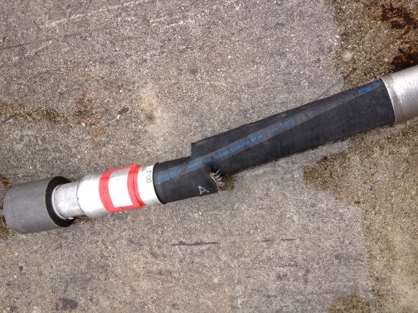
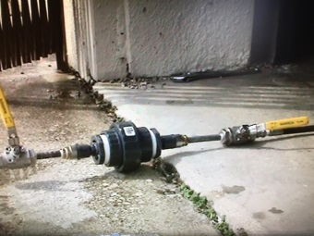



Task 19.2 - Evaluation of Nonmetallic Components in the Waste Transfer System
Baseline Results
Blowout tests:
3 hose coupons were tested with an average blowout pressure of 2805 psi
In-configuration leak tests:
3 flanges and 3 O-rings were leak tested in configuration at 150 psi and 255 psi respectively
Material tests:
Tensile tests – peak load, stress, modulus for EPDM and Garlock coupons
Hardness tests

Slide 32
Task 19.2 - Evaluation of Nonmetallic Components in the Waste Transfer System
Tasks for FIU Performance Year 7
  Continue to age the non-metallic components for the 6 month and year intervals.
  After the 6 months of aging, specimens will be removed and tested to determine the level of degradation in strength and material properties.
  Based on results of testing, additional data points may be needed for evaluation or modifications to the current system may need to be incorporated.
  Additional stressors may also be considered for testing.
  Additional stressors may also be incorporated into the testing.

