Slide 1
DOE-EM Cooperative Agreement
FIU Performance Year 6 Research Review
Presented: September 21, 2016
to the U.S. Department of Energy
Dr. Leonel Lagos, PhD, PMP® (Principal Investigator)

Slide 2
FIU Project 2
Environmental Remediation Science & Technology

Slide 3
Project Staff and Students
Faculty/Staff:
Dr. Vasileios Anagnostopoulos Dr. Hilary Emerson Dr. Reinaldo Garcia Dr. Ravi Gudavalli Dr. Yelena Katsenovich |  | Angelique Lawrence Dr. Mehrnoosh Mahmoudi Dr. David Roelant Dr. Shimelis Setegn
Students/DOE Fellows:
Alberto Abarca Mohammed Albassam Sarah Bird Claudia Cardona Silvina Di Pietro Natalia Duque Alejandro Garcia | Hansell Gonzalez Alejandro Hernandez Sandra Herrera Robert Lapierre Juan Morales Kiara Pazan Awmna Rana |  | Yoel Rotterman Aref Shehadeh Alexis Smoot Sarah Solomon Christopher Strand Christine Wipfli Frances Zengotita

Slide 4





Project Clients and Collaborators
Dr. Timothy Johnson Dr. Hope Lee Dr. Brady Lee Dr. Nik Qafoku Dr. Jim Szecsody | Dr. John Seaman
 | Dr. Don Reed Dr. Timothy Dittrich
Dr. Miles Denham Ms. Carol Eddy-Dilek Mr. Kevin Kostelnik Dr. Brian Looney Margaret Millings Dr. Ralph Nichols | John DeGregory (EM-4.11) Kurt Gerdes (EM-4.12) Paul Beam (EM-4.12) Skip Chamberlain (EM-4.12), PNNL Lead

Slide 5
Project Description
This project involves research that supports the resolution of critical science and engineering needs for both remediation and risk assessment purposes for radionuclides within the subsurface. Tasks include:
Laboratory scale batch and column experiments to better understand the impacts of potential in situ remediation techniques on the subsurface at Hanford site and SRS
Simplified experiments to better understand the mechanisms controlling the fate of trivalent actinides and lanthanides at the WIPP site and technetium and uranium at the Hanford site (includes equilibrium and kinetic batch experiments, column studies, microbiological experiments, and solid phase characterization)
Surface water modeling of Tims Branch at SRS supported by the application of GIS technology for management and geoprocessing of spatiotemporal data.

Slide 6
TASK 1
Remediation Research and Technical Support for the Hanford Site

Slide 7
  Ammonia Gas Injection for Remediation of Uranium
Dr. Hilary P. Emerson (FIU-ARC)
Dr. Yelena Katsenovich (FIU-ARC)
Alberto Abarca, (FIU-ARC, GRA)
Claudia Cardona (FIU-ARC, DOE Fellow)
Silvina Di Pietro (FIU-ARC, DOE Fellow)
Robert Lapierre (FIU-ARC, DOE Fellow)
Dr.Jim Szecsody (PNNL)
Dr.Nik Qafoku (PNNL)

Slide 8
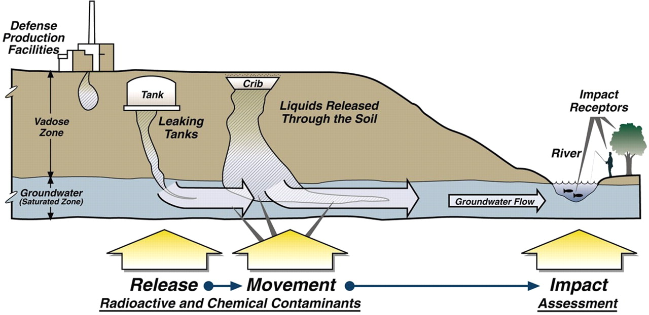
Ammonia Gas Injection
Research Objective
Investigate the effects of NH₃ gas injection on the fate of U and mineral dissolution in the presence of pure minerals and Hanford sediments (with a comparison of NaOH vs. NH₃ injection) and evaluate the stability and identity of precipitates.
Remediation Technology Approach
Additional liquids may increase the flux of U to GW
Desire to increase pH to dissolve natural aluminosilicate minerals and (co)precipitate uranium
Gee et al., 2007

Slide 9
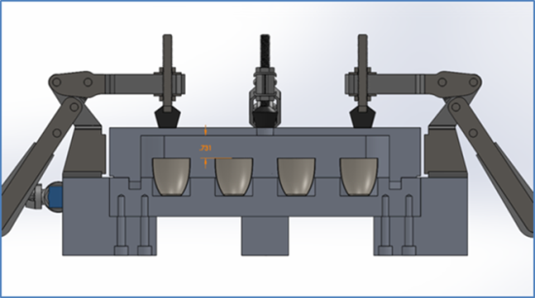
Ammonia Gas Injection
Highlights: Speciation Modeling
Updated GWB database to include a selection of newly reviewed thermodynamic data on uranium aqueous and solid phases.
  More accurate prediction on the formation of uranyl- bearing solid phases that correlate with SEM/EDS and XRD observations.
Quantified water adsorption on solids at constant temperature
  Provided estimates of water quantity retained within precipitates
  Explained the mechanism leading to the dissolution of water soluble uranium species incorporated in the uranium-bearing precipitates
Left - The full assembly of the isopiestic chamber with crucibles inside to quantify water adsorption on solids at constant temperature.
      Publication: Yelena Katsenovich, Claudia Cardona, Robert Lapierre, Jim Szecsody, Leonel Lagos, 2016. The Effect of Si and Al Concentrations on the Removal of U(VI) in the Alkaline Conditions Created by NH₃ Gas. Applied Geochemistry, 73, p. 109-117.
Notes:
Sample composition includes 2ppm of U(VI), 50mM of Si, 5mM Al, 5mMCa, and 2.9mM HCO₃ (left) and on the right the same elements except 50mM HCO_{3.}

Slide 10
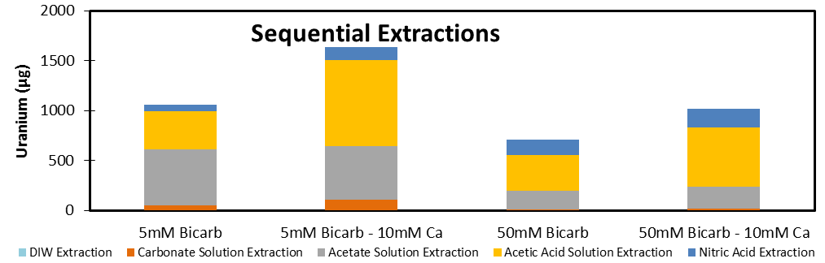
Ammonia Gas Injection
Highlights: Mineral-free Precipitate
Results (right) optimizing uranyl precipitation from the solution show that uranium precipitation (w/out minerals) increased with:
  Increasing calcium
  Decreasing bicarbonate
Sequential extraction of select samples showed that total uranium removed in low bicarbonate samples is greater than their high bicarbonate counterparts
  Likely due to an increase in uranyl silicate content, which is “targeted” in acetic acid extraction
  Solid phase samples currently awaiting analysis by EMP at PNNL
      Publication:
      R. Lapierre, Y. Katsenovich, L. Lagos, “Characterization of U(VI)-Bearing Precipitates Produced by Ammonia Gas Injection Technology into Unsaturated Sediments”. Proceedings of the WM-2016

Slide 11
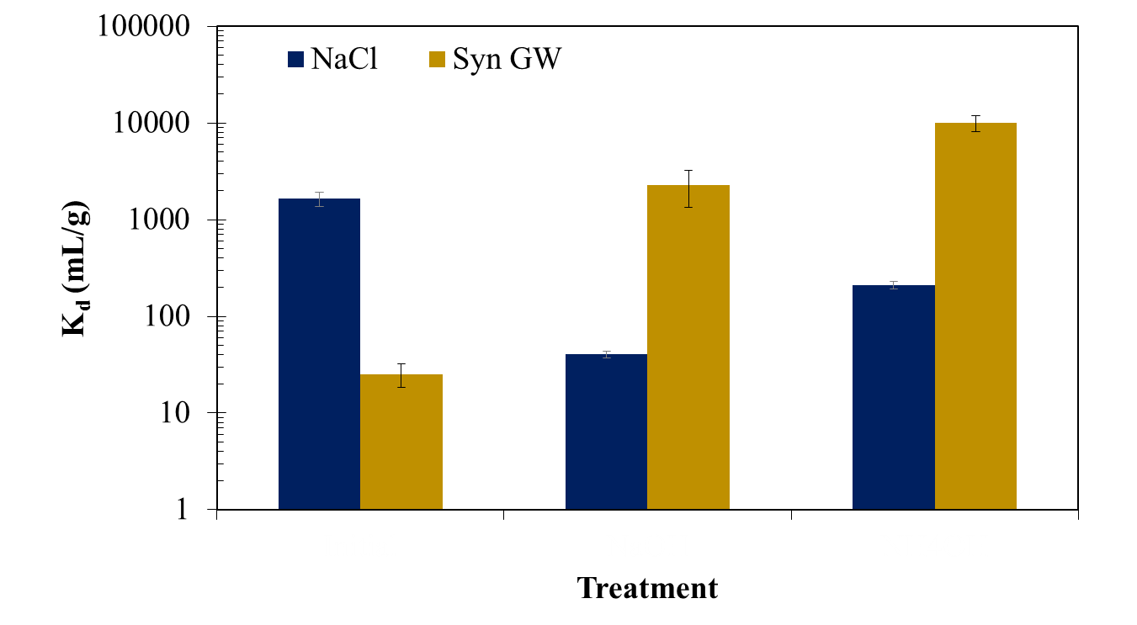
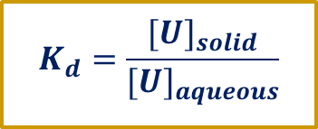
Ammonia Gas Injection
Highlights: Kaolinite-U
$$K_{d}=\frac{{[U]}_{solid}}{{[U]}_{aqueous}}$$
Significantly greater removal with base treatment for SGW versus simpler NaCl systems (due to U-carbonate chemistry)
Initial NaOH NH₄OH
Accomplishments: Submitted for publication in Journal of Environmental Radioactivity and as a research report as part of the DOE-EM Cooperative Agreement, presented as a student poster at Waste Management 2016 (DOE Fellow Di Pietro)
Notes:
Note: (1) significantly lower sorption in the ‘initial’ phase for synthetic porewater (yellow), likely due to carbonate species formation, (2) significant removal from aqueous phase with treatment, likely differences between NaOH and NH4OH but further study is needed

Slide 12
Ammonia Gas Injection
Benefits
NH₄OH
    Uranium removal is greatly increased following basic treatment
    NH₄OH removes slightly more U from the aqueous phase than NaOH in SGW
    Ammonia gas injection will not put additional liquid into the vadose zone
    Accomplishments: Poster and oral presentation at ACS Fall 2016 Meeting

Slide 13
Ammonia Gas Injection
Tasks for FIU Performance Year 7
Effects of Redox: Additional batch experiments with Hanford 200 Area sediments and minerals with ammonia gas (as opposed to aqueous NH₄OH, and monitoring of its effects on redox conditions)
Solid phase characterization: pre- and post- by XRD, BET, SEM-EDS (ongoing)
Precipitate Stability: Flow-through solubility experiments with mineral-free precipitates

Slide 14
Investigation of
Microbial-Meta-Autunite Interactions
Dr. Vasileios Anagnostopoulos
Dr. Yelena Katsenovich
Sandra Herrera (Graduate Student)
Sarah Solomon (DOE Fellow)
Dr. Brady Lee (PNNL)
Dr. Hope Lee (PNNL)

Slide 15
Microbial-Meta-Autunite Interactions
Objectives
Investigate the role of bicarbonate ions on U(VI) biorelease from Ca-autunite under oxygen restricted conditions using bacterial strains Shewanella oneidensis MR1 sp.
  Performed autunite biodissolution experiments in 20-mL sacrificial glass scintillation vials;
  Initial cell density of 10⁶ cells/mL, control vials were bacteria-free.
  Mineral-free batch experiments that replicate conditions of autunite biodissolution experiments.
  U, Ca and P concentrations along with three different bicarbonate concentrations, 0mM, 3mM and 10mM, measured before inoculation with bacteria.
Notes:
Soil bacteria significantly affect uranium mobility in an effort to obtain phosphorous. The Columbia River exhibits large stage variations, causing fluctuations in the water table.
Water table fluctuations and multiple rise-and-fall cycles in the river created an oxic-anoxic interface in this region.

Slide 16
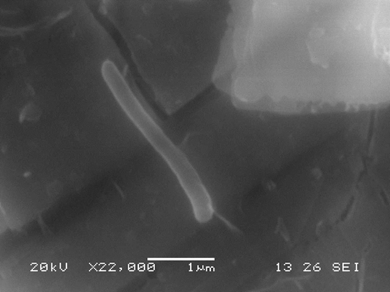
Microbial-Meta-Autunite Interactions
Highlights
  Increase in cell density and viability in the presence of bicarbonate ions
  Negatively charged U-HCO₃ complexes are less bioavailable to cells.
  No reduction of U(VI) to U(IV) in the presence of HCO₃.
  Increase of U release in oxygen restricted conditions.
  Exposure to U(VI) affected the cell physiology resulting in changes of protein masses.
Bacteria attachment on the mineral surfaces through specific structures
Tasks for FIU Performance Year 7
Biodissolution of synthetic Na-autunite
Bacteria consortia for the autunite biodissolution studies
Accomplishment:
S. Herrera-Landaez, V. Anagnostopoulos, Y. Katsenovich, B. Lee, H. Lee, “The Effect of Bicarbonate on Autunite Dissolution in the Presence of Shewanella oneidensis under Oxygen Restricted Conditions”. In the proceedings of WM-2016.
Notes:
Observed increased in cells density and viability in the presence of bicarbonate; In these conditions, U is present as U-HCO3

Slide 17
The influence of microbial activity on the corresponding electrical geophysical response
Dr. Yelena Katsenovich
Alejandro Garcia (DOE Fellow, ARC-FIU)
Dr. Brady Lee (PNNL
Dr. Timothy Johnson (PNNL)

Slide 18
  Geophysics
  Background
Goal: Investigate the corresponding electrical geophysical response, specifically spectral induced polarization (SIP), to detect subsurface microbial activity.
Began as a student internship at PNNL in Spring 2016.
Geophysical: six columns with sampling ports built with the help of Drs. Brady Lee and Jon Thomle (PNNL).
  0.1 L/day flow rate
  A layer of Hanford sediment mixed with autunite in the center
  Microbes cultured within a solution composed of synthetic groundwater, glucose, and uranyl acetate

Slide 19
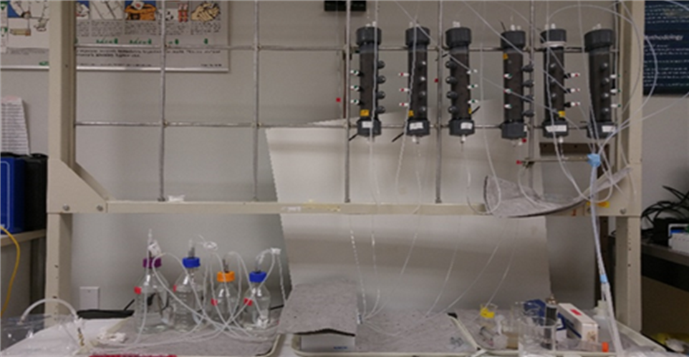
Geophysical Columns
Tasks for FIU Performance Year 7
Continue sampling of one-dimensional columns.
Inoculate columns will microbes and monitor over time using geochemical, microbiological, and SIP analyses.
Matrix for column experiments:
1 | 2 | 3 | 4 | 5 | 6
SGW* | SGW‡ | SGW *+ Glucose | SGW‡ + Glucose | SGW* + Glucose + Inoculum | SGW‡ + Glucose + Inoculum
*No HCO₃, ‡3 mM HCO₃

Slide 20
^{New Task} Technetium Fate and Transport Under Reducing Conditions
Dr. Vasileios Anagnostopoulos (FIU-ARC)
Dr. Yelena Katsenovich (FIU-ARC)
Alejandro Hernandez (FIU-ARC, DOE Fellow)
Dr.Nik Qafoku (PNNL)

Slide 21
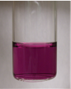
Contaminant Fate and Transport Under Reducing Conditions
Objectives
Investigation on the fate and transport of Tc under reducing conditions in the presence of bicarbonate ions, which are a major ion in the Hanford Site groundwater and pore water compositions.
Tc(IV) carbonate solution
Goals
Investigate the behavior of Tc under conditions related to the Hanford Site (in the presence of bicarbonates and under reducing conditions) and examine their partitioning between the aqueous phase and actual Hanford soil.
Investigate the potential re-mobilization of prior immobilized Tc(IV) as an effect of bicarbonate concentration.
Will prior immobilized Tc(IV) re-enter the aqueous phase due to the presence of bicarbonates? If so, in what range of bicarbonate concentration?

Slide 22
TASK 2
Remediation Research and Technical Support for Savannah River Site

Slide 23
FIU’s Support for Groundwater Remediation at SRS F/H Area
Dr. Vasileios Anagnostopoulos
Alejandro Hernandez (DOE Fellow)
Christine Wipfli (DOE Fellow)
Awmna Rana (DOE Fellow)
Dr. Miles Denham (SRNL)

Slide 24
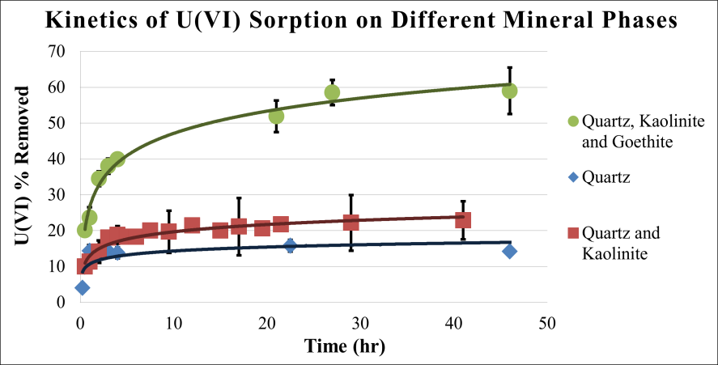
Sodium silicate treatment for the attenuation
of U(VI) at acidic groundwater plumes
Objectives
Investigate the potential use of sodium silicate in order to:
Restore the alkalinity of the treatment zone (pH 3.5)
Investigate the mechanism of U(VI) removal from the aqueous phase through sorption
Research highlights
Modeled the kinetic behavior of U(VI) retention by pure minerals relevant to SRS F/H area
Elucidated the mechanism of U(VI) retention by SRS soil by examining the dependence of sorption on ionic strength: U(VI) is strongly bound through inner sphere complexation
Performed sequential extractions (BCR) experiments: U(VI) is in acid soluble form and associated to Fe-oxides
Investigated the role of iron chemistry in the soil: determined a positive correlation between Fe content in soil and U(VI) % removal
All the acquired information leads to a better understanding of the U(VI) transport/retention under conditions relevant to SRS and assists in more efficient remediation strategy planning

Slide 25
Sodium silicate treatment for the attenuation of U(VI) at acidic groundwater plumes
Accomplishments
DOE Fellows received the following awards for their research on this task:
Alejandro Hernandez ACS Environmental Chemistry Undergraduate Award 1st place in Poster Competition, 4th Annual Life Sciences South Florida STEM Undergraduate Research Symposium
Christine Wipfli 1st Place in DOE Fellows Poster Competition
Best Student Poster, WM 2015
Oral presentation: Vasileios Anagnostopoulos, Alejandro Hernandez, Christine Wipfli, Yelena Katsenovich, Miles Denham. Sodium silicate treatment to attenuate uranium mobility in the acidic groundwater plumes. ACS Annual Meeting, August 2016, Philadelphia, PA
Invitation to publish the experimental findings to Journal of Chemical Technology – manuscript is being prepared.
This task is complete.

Slide 26
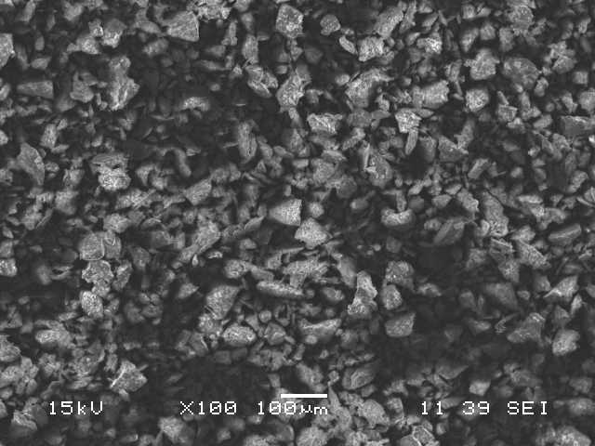
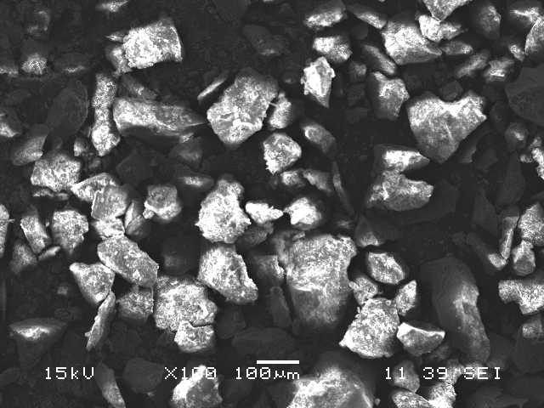
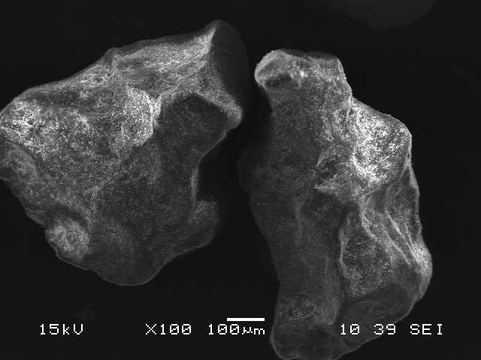
Investigation on the Properties of
Acid-Contaminated Sediment and its
Effect on Contaminant Mobility
New task Year 7
Goal: Compare morphological and physico-chemical properties of acid-contaminated and background sediments that may affect the mobility of uranium in contaminated groundwater
Approach: (1) Create different profile acid-impacted soil in the lab, (2) determine ion exchange capacity, porosity and surface area and characterize the surface by means of SEM-EDS and XRD, (3) investigate the role of mineralogical properties with regards to uranium mobility.

Slide 27
Monitoring of U(VI) Bioreduction after ARCADIS Demonstration at the SRS F-Area
Dr. Yelena Katsenovich
Aref Shehadeh (DOE Fellow)
Dr. Miles Denham (SRNL)

Slide 28
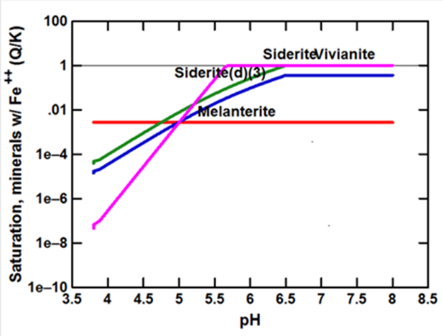
ARCADIS Demonstration at the SRS F-Area
Objectives
Evaluate microcosms mimicking the enhanced anaerobic reductive precipitation (EARP) remediation method previously tested at SRS F/H Area.
Conducted batch experiments:
  Observed pH reduction to ~4 due to molasses fermentation
  Increase in iron concentration
  No sulfate reduction
    Concentration of the initially added sulfate has not changed
  No formation of siderite and pyrite via XRD
  Formation of siderite is predicted by speciation modeling at pH ~6.5-7.
Accomplishments:
Submitted abstract to WM17 based on results of this study.
Task is complete and will not continue in Year 7.

Slide 29
Application of Humic Acid for Uranium Remediation at SRS
Hansell Gonzalez (DOE Fellow)
Dr. Ravi Gudavalli
Dr. Yelena Katsenovich
Dr. Vasileios Anagnostopoulos

Slide 30
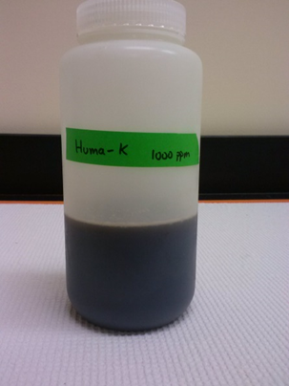
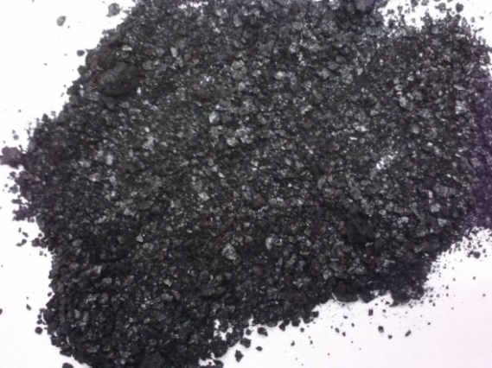
Application of humic acid for U remediation at SRS
Objectives
  Investigate a possible synergy between humic acid and colloidal silica on uranium removal at different pH values;
  Determine if low cost, unrefined humic acid (Huma-K) can be used to control the mobility of uranium in contaminated plume;
  Evaluate the binding mechanism and reversibility of humic acid (Huma-K) sorption on SRS sediment at various pH via batch experiments;
  Understand the effect of sorbed HA on uranium mobility through column experiments and develop a representative model.

Slide 31
  Application of humic acid for U remediation at SRS
  Highlights
  Constructed multi-component batch systems with a pH range from 3 to 8 to effectively analyze synergistic contributions to the removal of U(VI) from the aqueous phase.
  Batch 1: Si (3.5 mM) + U(VI) (0.5 ppm) + HA (50 ppm), (no sediments)
  Batch 2: U(VI) (0.5 ppm) + HA (50 ppm), (no Si or sediments)
  Batch 3: Sediments + Si (3.5 mM) +U (VI) (0.5 ppm) + HA (50 ppm)
  Batch 4: Sediments + U(VI) (0.5 ppm) + HA (50 ppm), (no Si)
  Control: U(VI) (0.5 ppm), (no SI, HA, or sediment)
Analyzed filtered and unfiltered samples to estimate uranium removal for aqueous phase

Slide 32
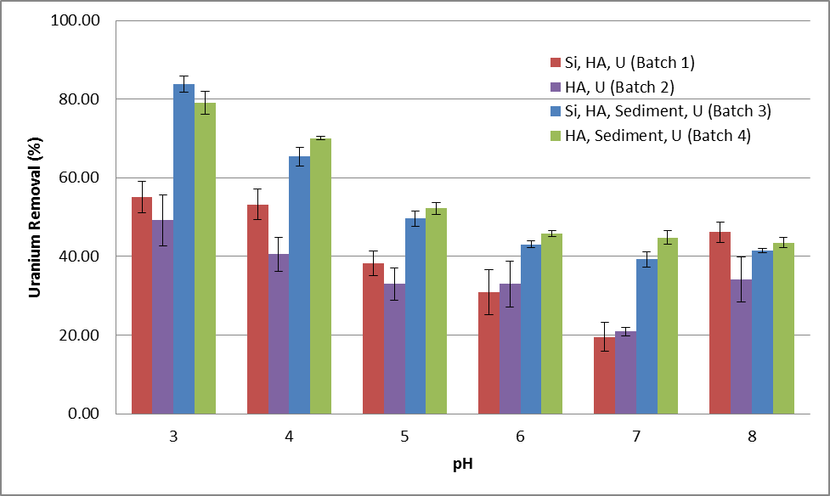
Application of humic acid for U remediation at SRS
Highlights
The percent removal of uranium is directly influenced by the presence of and interactions with humic acid.
Inclusion of sediment increased the percent removal of uranium at all pH values relative to non-sediment-bearing batches.
Accomplishments:
Two posters on the research results were presented at WM16
Won ‘Best Poster Presentation’ award for Track 7 - Environmental Remediation

Slide 33
Application of humic acid for U remediation at SRS
Highlights
Performed FTIR analysis of fine fraction of SRS sediments before and after amendment with Huma-K.
  some functional groups in the sediment decreased after sorption of Huma-K
Performed potentiometric titrations of SRS sediments
  sediments have similar acido-basic properties as quartz mineral.
Investigated desorption of Huma-K at different pH values.
  The results showed increased desorption with pH.
Desorption of Huma-K from sediment at different pH values
Accomplishment:
Prepared a draft manuscript for publication in a peer-reviewed journal

Slide 34
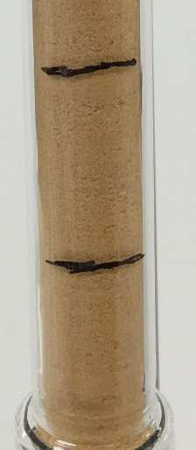
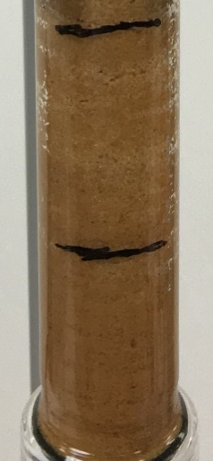
Application of humic acid for U remediation at SRS
Highlights & Tasks for
FIU Performance Year 7
Highlights: Glass column was filled with SRS sediment to study the mobility of uranium through humic acid sorbed media.
Performed Huma-K sorption/desorption study followed
by uranium injection.
33% of Huma-K was retained in the column.
Achieved 81% uranium removal.
Tasks for FIU Performance Year 7
  Investigate the synergetic effect HA and Si at variable U(VI) concentrations on the removal efficiency of U(VI).
  Determine if sediments amended by Huma-K enhance the removal of uranium in acidic conditions.
  Study the migration and distribution of other commercially available HA and obtain sorption and desorption parameters under different pH conditions.

Slide 35
TASK 3
Surface Water Modeling of Tims Branch
Dr. Noosha Mahmoudi
Angelique Lawrence
Dr. Shimelis Setegn
Dr. Reinaldo Garcia
Mohammed Albassam (DOE Fellow)
Natalia Duque (DOE Fellow)
Juan Morales (DOE Fellow)
Christopher Strand (DOE Fellow)

Slide 36
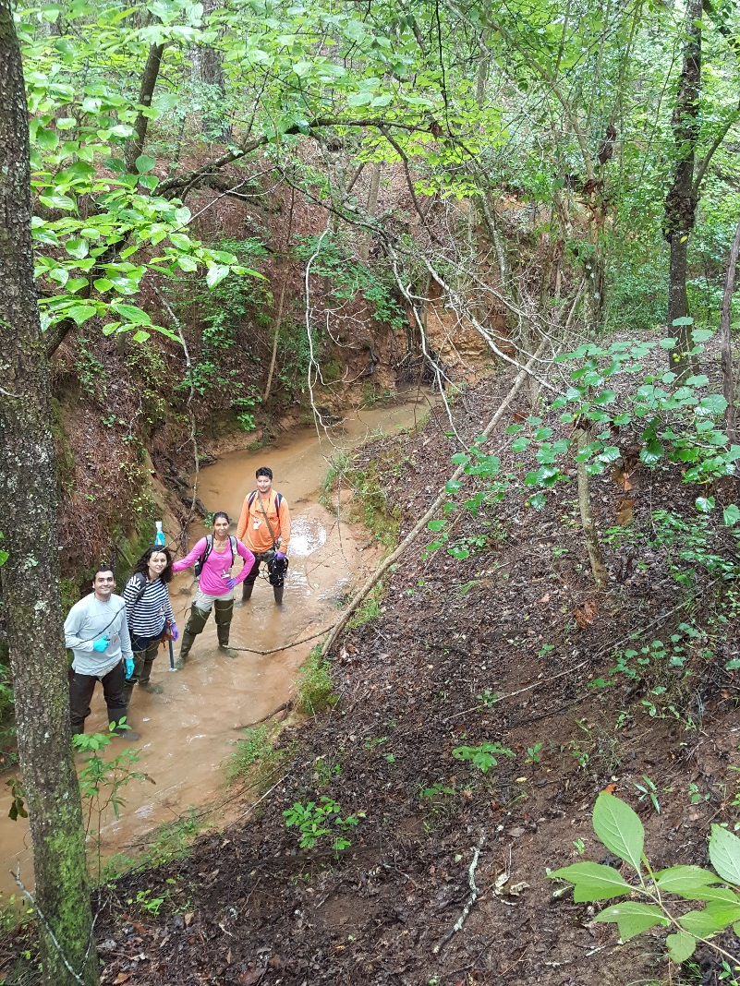
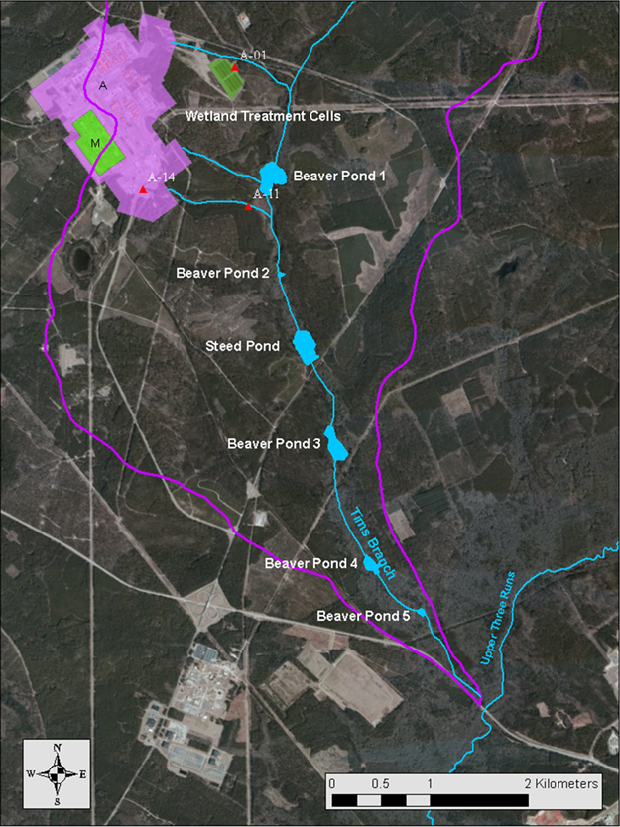
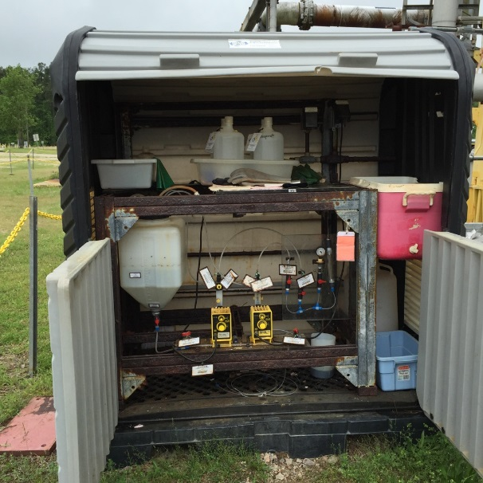
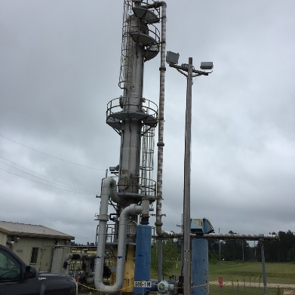
Surface Water Modeling of Tims Branch
Background
  Tims Branch watershed impacted by contaminated discharge from SRS A/M Area laboratories and facilities.
  Tin (IV) dioxide released as byproduct of cleanup through A-014 OF.
  Tin (IV) oxide deposited as sediment along A-014 outfall tributary.
  Scientists postulate tin resuspension and remobilization during extreme rainfall.
  Potential impacts suggest need
  to monitor fate and transport of
  tin in environment.

Slide 37
Surface Water Modeling of Tims Branch
Objectives
Develop physically based numerical model as a tool to simulate surface hydrology at Tims Branch and its major tributary
Develop 2D model of overland flow in Tims Branch watershed using MIKE SHE
Develop geodatabase and apply GIS tools to support surface hydrology framework and modeling
Measure flow discharge along Tims Branch and A-014 using in-situ flow meter
Develop standalone 1D model of stream flow for Tims Branch using MIKE 11
Develop standalone 1D model of A-014 outfall
Measure water quality using YSI multi-parameter meter
Collect water samples along Tims Branch and A-014 to measure suspended particle concentration
Conduct cross section measurement and profiling along Tims Branch and A-014
Conduct fieldwork to collect in-situ data and samples for hydrology model development, calibration, and application
Pre- and post-process model configuration parameters using ArcGIS tools
Conduct geospatial analyses
Utilize ArcGIS platform for visualization of hydrological model results

Slide 38
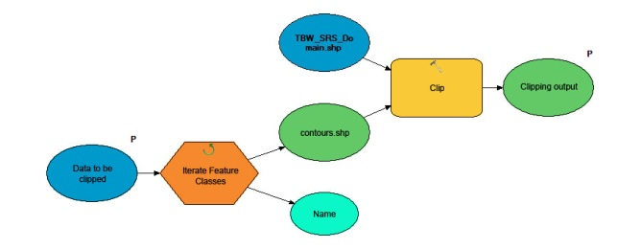
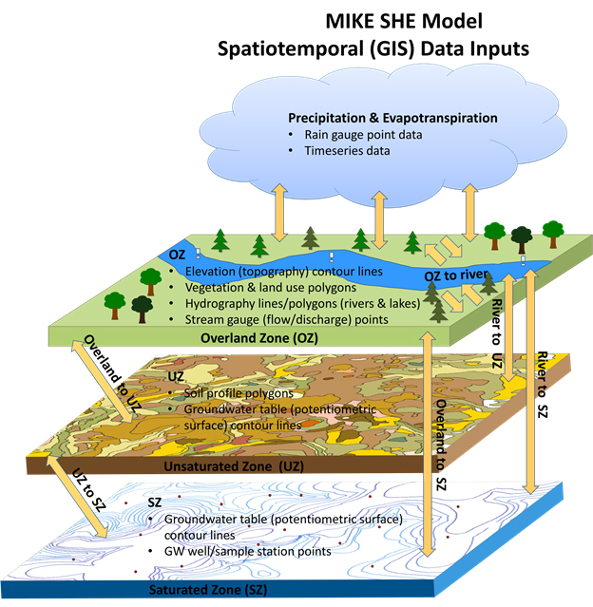
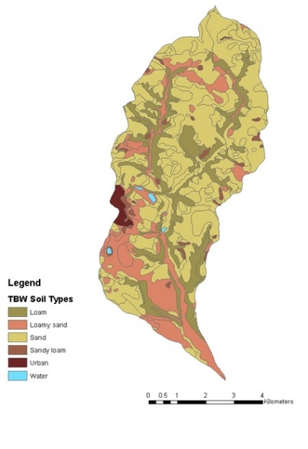
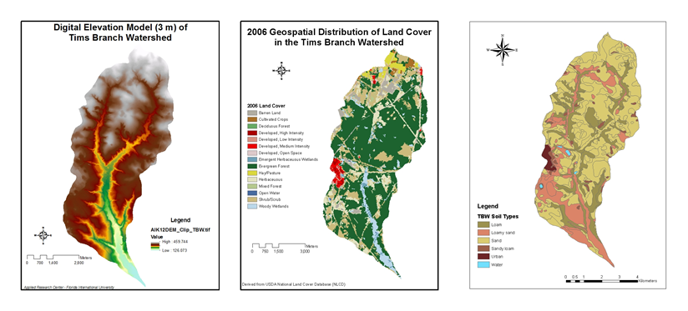
GIS for Hydrological Modeling Support
Highlights
SRS/Tims Branch Geodatabase: Foundation for management, storage, processing, analysis and visualization of hydrological model data.
  Geospatial & timeseries data:
  (topography, land cover, precipitation, groundwater elevation, geology, etc.)
  Federal/State data sources:
  (USGS/EPA/USDA/DOI/SCDNR/SRNS)
  Scalable and replicable infrastructure:
  (applicable at other DOE sites)
ArcGIS platform & tools: Improve overall efficiency. Save time.
  ArcToolbox: Geoprocessing, feature delineation, geospatial analysis
  ModelBuilder: Automation and batch processing of model data
Process Flow
Model

Slide 39
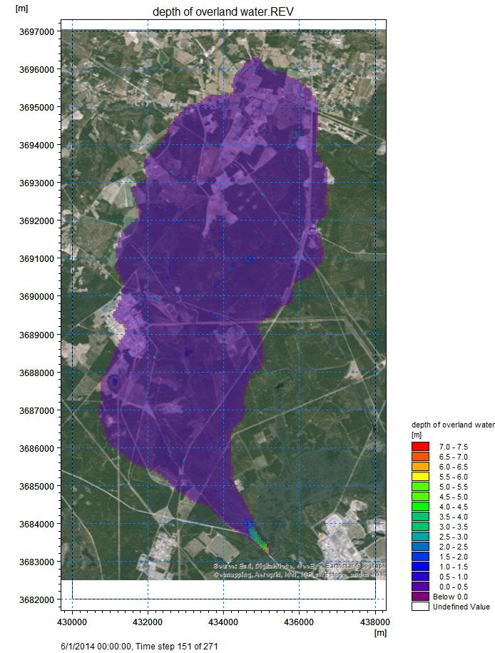
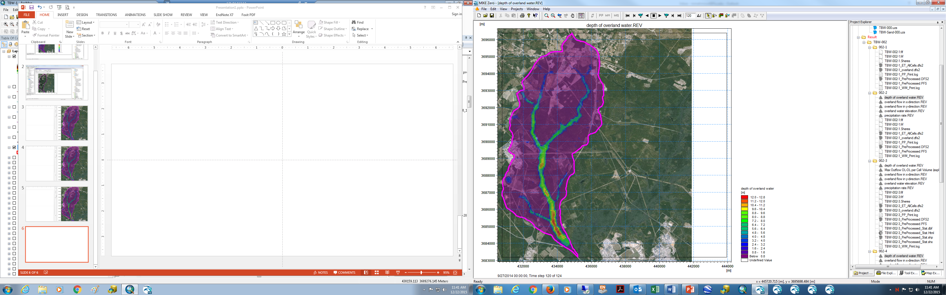
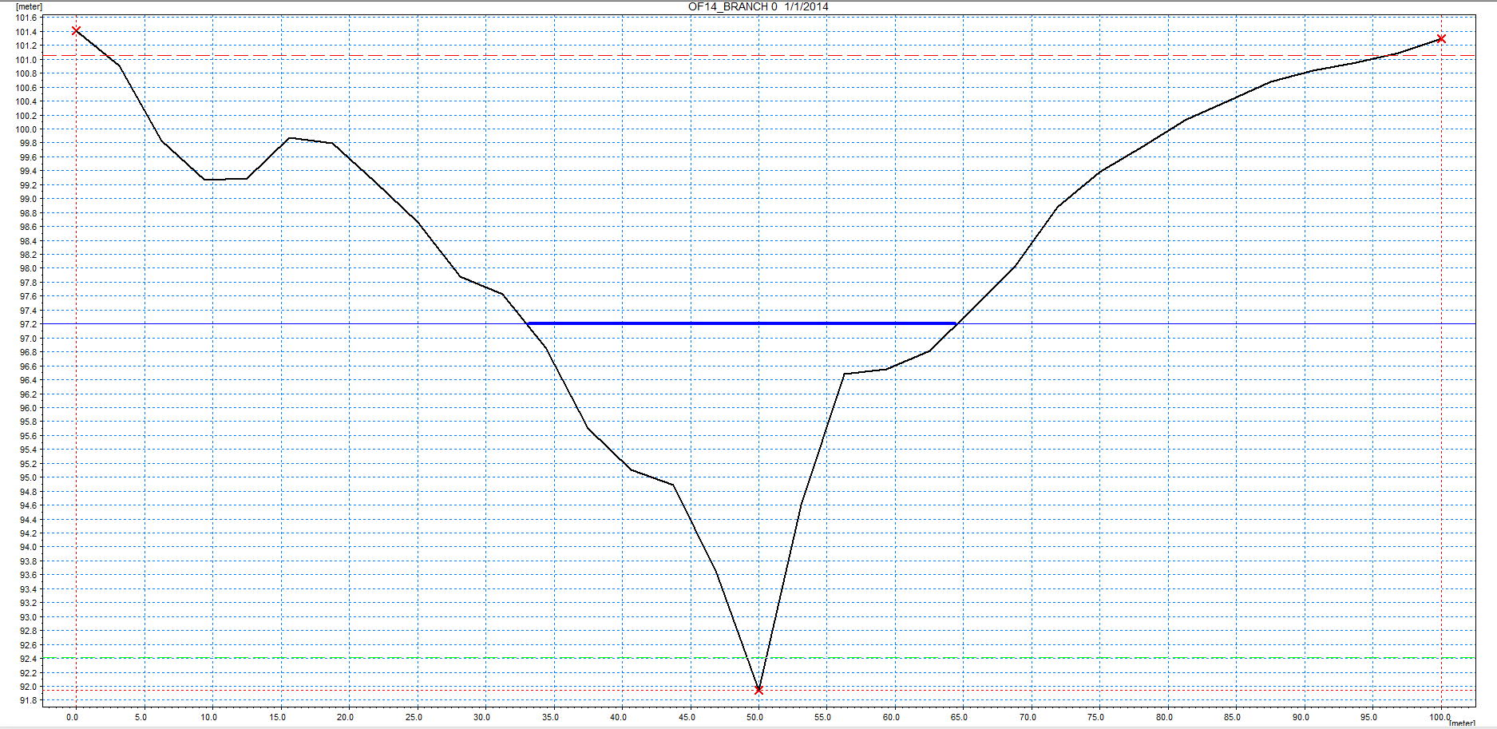
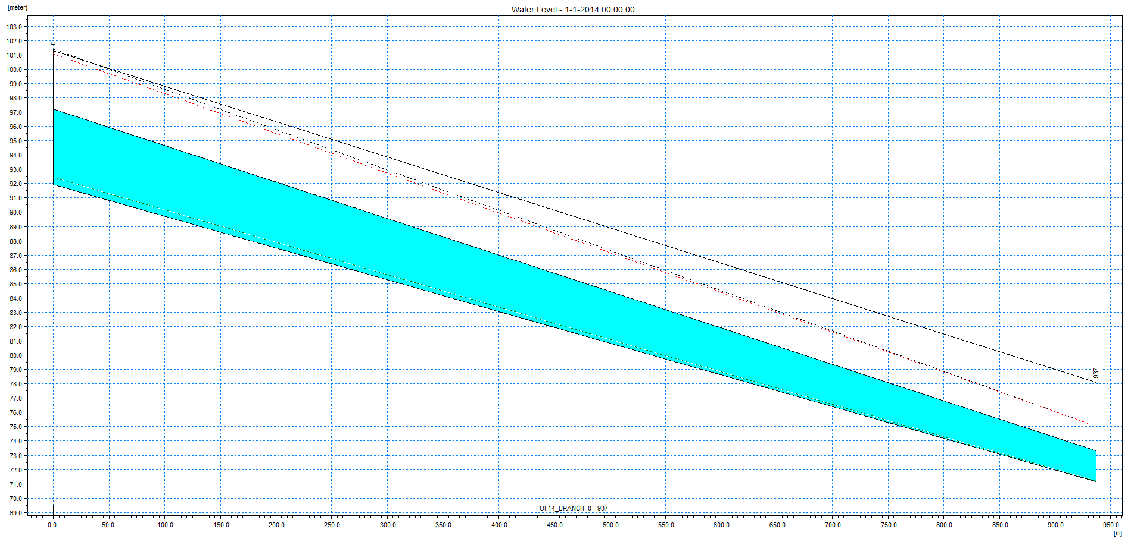
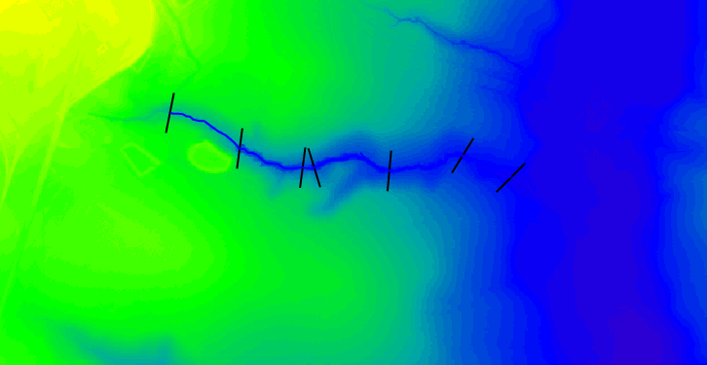
Hydrology Modeling
Highlights
Conceptual model of Tims Branch
MIKE SHE 2D model of overland flow for Tims Branch watershed
Preliminary setup for MIKE 11 1D stream flow of A-014 outfall tributary

Slide 40
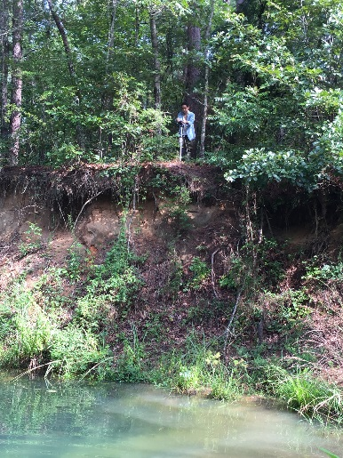
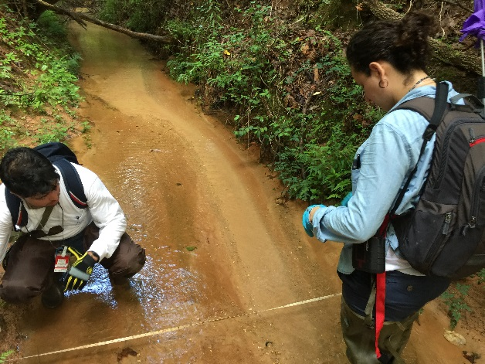
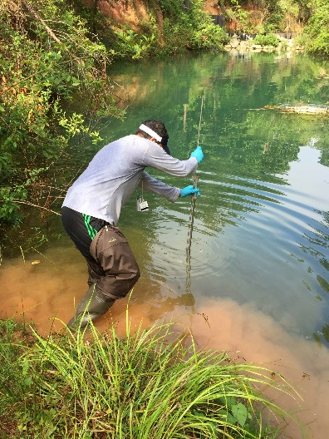
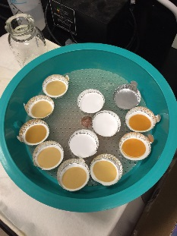
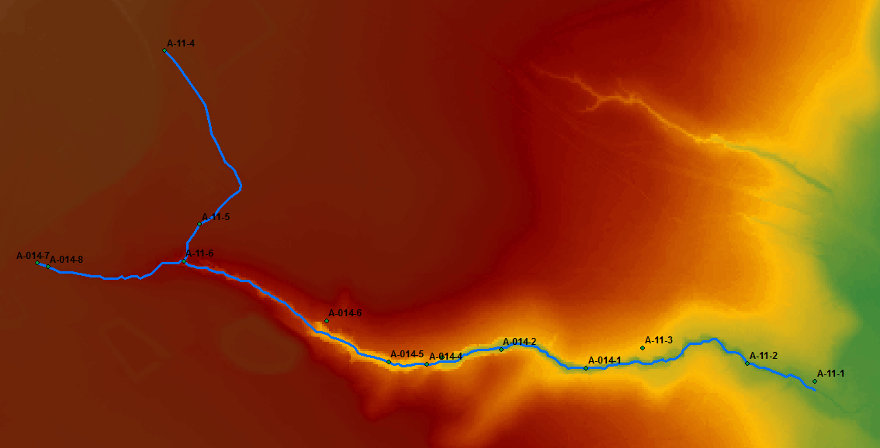
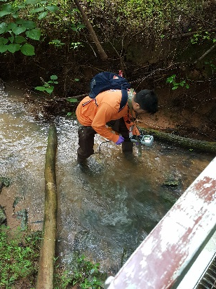
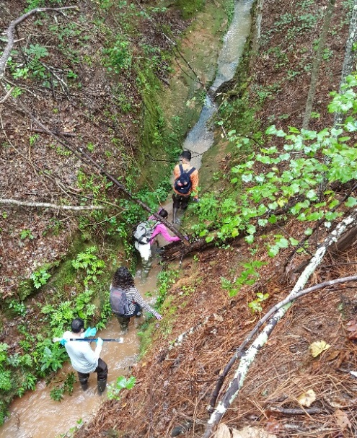
In-Situ Data Collection and Sampling
Highlights
August 2016: 4 days of field and lab work at SREL
  Conducted by ARC research staff and 3 students
  Approx. 22 locations visited
Cross section profiling along A-014 and Tims Branch
Field measurements:
  Discharge
  Water quality: temperature, pH, turbidity
  Suspended particle concentration: Approx. 33 water samples collected and analyzed

Slide 41
Surface Water Modeling of Tims Branch
Tasks for FIU Performance Year 7
Calibration of Tims Branch overland flow and A-014 OF stream models
Model sensitivity analysis
Rainfall frequency analysis and scenario design
Scenario analysis
MIKE SHE model refinement
Coupling of MIKE SHE and MIKE 11 hydrological models
Estimation of Evapotranspiration (ET) to generate ET time series
Implementation of alternative distributed hydrologic, flow and transport model
Data analysis and visualization
Seasonal sampling and data collection of A-014 and Tims Branch

Slide 42
Task 5
LANL-ARC Collaboration
Hilary P Emerson (FIU-ARC)
Frances Zengotita (FIU-ARC, DOE Fellow)
Timothy Dittrich (LANL)
Michael Richmann (LANL)
Don Reed (LANL Team Leader) Russ Patterson (DOE-CBFO)
Research performed at the Carlsbad Environmental Monitoring and Research Center (CEMRC) operated by New Mexico State University

Slide 43
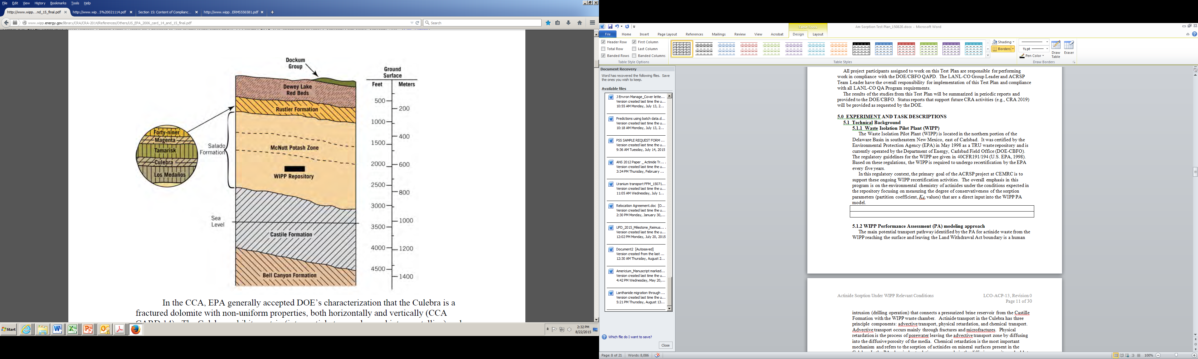
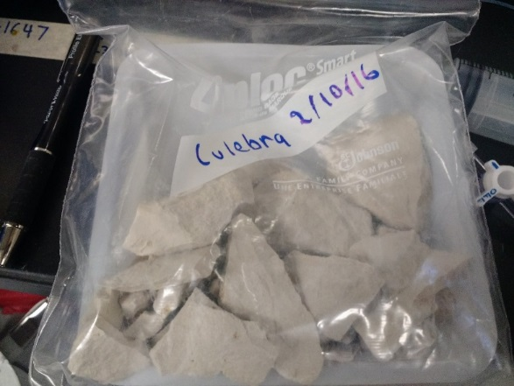
Task 5
WIPP Release Scenario
Objective: To further our understanding of the sorption of trivalent actinides and lanthanides in WIPP-relevant minerals
Human Intrusion is most likely per cuttings, cavings or spallings
*Leads to direct and/or long-term brine release
Horizontal brine release through Rustler formation (most transmissive)
*Most permeable layer- Culebra dolomite [CaMg(CO₃)₂]
Notes:
Cuttings and cavings – solids may be carried to the surface by drilling fluid in the event that a borehole intersects a pressurized brine pocket and disposal room, leading to flooding of the room and subsequent transport through boreholes to the highly transmissive Culebra layer or the surface
Spallings – occur when a borehole intersects a disposal room with pressure buildup exceeding 8 Mpa drilling fluid pressure and leading to waste ejection
Rustler formation is 7-8 m thick, it is an argillaceaous and arenaceous dolomite-rich member (Domski et al 2011), it is confined between mixed carbonate/sulfate/halite Los Medanos below and sulfate bedded-Tamarisk above
Magenta member is 7-8 m thick with a carbonate-rich layer overlain by a nodular sulfate-rich gypsum confined between the sulfate beds of the Tamarisk and anhydrite Forty-niner

Slide 44
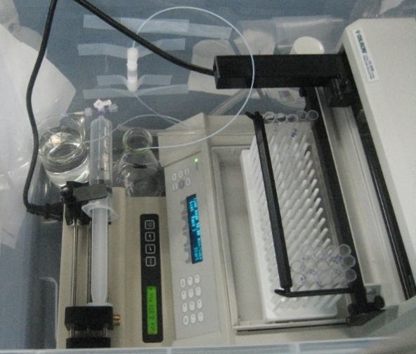
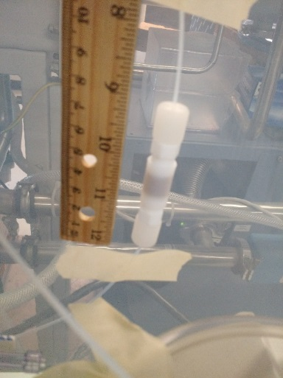
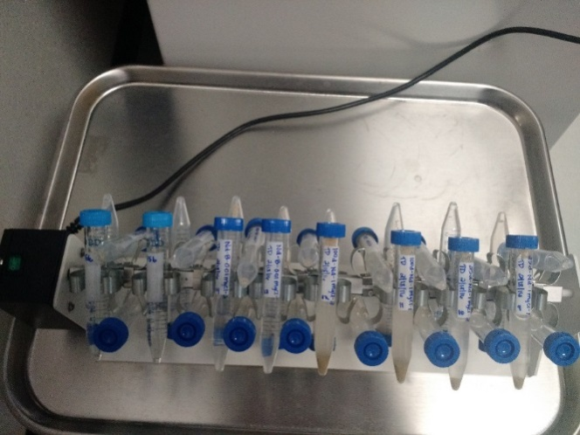
Task 5
Materials and Methods
Focus is simplified brines, i.e. NaCl
Batch sorption (Equilibrium and kinetics)
  Initially 20 ppb Nd
  5, 25 and 100 g/L dolomite
  0.01 - 5.0 M IS (3 mM NaHCO₃ + NaCl)
  Target pH 8.6
Continuous injection mini columns
  1 cm column (~1 gram dolomite, porosity 0.32)
  0.01 - 5M IS (3 mM NaHCO₃ + NaCl)
  20 ppb Nd
  Target pH 8.6

Slide 45
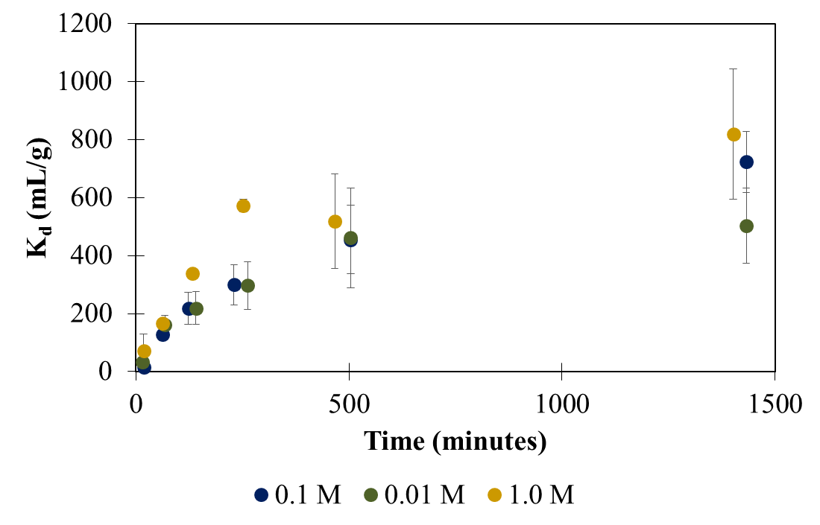
Task 5
Highlights
Accomplishments: Submitted abstract to AGU 2016 and McNair 2016, deployed Dr. Emerson to LANL CEMRC for ten weeks in Spring, recruited DOE Fellow Zengotita
20 ppb Nd(III) – IS as NaCl + 0.003 M NaHCO₃
Note: Appears to follow first order kinetics up to 200 minutes, then kinetics reach equilibrium

Slide 46
Task 5
Preliminary Conclusions
Preliminary K_{d} 500-900 mL/g (for ionic strength from 0.01 – 1.0 mol/L) – equivalent to R = 4800 - 8500
Recommended K_{d} range for Pu(III) and Am(III) for WIPP conditions 20 – 400 mL/g (Brush, 1996)
What does this mean?
Strongly sorbing contaminant (>80% sorption)
Previous model is likely over predicting transport (overly conservative)
Tasks for FIU Performance Year 7
Continue 0.01M – 5M [NaCl + 3 mM NaHCO₃] column and batch experiments with 20 ppb Nd [1.2x10-7 M]
Model results via PHREEQC
Am(III) for comparison to our trivalent analog, Nd(III)
Relevant ligands? EDTA, DFOB, oxalic acid?

Slide 47
Questions

