Slide 1
DOE-EM Cooperative Agreement
FIU Performance Year 6
Year End Research Review
Presented: September 21, 2016
to the U.S. Department of Energy
Dr. Leonel Lagos, PhD, PMP® (Principal Investigator)

Slide 2
FIU-DOE Year End Research Review
Wednesday Sept 21, 2016 Morning | Wednesday Sept 21, 2016 Afternoon
9:00 - 10:00 Workforce Development & Training (FIU Project 4) | 1:00 - 2:00 High Level Waste / Waste Processing (FIU Project 1)
10:00 - 11:00 D&D and IT for EM (FIU Project 3) | 2:00 - 3:00 Soil/Groundwater (FIU Project 2)
Presentations available at doeresearch.fiu.edu

Slide 3
FIU Project 3
Waste and D&D Engineering and Technology Development

Slide 4

Project Clients and Collaborators
DOE EM:
Andrew Szilagyi, John De Gregory, George Cava, Rosa Elmetti, Ana Han, Jonathan Kang
SRNL:
Michael Serrato, Aaron Washington, Connor Nicholson

Slide 5
Cooperative Agreement Research Areas and Impact on DOE EM Environmental Restoration Mission
D&D and Information Technology for DOE EM
Project 3: Waste and D&D Engineering and Technology Development
DOE Technical Challenge - D&D:
Completing the D&D of active/excess/abandoned facility to a final disposition end state in a timely and safe manner; Preserving and transferring D&D knowledge and information to assist future D&D projects and the future workforce.
  FIU Research:
  Providing D&D technology innovation, development, and evaluation results and information needed to complete challenging D&D safely and effectively. Maintaining and preserving the D&D knowledge base by enhancing communication, information sharing and distribution, and collaboration within the D&D community of practice.
DOE Technical Challenge - Waste & Materials Disposition:
Managing waste forecast information for planned treatment/disposal across the DOE complex.
  FIU Research:
  Providing a web-based tool to receive, organize, and report DOE waste forecast data from across the complex via a common application which provides efficiency to waste disposition decision making.

Slide 6
  D&D Tasks
Mr. Joseph Sinicrope

Slide 7
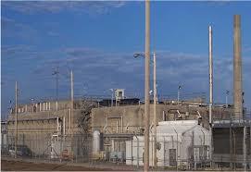
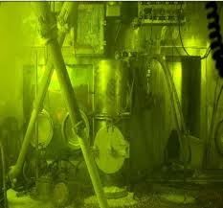
Background: Basis for Interim Operations (BIO) for SRS 235-F
Potential consequences of a seismically-induced full-facility fire are greater than 10 rem offsite and 27,000 rem to the collocated worker at 100 meters
Fires could start inside the building if energized electrical equipment or wiring failed or was damaged during a seismic or other natural hazard event
Very proactive fire preventive controls ISO D&D activities
  Eliminating potential ignition sources
  Controlling the amount of combustibles
  Removal of residual contaminants
  Identification and deployment of tools, fire resilient fixatives, etc.

Slide 8
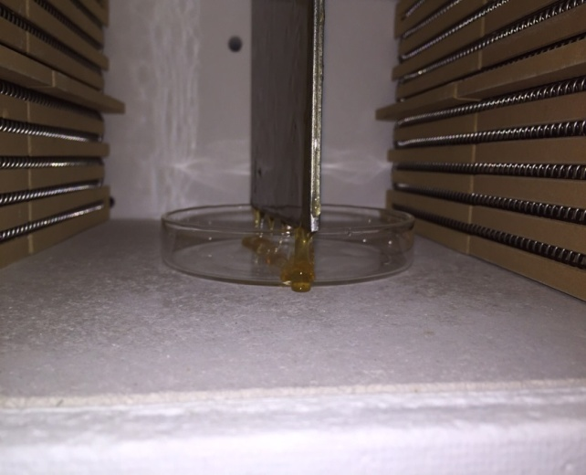
Baseline of Fixatives ISO D&D
Conducted extensive baseline of 5 industry fixatives and decon gels on various substrates (stainless steel, wood, glass, sheetrock)
Primary focus was on determining fire resiliency
  Exposure to open flame
  Incremental temperature increases in muffle furnace
Collected data on combustibility, mass loss, impact on adhesion, contaminant transport, chemical breakdown
Figure 1: Intumescent coating reacting to flame / heat source

Slide 9
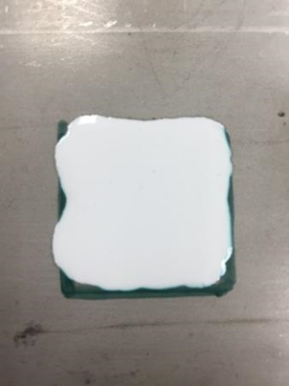
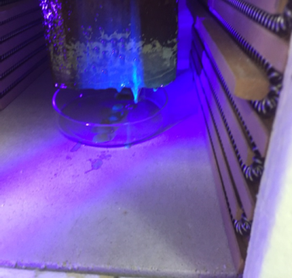
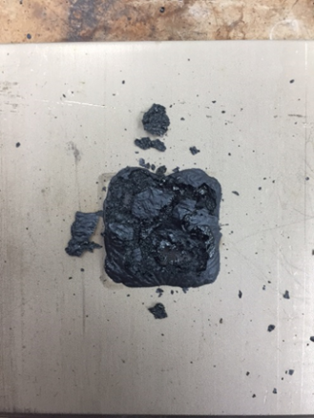
Basic Fixative Profile
Contaminant transport begins
Start: fixative intact
Finish: significant mass loss, discoloration, desiccation, cracking, and flaking.

Slide 10
Baseline of Fixatives ISO D&D
Executive Highlights
Melting / expansion / transport of fixative and contaminant began, on average, at 300⁰-400⁰ F within minutes of exposure
All 5 fixatives began to exhibit minor mass loss starting at temperatures as low as 200⁰ F, but most significant degradation in terms of mass loss, desiccation, chemical breakdown / change, etc. occurred between 600⁰-800⁰ F (ref matrix and charts)
All fixatives lost anywhere from 70% to upwards of 90% mass when exposed to incremental temperature increases (200⁰-800⁰ F). Again, greatest mass loss percentage occurred between 600⁰-800⁰ F.
All 5 fixatives “ignited” / became flammable almost immediately when exposed to the propane torch / open flame and burned completely between 1-5 minutes.

Slide 11
Enhancing Fire Resiliency of Fixatives
Problem Statement: Mitigate the potential release of radioisotopes under fire conditions during D&D and storage activities.
Goal: Improve operational performance of fixatives by enhancing their fire resiliency.
Potential Solution: Incorporate / adapt commercial-off-the-shelf intumescent coatings.
Explanation: Since 9/11, there have been significant improvements in fire retardant / fire resistant technologies, with intumescent coatings being at the forefront of this development. U.S. Military, NASA, oil and gas industry and others use this proven technology extensively to fire harden / protect facilities.
Fire and Thermal Protection Coating Examples
http://videos.sorensonmedia.com/Minerals+Technologies+Inc./firex.mp4/c2560e34-0cad-11e4-82d0-12313d27693b
https://www.youtube.com/watch?v=UjlZqIOW39s

Slide 12
Adaptation of Intumescent Coatings as a Fire Resilient Fixative
Designed to swell 50 to 100 times original thickness into an insulating char upon exposure to heat / fire
  Provides physical barrier to heat and mass transfer
Inhibits transport of volatiles to the environment and the transport of oxygen to unburned regions beneath char
  Retention of mass in the char limits further involvement of the underlying materials in the fire
Undergo rigorous ASTM, NFPA, UL, and UBC fire testing:
  UL 263 / UL 723 / ASTM E-119 / ASTM E-84 / ASTM E-2768/ UL 10B
  NFPA: 251 / NFPA: 255 / NFPA: 703 / NFPA: 252
  As context, ASTM E119 test subjects a given wall / structure to 24 gas flames that reach temperatures between 1800-2000º F for periods between 1-2 hours
Exceptionally cost effective (as low as $0.75 cents per square foot)
Easily applied via brush, roller, or sprayer to a wide variety of substrates (stainless steel, wood, sheetrock, sheet metal, etc.)
Very resilient to environmental conditions (heat, humidity, etc.)

Slide 13
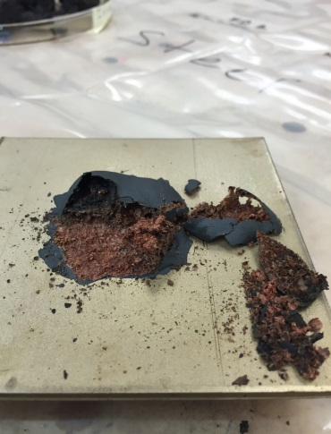
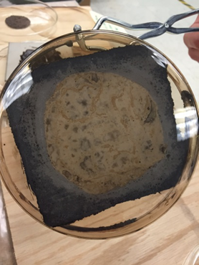
Proof of Concept Executive Highlights
Intumescent Coatings (IC)
All 5 fixatives, when layered with the intumescent coating, conclusively displayed enhanced fire resiliency
  Enhanced thermal insulation / protection
    Fixative and substrate remained relatively intact
  Mitigated flame spread and propagation
  Limited to no smoke
Some ICs have demonstrated potential as standalone fixative

Slide 14
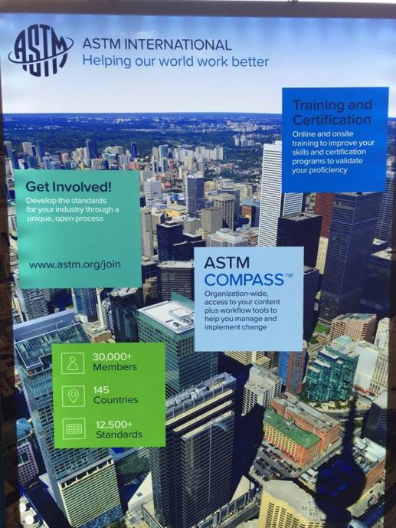
Testing Standards/Protocols for D&D
ASTM International
Engaging ASTM International on development and promulgation of testing standards and protocols for D&D technologies
Primary objective is to ensure standardized comparison metrics across the DOE-EM complex for similar technologies (apples to apples)
Current practices afford too much variance within technology categories
Serving as ASTM International E10.03 Subcommittee Chair and coordinating/ expediting standards development
Completed drafts of two new standards for fixatives and strippable coatings

Slide 15
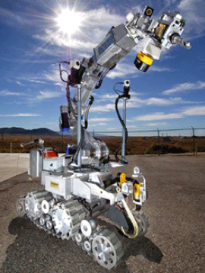
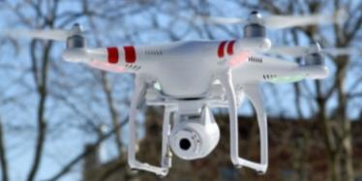
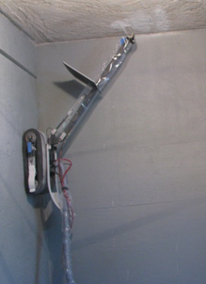

Robotic Technologies for D&D
Initial focus on robotic technologies relevant to SRS-235F problem set
Started with existing database in D&D KM-IT to identify all robotic technologies with potential for application to D&D challenges
Created information matrix of all potential robotic technologies
Phantom (DJI)
Mighty Mouse
(Sandia National Lab)
Remote Climber
(ICM)
HRP-3 Promet MK-II (Kawada Industries)

Slide 16
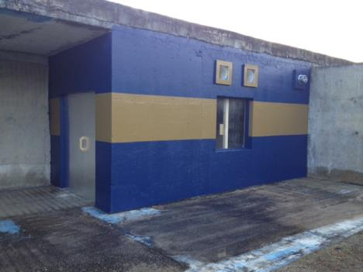
Tasks for FIU Performance Year 7
Conduct cold demo / test and evaluation of intumescent coating at FIU ARC on full scale SRS 235-F hot cell mock-up test bed
Support hot demo / test and evaluation in applying designated intumescent coating to contaminated area at SRS 235-F PuFF Facility
Continue baselining other intumescent coatings with a focus on improved adhesion and bonding characteristics
Identify potential broader applications of the intumescent coating technology to satisfy other problem sets and challenge areas related to fire / extreme heat conditions across DOE EM (e.g., WIPP).
Figure 1: Intumescent coating reacting to flame / heat source

Slide 17
Tasks for FIU Performance Year 7
Continue international standards development for D&D technologies via ASTM E10.03 subcommittee
Complete review, revisions, and finalize standards developed and drafted during FIU Performance Year 6
Identify next topic for standards development and begin drafting new standards and protocols for D&D technologies.
Figure 1: Intumescent coating reacting to flame / heat source

Slide 18
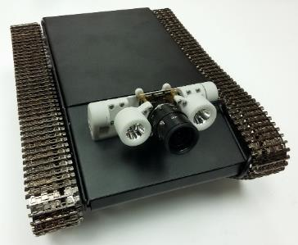
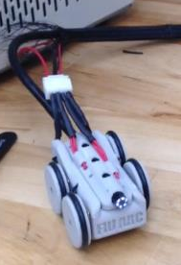
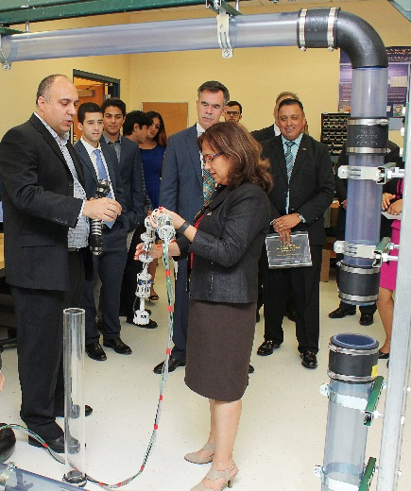
Tasks for FIU Performance Year 7
Identify cross-cutting applications of robotic technologies being developed at FIU in the high-level waste research area that could potentially be used in support of D&D activities.
  Collaborate with SRNL to define the requirements for a robotic technology to meet the D&D challenge(s) at the SRS 235-F facility.
  Evaluate the potential for adapting and applying in-house technologies being developed and/or tested at FIU in the high-level research area (e.g., mini-rover inspection tool, peristaltic crawler, flying drone) to meet the defined D&D requirements.
  If potential for one of the technologies for the required application is identified, develop an initial conceptual design for adapting the technology and perform basic proof-of-concept testing on a small scale.
Notes:
Waste Information Management System (WIMS) (Task 1)
WIMS is deployed and accessible on the web at http://www.emwims.org
Maintain WIMS operations - database management, application maintenance, performance tuning, and perform annual data update
D&D Support to DOE EM for Technology Innovation, Development, Evaluation, and Deployment (Task 2)
Develop and refine decision-support model for selecting fixatives, strippable coatings, and decontamination gel products for specific site applications
Develop remote high rad access technology, e.g., SRS 235-F Facility, to include technology such as a tether-less remote wall climber system
Complete applied research on dual-purpose organic semiconductor thin films for polymer interface and electrostatic applications applicable to SRS 235-F and the DOE complex for radioactive waste handling and packaging
Complete applied research on incombustible fixatives supporting the SRS 235-F facility
Fogging research and evaluation in support of the SRS 235-F facility
Collaborate with DOE EM-13 and the D&D community of practice in the identification and development of Lessons Learned and Best Practices related to D&D
D&D KM-IT – (Task 3)
Mobile applications: selection of fixatives, strippable coatings, & decon gels; distributed data collection from low cost sensor networks
Mobile “friendly” website compliant
Maintain operational and data inventory development of the D&D KM-IT data-base
Continued enhancements through -
Search Engine Optimization
Web Analytics (Quarterly & Annual)
Video & Photo Library
Lessons Learned and Best Practices
Continue outreach activities – e.g., workshops, conferences, newsletters
Implement the “D&D Knowledge Management Information Tool – A Strategic Approach for the Long-Term Sustainability of Knowledge” document

Slide 19
  Deactivation and Decommissioning
  Knowledge Management
  Information Tool (D&D KM-IT)
Dr. Himanshu Upadhyay

Slide 20
D&D KM-IT Goal
To attain the long-term active use, operation, and continued growth of the D&D knowledge from across the D&D global community and capture within the D&D KM-IT system resulting in enhanced worker safety, improved operational efficiencies, improved communication & knowledge among stakeholders, and the cross-generational transfer of D&D knowledge to the future workforce.

Slide 21
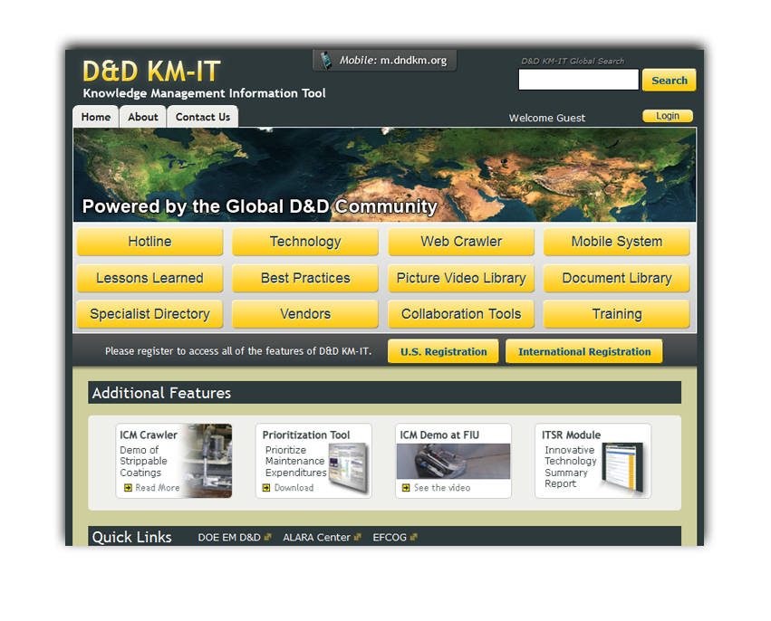
D&D KM-IT
D&D KM-IT is successfully deployed and can be accessed from the web address http://www.dndkm.org.
A web-based knowledge management information tool custom-built for the D&D user community by FIU-ARC in collaboration with DOE, EFCOG, and the former DOE ALARA Centers.

Slide 22
Knowledge Management Information Tool
Hotline
Web Crawler
Mobile System
Training
Technology
Document
Library
Collaboration Tools
Picture Video Library
Best Practices
Lessons Learned
Specialist Directory
Vendors
D&D KM-IT Modules
Notes:
Go over summary and conclusion

Slide 23
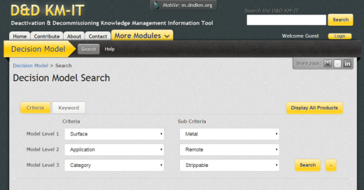
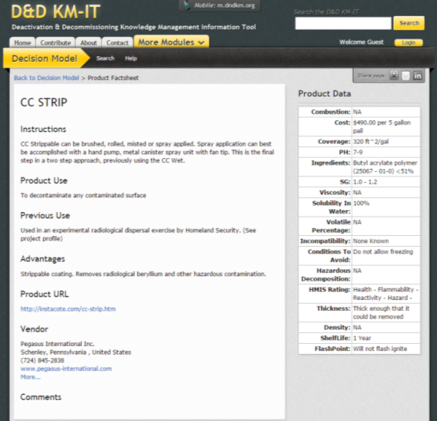
D&D Fixative Module
D&D Fixative Module for the Selection of Fixatives, Strippable Coatings, and Decontamination Gels
Developed new module to assist in the selection of available industry contamination control products
Beta testing by field site users prior to public launch
Web-based and mobile versions of the D&D Fixative Module were deployed live on June 29, 2016

Slide 24
D&D KM-IT – Outreach
Participation in conferences (e.g., Waste Management Symposium, DD&R, etc.)
Newsletters to registered D&D KM-IT users & SMS
Periodical memos from DOE HQ to site managers
Collaboration with other databases/systems like Decontamination and Decommissioning Science Consortium (DDSC), OSTI and ORAU
Engage DOE Project Directors and DOE EM IT
Engage user involvement via a user advisory group
Share knowledge by contributing to wiki resources like Wikipedia and DOE’s Powerpedia

Slide 25
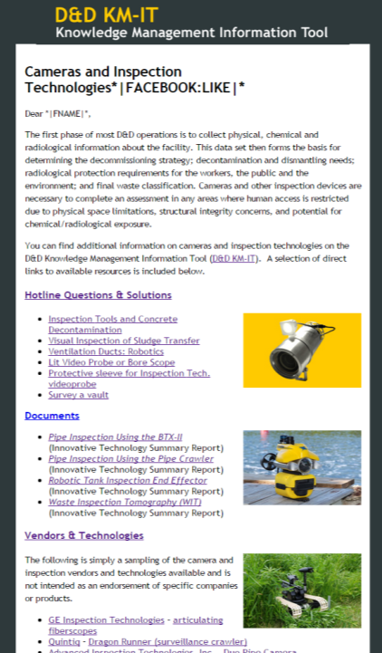
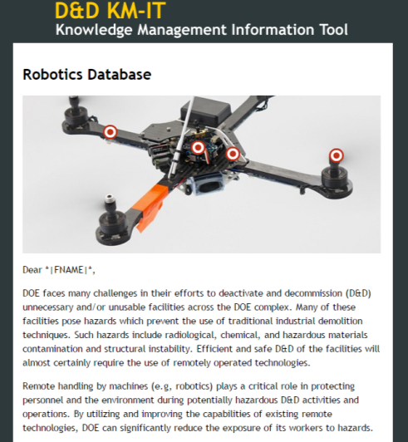
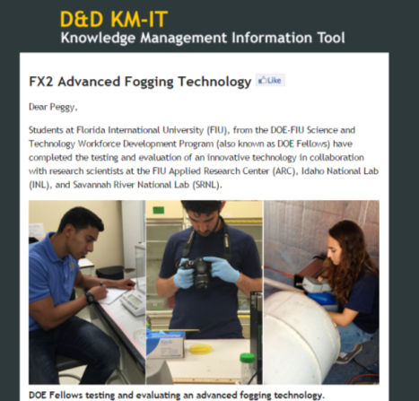
D&D KM-IT User Outreach
Developed and distributed newsletters:
Availability of Robotics Database
FX2 Advanced Fogging Agent Test/Evaluation
Inspection Technologies/Cameras
Availability of D&D Fixative Module

Slide 26
D&D KM-IT Statistics as of Sept 2016
919 registered users
101 subject matter specialists
948 D&D vendors
1297 D&D technologies
494 robotic technologies
195 questions and solutions in Hotline module
Yellow – 2012
Blue - 2016
Vendors
Techs
Users
SMS
Growth from March 2012 to September 2016
Fully searchable resources – Original sources no longer available
169 ALARA Center reports archived
231 Innovative Technology Summary Reports archived

Slide 27
Web Analytics – Method & Application
To measure and optimize web usage
Provides baseline measurements of critical metrics
Used to improve weak metrics and enhance strong metrics
Follow up on feedback from visitors
Measures the impact of D&D KM-IT on the D&D community
Web Analytics
Measure
Report
Analyze
Optimize
Notes:
Go over summary and conclusion

Slide 28
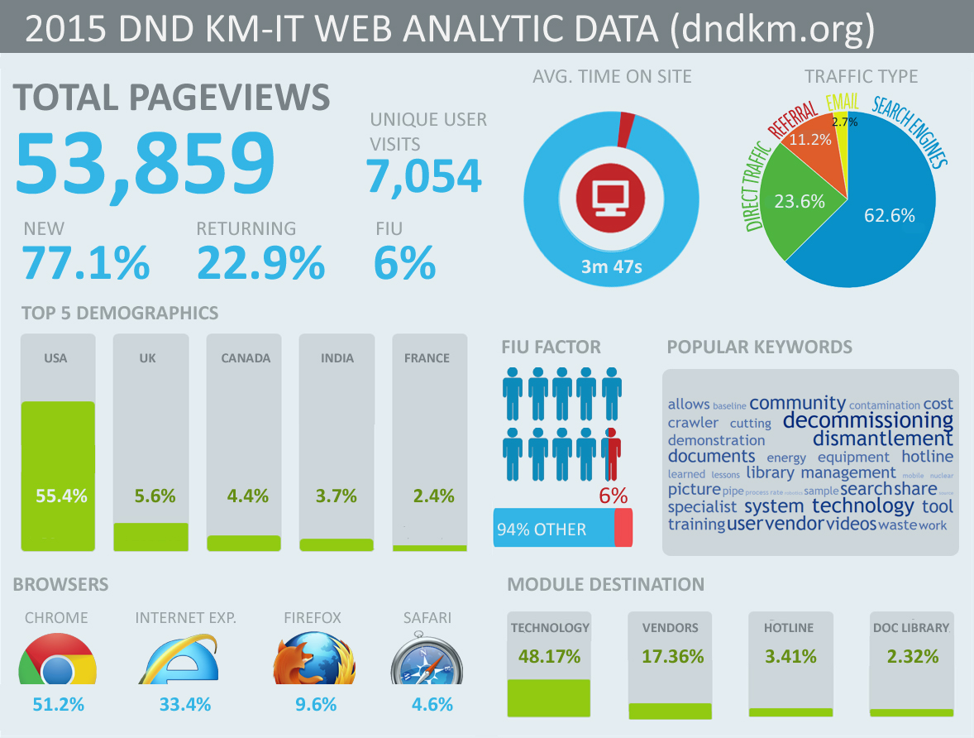
D&D KM-IT Web Analytics Infographic

Slide 29
Tasks for FIU Performance Year 7
Outreach to promote KM-IT at DOE sites and national labs, such as Oak Ridge and Savannah River.
Research creating native mobile applications for each of the three major mobile device platforms (Windows, Android and I-OS) using fixatives as a pilot.
Work with DOE sites to identify additional high priority needs for mobile applications.
Implement initial social media integration with D&D KM-IT to allow Like/Share/Pin to Facebook, Twitter, LinkedIn, and Pinterest. Create pilot to utilize YouTube as platform for D&D KM-IT videos.
KM-IT content management with focus on increasing information on robotics technologies as well as general D&D technologies.
Web Analytics monitoring of the KM-IT platform with Google Analytics, application optimization and reporting / visualization.

Slide 30
  Waste Information Management System (WIMS)
Dr. Himanshu Upadhyay

Slide 31
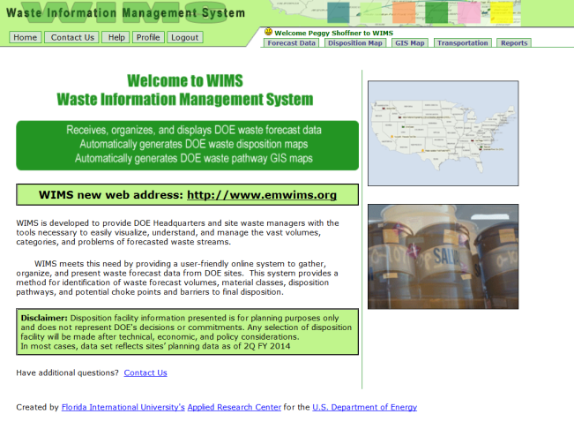
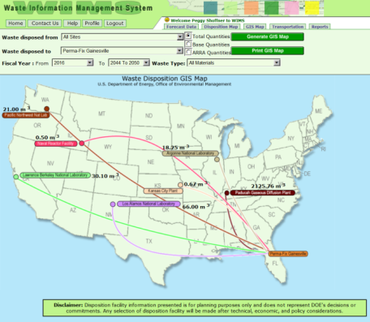
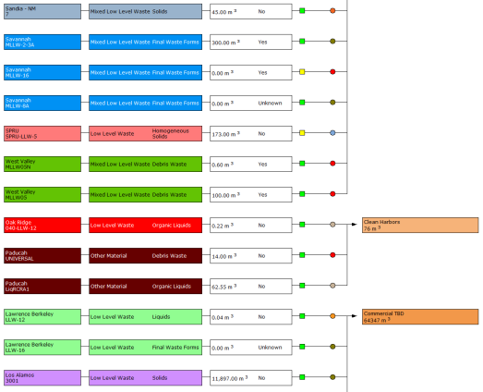
Waste Information Management System
WIMS is successfully deployed http://www.emwims.org
Easy-to-use tool to visualize and understand the forecasted DOE waste streams.
Completed integration of 2016 waste forecast and transportation data into WIMS.
New 2016 dataset launched on public website on June 14.

Slide 32
Tasks for FIU Performance Year 7
  Maintain WIMS via database management, application maintenance, and performance tuning.
  Integrate annual forecast data update.

