Slide 1
DOE-EM Cooperative Agreement FIU Performance Year 6 Year End Research Review
Presented: September 21, 2016
to the U.S. Department of Energy
Dr. Leonel Lagos, PhD, PMP® (Principal Investigator)

Slide 2
FIU-DOE Year End Research Review
Wednesday Sept 21, 2016 Morning | Wednesday Sept 21, 2016 Afternoon
9:00 - 10:00 Workforce Development & Training (FIU Project 4) | 1:00 - 2:00 High Level Waste / Waste Processing (FIU Project 1)
10:00 - 11:00 D&D and IT for EM (FIU Project 3) | 2:00 - 3:00 Soil/Groundwater (FIU Project 2)
Presentations available at doeresearch.fiu.edu

Slide 3
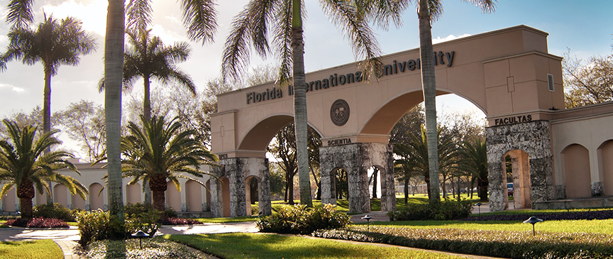
Florida International University
FIU is a vibrant, 55,000 student-centered public research university located in Miami, Florida. FIU is worlds ahead in its commitment to learning, research, entrepreneurship, innovation, and creativity so that graduates are prepared to succeed in a global market.
FIU is among the largest Hispanic-serving institutions in the U.S. and is designated a Minority-Serving Institution.
As a top-tier research institution, FIU emphasizes research as a major component in its mission.
FIU averages over $100 million in research annually.

Slide 4
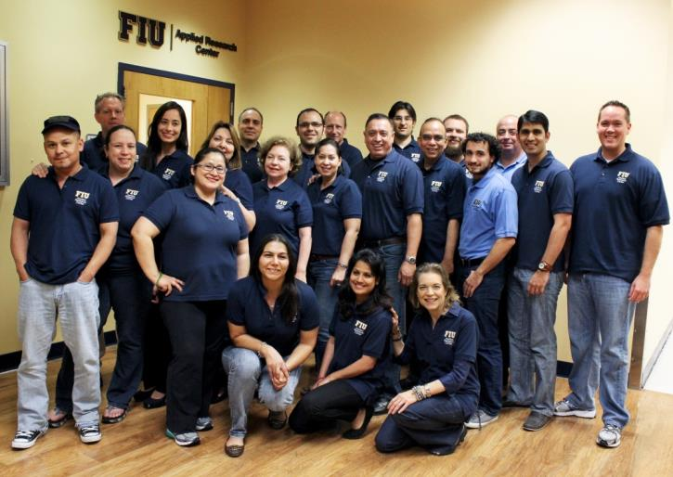
FIU’s Applied Research Center Serves as a Portal to FIU
Founded in 1995, ARC has executed over $100 million in research with DOE, DoD, other Federal and State Agencies as well as private industry.
ARC’s Portal Concept provides ease of access to FIU’s Colleges and Centers to facilitate collaborative research.
ARC’s mission is to provide world-class R&D and technology solutions to clients.
ARC’s multicultural, multilingual staff are client service-oriented professionals and include Project Management Professionals (PMP®) and Professional Engineers (PE).
Successful STEM Workforce Development Programs (DOE Fellows and Cyber Fellows).

Slide 5
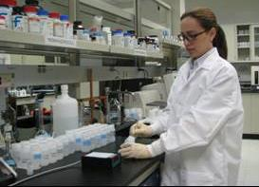
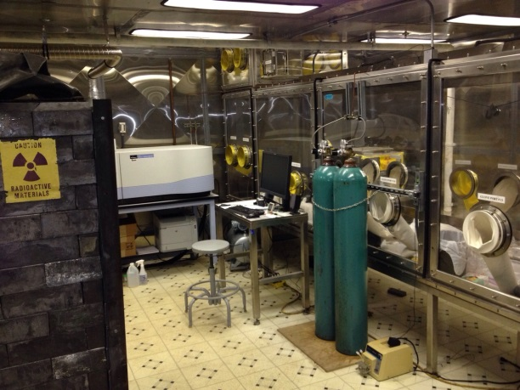
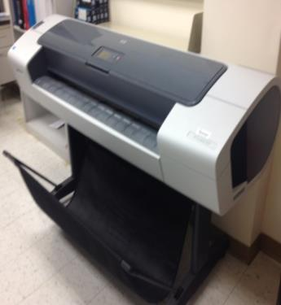
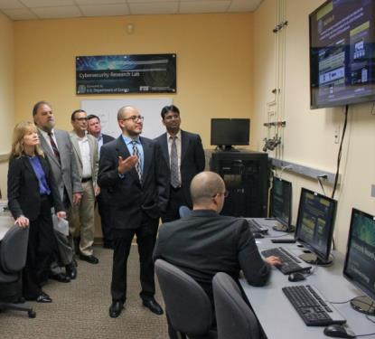
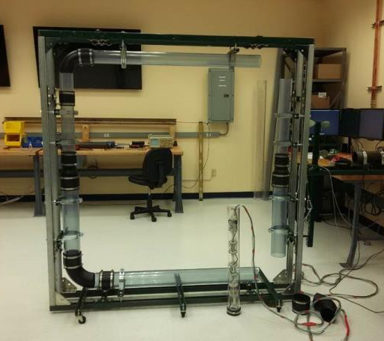
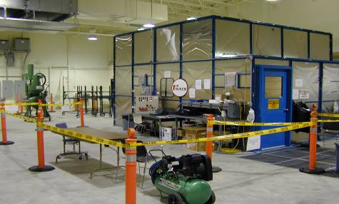
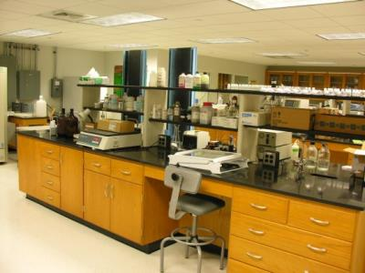
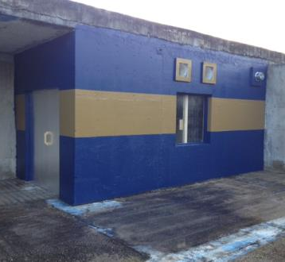
Applied Research Center Facilities
Robotics & Sensors Lab - Technology Testing & Demonstration Facility – Radiological Lab – Analytical Chemistry Lab – Soil & GW Lab – Multi-Function High Bay – GIS Lab – Cybersecurity Lab – Secure Server Room – Engineering Design Center – Machine Shop

Slide 6
DOE-FIU Cooperative Agreement History
Dates
November 1995 – EM awarded a five-year grant to FIU to develop expertise in decontamination and decommissioning, high-level waste tank, and characterization innovative technologies to solve EM environmental restoration challenges.
October 2000 – EM awarded FIU another 5-year Grant.
February 2005 – EM awarded a new 5-year Cooperative Agreement Renewal Award for continuation of services with FIU.
April 2007 – EM & FIU established a STEM student workforce development “pipeline” initiative – DOE Fellows Program.
May 2010 – EM renewed FIU’s 5-year Cooperative Agreement.
August 2015 – EM renewed FIU’s 5-year Cooperative Agreement.
FIU’s expertise and facilities evolution stem from support of T&E under the former large-scale demonstrations initiated by the D&D Focus Area.
The history between DOE EM and FIU has developed a relationship that allows a unique integration and collaboration of national experts at DOE national labs and sites, FIU faculty and ARC researchers, and FIU minority STEM students to provide technical solutions for DOE’s high priorities/high impact environmental challenges.

Slide 7
Current Cooperative Agreement Research Efforts
FIU is providing continuing support in research areas that support DOE EM’s vision and DOE field site priorities:
Robotics (e.g., applications in HLW, D&D, etc.) for SRNL and PNNL – FIU has special niche in developing remote systems for HLW applications
Soil & Groundwater R&D (e.g., Tc-99, Iodine, Co-contaminants, etc.) for PNNL, SRNL, and LANL
High Level Waste for Tank Farm, PNNL, and WRPS
D&D Technology Testing & Evaluation for SRNL and Idaho
Waste and knowledge management systems for EM (KM-IT and WIMS) for all DOE field sites and HQ
STEM Students Workforce Development & Training (DOE Fellows) for DOE and contractor future workforce

Slide 8
Current Cooperative Agreement Research Efforts
The Cooperative Agreement is developed to provide university support to DOE EM, which is distinct from the support provided by industry contractors:
FIU is field site oriented with research focused on success of the field sites
Student development is integral to the university’s mission
Student academic progress is tied to the DOE EM research performed by FIU for undergraduate senior design projects, masters’ theses, and PhD dissertations
Changes in research direction and task scope must evaluate impact to current/future student studies, especially the impact to completion of masters and PhDs

Slide 9
Cooperative Agreement Team
FIU
ARC Research Staff
FIU Students and DOE Fellows
FIU Faculty
DOE HQ
DOE HQ Project Leads
DOE EM Offices
Technical Monitor
Field Sites
DOE Field Offices
DOE Sites
National Research Laboratories
DOE-FIU Cooperative Agreement
Notes:
FIU Cooperative Agreement operates in a integrated “project-ized” fashion.
This approach has evolved over the past 20-years of the cooperative agreement’s history.
Four Projects center on key topical areas:
HLW
S&G
D&D and knowledge management IT
Future “workforce development”
Projects are generally comprised of representatives for the Sites, Labs, FIU, and HQ elements.
Project scope centers on addressing key scientific/technical problem areas/challenges facing EM sites and their environmental cleanup campaigns.
Project Development - during the course of each performance year the Project Teams :
Coordinate, Monitor, and help to facility project scope execution –
Sites & HQ provide ongoing feedback to FIU
FIU keeps team members updated on progress
Identify & prioritize scope for the next performance year under the Cooperative Agreement’s project description structure (FIU works closely with sites & other team members)
Mid-year and end-year project presentations to HQ Project Leads, HQ Management & Sites and Labs
Monthly status reports
Also – quarterly and annual per cooperative agreement requirements

Slide 10
FIU Project 4 DOE-FIU Science and Technology Workforce Development Program

Slide 11
Cooperative Agreement Research Areas and Impact on DOE EM Environmental Restoration Mission
STEM Workforce Development
Project 4: DOE-FIU Science & Technology Workforce Development
DOE Challenge: A significant portion of the EM workforce (DOE & contractors) is nearing retirement age, contributing to a shortage of a well-trained technical workforce to continue EM’s mission.
FIU Research: Providing a pipeline of FIU STEM minority students trained and mentored to enter the DOE workforce in technical areas of need - the DOE Fellows traineeship program.

Slide 12
Program’s Components
Paid 10-week summer internships at DOE national laboratories, DOE sites, DOE-HQ or DOE contractors, working under the supervision of DOE scientists (mentors).
Paid 20 hours/week Student Research Assistantship at ARC during school year.
Research experience with ARC scientists at FIU during school year: one-on-one mentoring performing hands-on DOE-related applied research.
Tuition waiver for graduate studies (Master, PhDs).
2 to 4 years Developmental Training Program (depends on masters or PhD track).
DOE Lecture Series and technical seminars.
Participation in conferences/workshops.

Slide 13
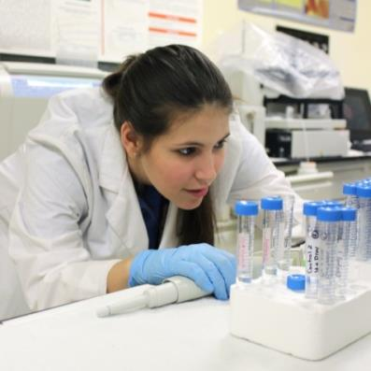
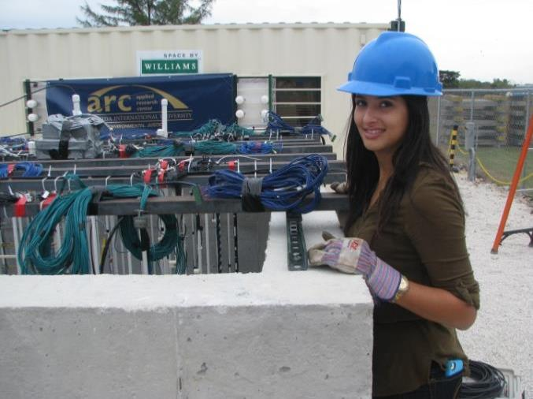
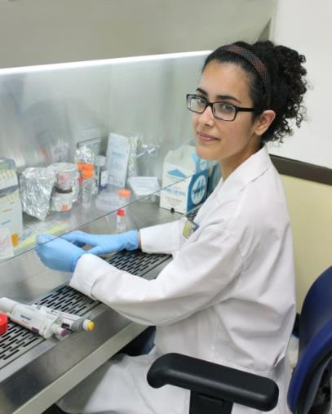
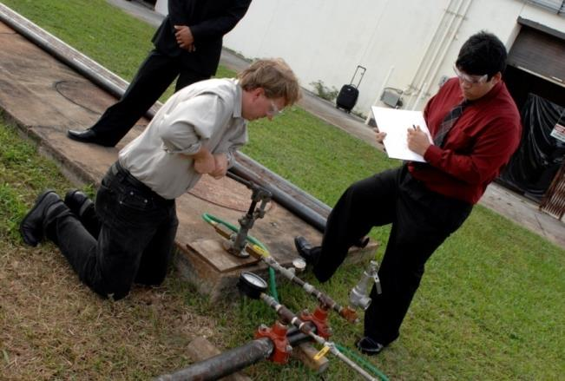
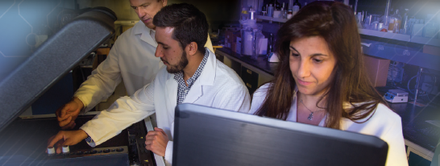
DOE Fellows Hands-On Research at FIU

Slide 14
Graduate Degrees Based on DOE EM Research
DOE-EM based research on the Cooperative Agreement projects are the basis of master’s degree thesis and PhD dissertations completed or currently in progress (DOE Fellows & graduate research assistants).

Slide 15
Graduate Thesis / Dissertations Directly Supported by Research Performed under the Cooperative Agreement - Current
DOE Fellow | Exp. Degree | Major | Topic of Research
Alejandro Garcia | M.S. | Geoscience | The Influence of Microbial Activity on The Corresponding Electrical Geophysical Response After Ammonia Injections In The Vadose Zone
Claudia Cardona | Ph.D. | Civil engineering | Evaluating the effects of Si and Al concentration ratios on the removal of uranium
Hansell Gonzalez | Ph.D. | Chemistry | Study of Unrefined Humic Substances As A Potential Low-cost Remediation Method For Acidic Groundwater Contaminated With Uranium
Juan Morales | M.S. | Public Health | TBD (Starts Summer 2016)
Maximiliano Edrei | M.S. | Mechanical Engineering | Computational Fluid Dynamics Modeling of Pulse Jet Mixing (PJM) process for HLW in Waste Tanks at Hanford Site
Mohammed Albassam | M.S. | Envr. Engr. | TBD (Starts Summer 2016)
Natalia Duque | M.S. | Water Resources Management | Modeling of Surface Water And Sediment Transport In The Tims Branch Ecosystem
Robert Lapierre | M.S. | Chemistry | Characterization of the uranium-bearing products of novel remediation technologies
Sebastian Zanlongo | Ph.D. | Computer Science | Development of Robotic Inspection Tools For DST Primary Tanks
Silvina Di Pietro | Ph.D. | Chemistry | Investigation of NH₃ Partitioning In Relevant Hanford Minerals and Synthetic Porewater

Slide 16
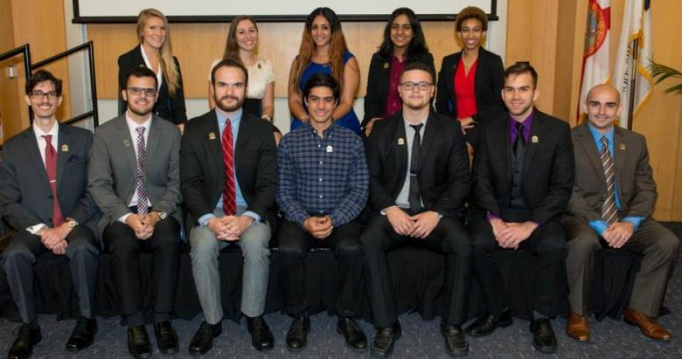
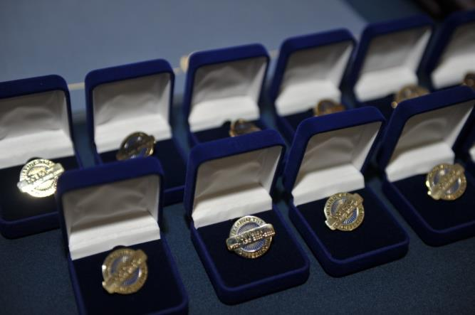
DOE Fellows Induction Ceremony
A total of 120 FIU minority STEM students have been inducted as DOE Fellows.
Conducted a total of 9 Induction Ceremonies since program inception in 2007.

Slide 17
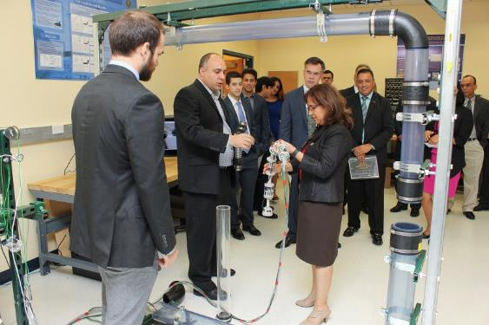
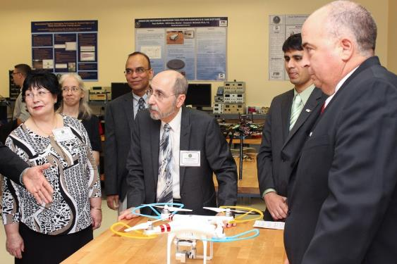
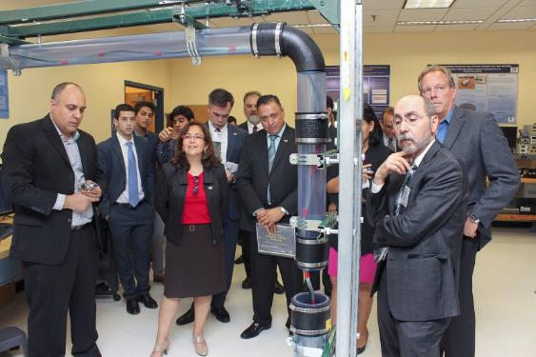
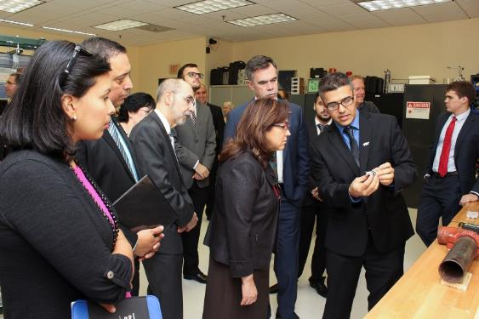
DOE Fellows Induction Events – Robotics Lab Tour

Slide 18
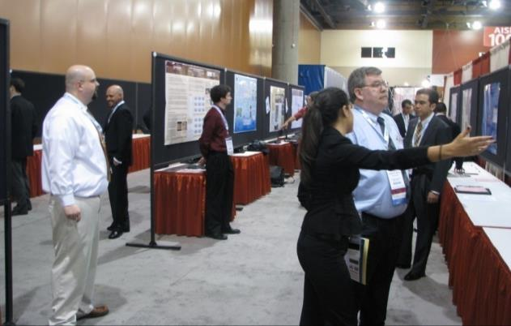
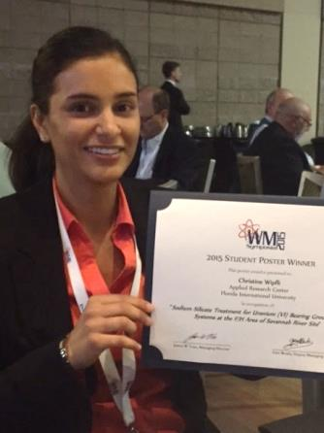
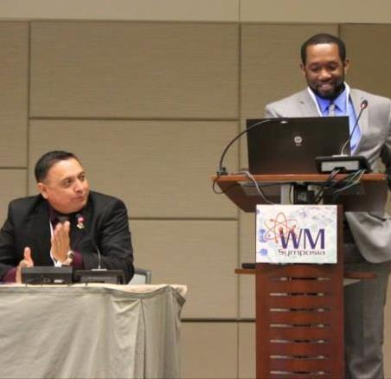
DOE Fellows at Conferences
Won one (1) Best Professional Poster and five (5) Best Student Posters at Waste Management Symposia since 2008.
WM Student Poster Session
Presented over 165 papers and posters at Waste Management (2008-2016) and other national/international conferences, including two (2) presentations at ICEM13 (Brussels, Belgium), and 5 at ANS conferences.
Best Student Poster WM15
Entering the Workforce Panel at WM15

Slide 19
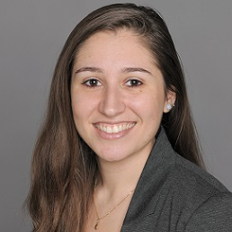
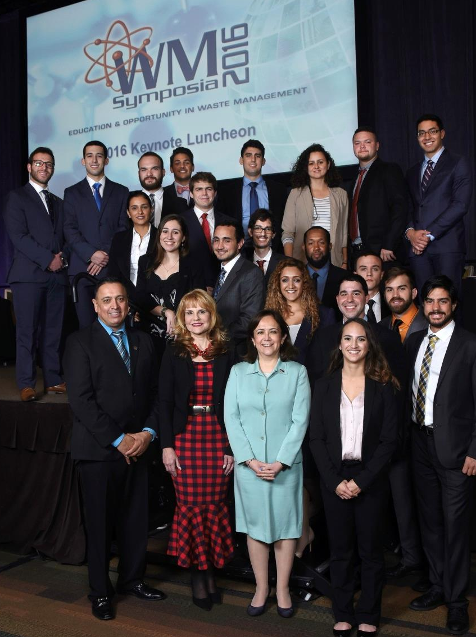
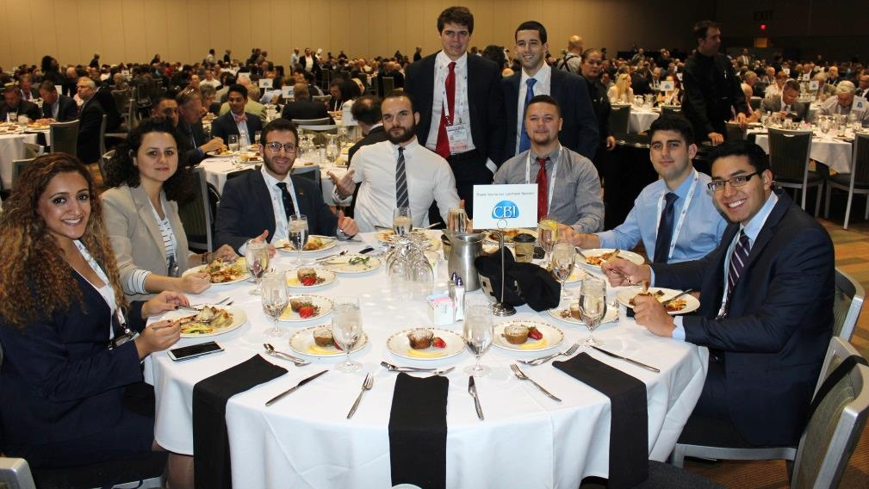
DOE Fellows at WM16
DOE Fellow Silvina A. Di Pietro awarded 2016 Roy G. Post Foundation Scholarship

Slide 20
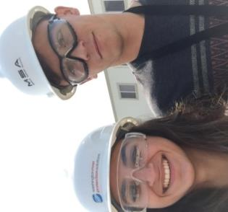
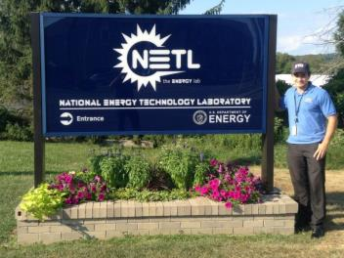
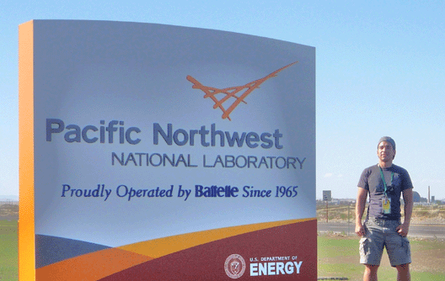
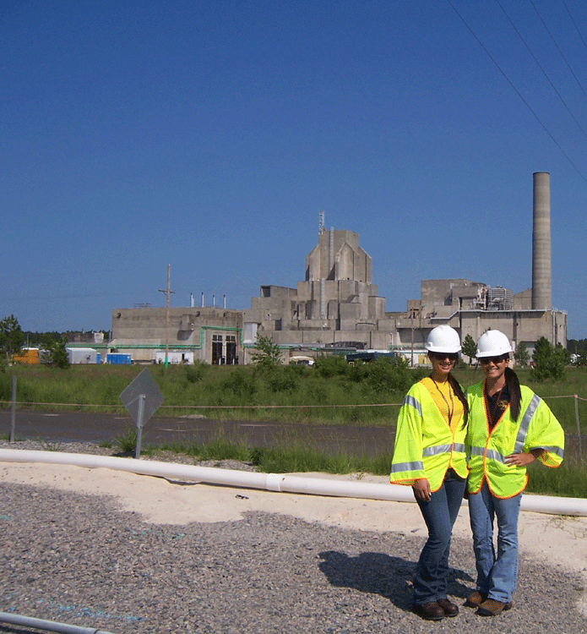
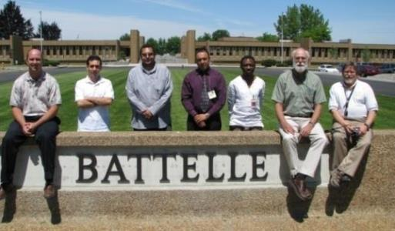
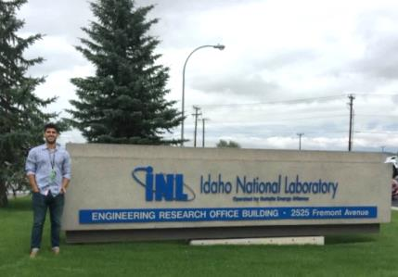
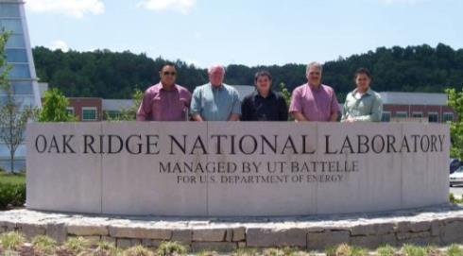
DOE Fellow Internships
108 internships completed at DOE sites, DOE national labs, DOE-HQ, and DOE contractors across the DOE Complex

Slide 21
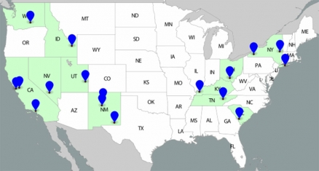
DOE Fellow Internships*
23 DOE EM HQ
21 ORNL / Y-12 NSC
17 SRS/SRNL/SREL
13 Hanford/WRPS
13 PNNL
4 INL
2 DOE Oak Ridge
2 NETL
2 LANL
2 Columbia Energy & Envr
2 NuVision Engr.
2 Sullivan International
1 LLNL
1 Moab
1 ORP
*includes spring/summer 2016

Slide 22
Spring/Summer 2016 Internships
Project | DOE Fellow | Location | Internship Mentor | Comments
1 | Erim Gokce | WRPS | Ruben/Dennis | High Level Waste
 | Max Edrei | NETL | Chris Gunter | High Level Waste CFD
 | Sebastian Zanlongo | LANL | David Mascarena | LANL robotics group
2 | Alejandro Garcia | PNNL | Brady Lee | Spring: Task 2 and Masters
 | Alejandro Hernandez | SRNL | Miles Denham | SRNL Soil & Groundwater
 | Awmna Rana | REU/SREL | John Seaman (SREL) | Applied for MSIPP Internship, Alternative would be SRNL
 | Christopher Strand | LANL | Bill Foley | LANL Soil & Groundwater
 | Hansel Gonzalez | SRNL | Miles Denham | Task 2 and PhD
 | Sarah Bird Alexis Smooth | HQ /EM-12 | Skip Chamberlain (EM-12) | SRNL Soil & Groundwater
 | Silvina Di Pietro | PNNL | Jim Szecosdy/Nik Qafoku | Task 2 and PhD

Slide 23
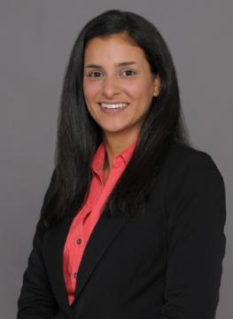
IAEA Internship
Christine Wipfli
March 2016 - March 2017
IAEA Division of Nuclear Fuel Cycle & Waste Technology
Vienna, Austria
DOE Fellow Christine Wipfli awarded a prestigious one-year internship at the International Atomic Energy Agency (IAEA) in the Division of Nuclear Fuel Cycle & Waste Technology in Vienna.

Slide 24
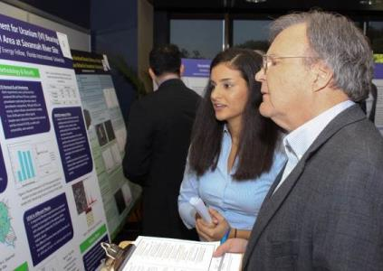
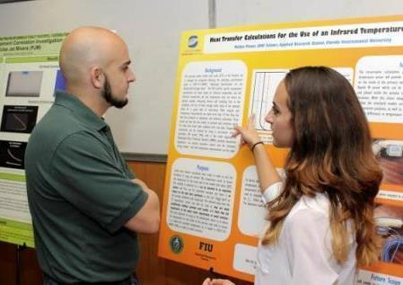
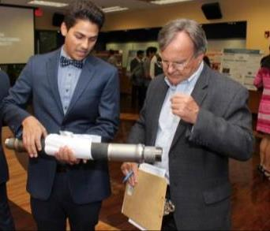
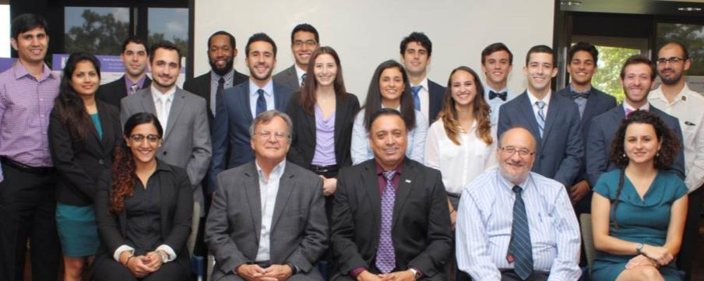
Annual DOE Fellows Poster Exhibition
9 DOE Fellow Poster Exhibitions held at FIU since 2007. 138 research posters presented.

Slide 25
Graduate Degrees Based on DOE EM Research
DOE-EM based research on the Cooperative Agreement projects are the basis of master’s degree thesis and PhD dissertations completed or currently in progress (DOE Fellows & graduate research assistants).
45 Fellows started program as undergraduates and continued to obtain a Masters and/or PhD degree at FIU or other institutions (including MIT, Michigan, Purdue, Stanford, Virginia Tech, and others)

Slide 26
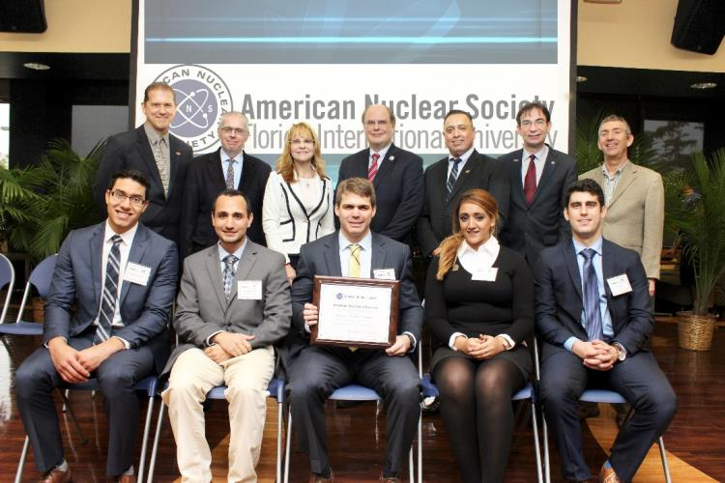
FIU Student Chapter American Nuclear Society
Officially launched on January 28, 2016 with a visit to FIU from ANS president Eugene “Gene” Grecheck for a special ceremony to present the Student Section Charter.
Chapter officers: Ryan Sheffield (President), Maximiliano Edrei (Vice President), Awmna Rana (Secretary), Janesler Gonzalez (Committee Head), and Jesse Viera (Treasurer). Dr. Leonel Lagos from FIU’s Applied Research Center is serving as the FIU Chapter Faculty Advisor.

Slide 27
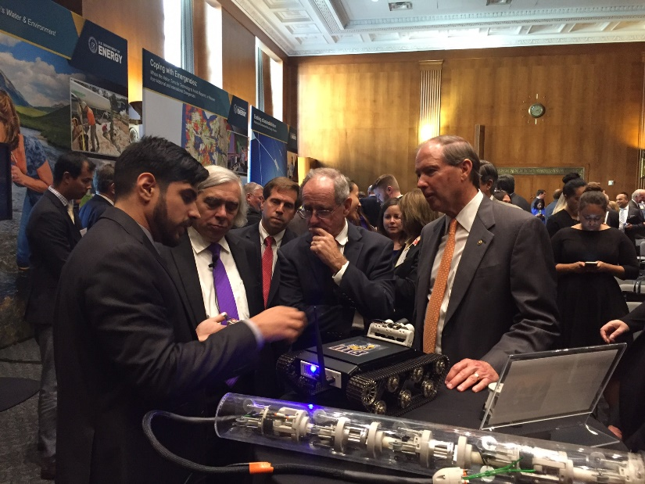
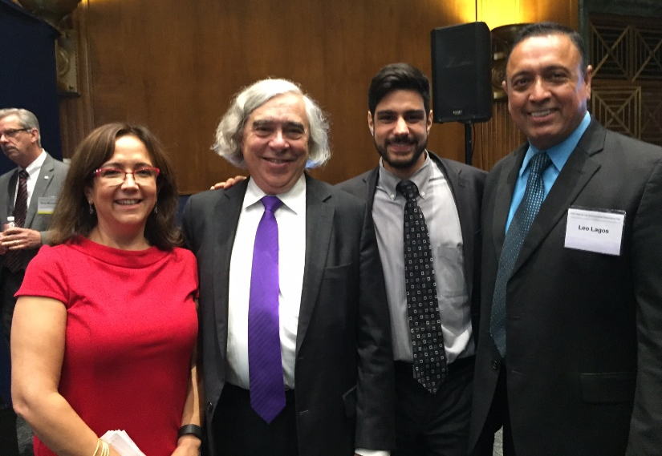
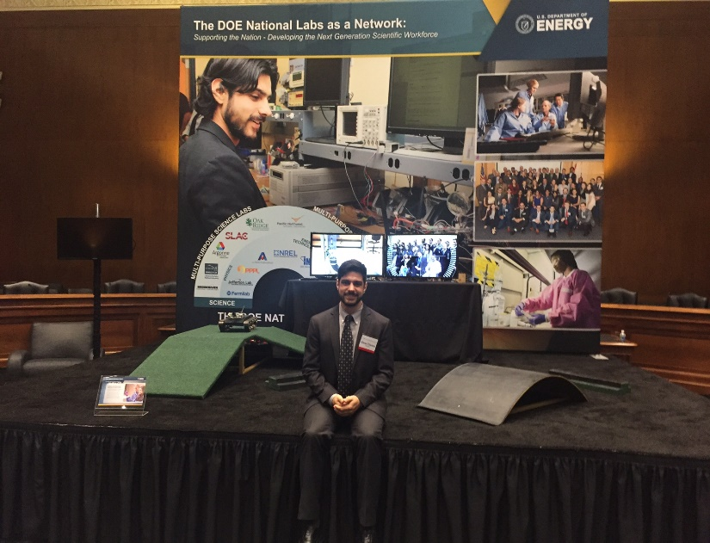
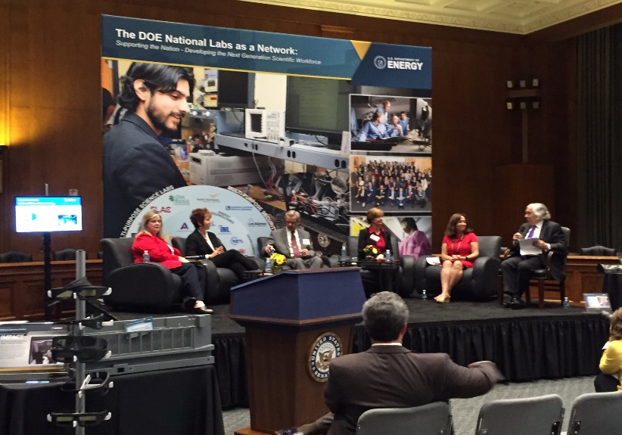
DOE Fellow - DOE National Labs Day on the Hill – September 2016

Slide 28
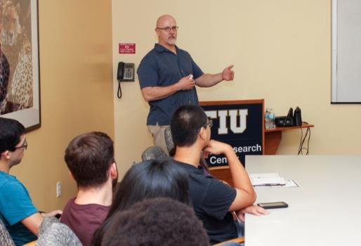
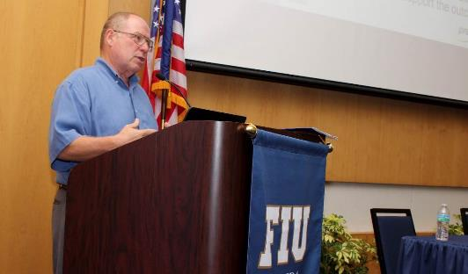
DOE Fellows Lecture Series
Brady Lee (PNNL)
Steve Thompson (UK’s NNL)
Anthony Banford (UK’s NNL)
Keith Miller (UK’s NNL)
Don Reed (LANL)
Karthik Subramanian (WRPS)
Jim Voss (WM Symposium)
Costas Tsouris (ORNL)

Slide 29
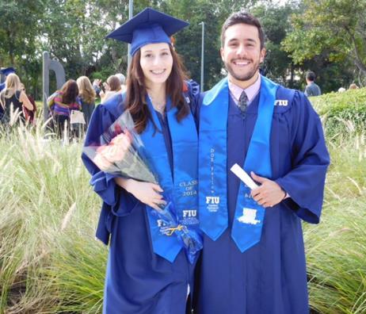
Getting Them Hired
8 Fellows hired by DOE, DOE national labs, and DOE contractors.
13 Fellows hired by other federal, state, and local gov’t agencies (Dept. of Defense, NASA, Dept. of Commerce, Dept of the Navy (NAVSEA), etc.).
58 Fellows hired by private STEM industry (GE, Lockheed Martin, Raytheon, Texas Instruments, Motorola, Florida Power & Light, Boeing, Inter Corporation, MWH Global Inc., and others) .
Graduation rate of DOE Fellows - 99%
Retention rate of DOE Fellows in the program - 75%

Slide 30
STEM Minority Students Pipeline

Slide 31
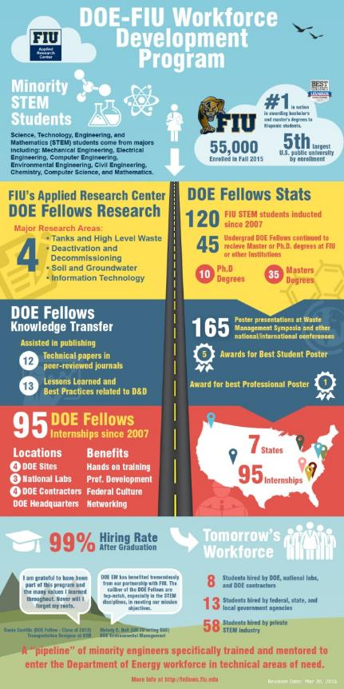
DOE Fellows – The Big Picture
Click image to open file

Slide 32
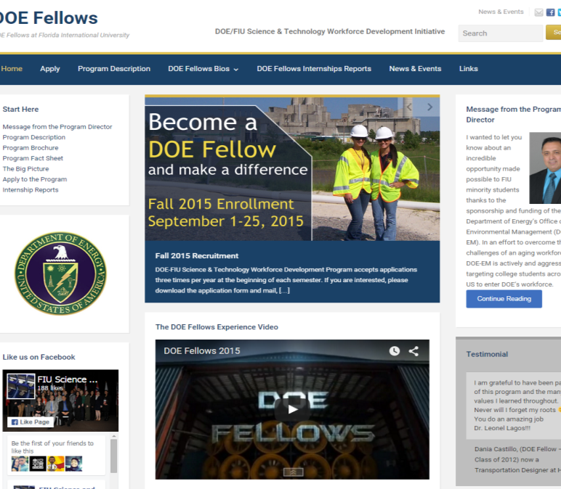
Program Website and Facebook
Follow us on Facebook at:
FIU Science and Technology Workforce Development Initiative
http://fellows.fiu.edu

Slide 33
Tasks for FIU Performance Year 7
Active hands-on research assisting ARC scientists/engineers during the execution of DOE-EM research - integrating education with practical experience in the DOE EM problem areas.
Recruitment of qualified talented FIU minority STEM students as new DOE Fellows
Engage in DOE EM research (Projects 1, 2, 3)
Poster exhibition & competition (October 2016)
Annual DOE Fellows induction ceremony (November 2016)
Summer internship program
Summer internship technical reports
Conference participation & presentations, including WM Symposia 2017
DOE Fellows lecture series forum
DOE EM HBCU collaboration/interactions
Promote career opportunities
Notes:
#1 in the nation in awarding bachelor’s & masters degrees to Hispanic students – “2014 US News & World Report – Best Colleges”
FIU student enrollment - Fall 2015:
55,000 students
5th Largest U.S. Public University by enrollment
Of the 120 the DOE Fellows inducted into the program since 2007 -
45 undergraduates went on to receive:
35 - Masters and
10 - PhDs
95 DOE Fellow internships since 2007
Locations in 7 states to include:
4 - DOE sites
3 – National Labs
4 – DOE contractors
DOE Headquarters
Assisted in the publishing of 12 technical papers in peer-reviewed journals
Assisted in the publication of 13 D&D Lessons Learned and Best Practices

